Slide 1
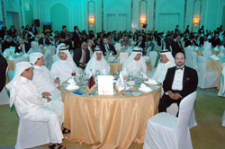
About Seminars

Slide 2
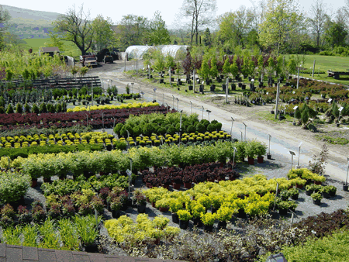
“Seminar”
The word “seminar” is the origin of the words “seminal”, “seminarian” and “seminary.
They all derive from the Latin “seminarium” – a garden seed plot or nursery.

Slide 3
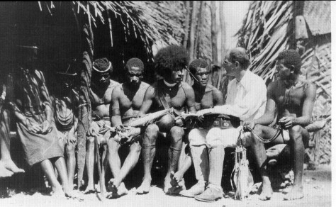
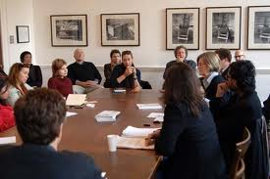
What a Seminar Is and Is Not….
NOT a lecture class:
I shall be trying to plant the seeds of ideas into your minds
NOT a lecture class:
Much of the responsibility for learning falls upon you, the students.

Slide 4
A Seminar IS
Self-generating – we teach ourselves;
Communal – we learn together;
Participatory – we engage, not sit back
Fun! – high level play

Slide 5
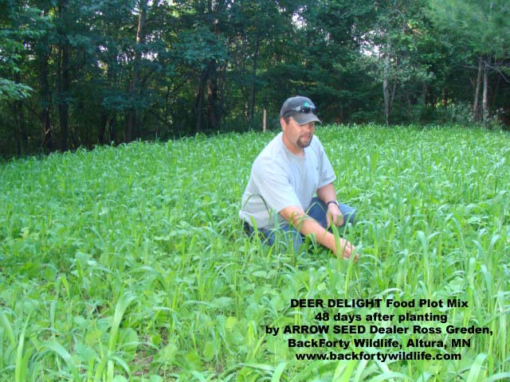
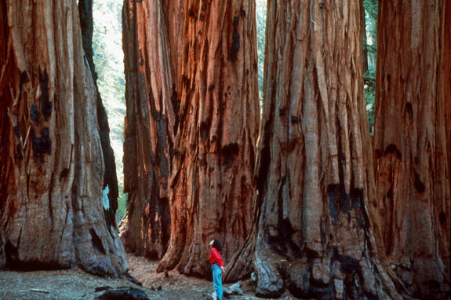
All things organic, both young plants & young scholars, grow in two ways:
The TLC of a gardener
Growing on their own

Slide 6

A Seminar Is about Our Growth in Learning in Common

