Slide 1
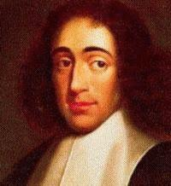
Close Reading of
Primary Texts
(CRePT)

Slide 2
What Is a Primary Text?
A primary ‘text’ is the immediate text of reference, e.g. the Bible, a play by Shakespeare, a film by Satyajit Ray, (in cases, also our textbook!);
A secondary text is a text written about a primary one, e.g. McDannell’s Family Bibles, our textbook
A secondary text generally seeks to interpret or explain the contents of a primary text.
A secondary text can become a primary one when it becomes the immediate text of reference

Slide 3
Why Study Primary Texts’?
Becoming intellectually mature means learning how to question authority, not just reciting what we have been told or have read;
Secondary sources are, in effect, telling us what a primary text says;
So, if we want to gain intellectual maturity, we need to gain confidence in learning to read original -– primary -- texts.
Religious studies, in part, began because people wanted to become intellectually mature about reading religious texts!

Slide 4
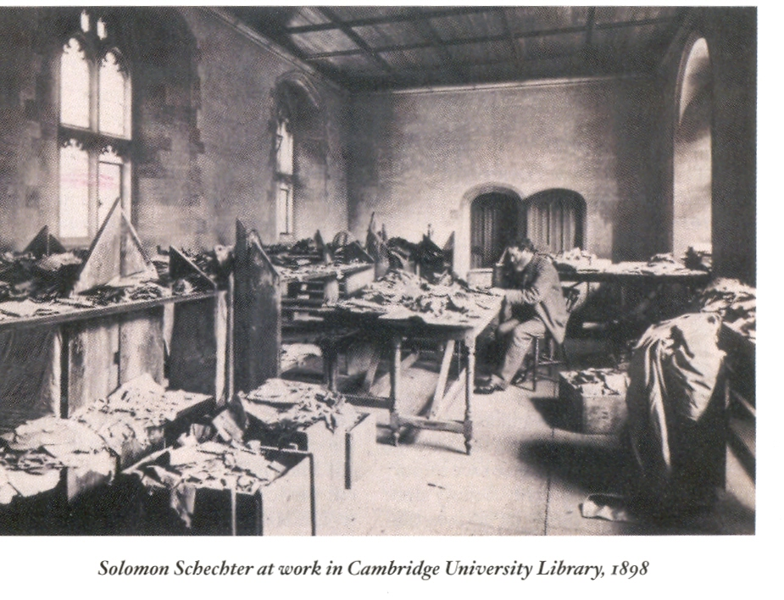
Why Reading Primary Texts Is Not More Often Done
because it’s harder… than leaning on secondary texts to tell us what primary texts say

Slide 5

Time to Take Off the Training Wheels!

Slide 6
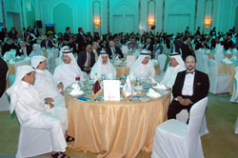
Seminars Are for Studying Primary Texts… without “Training Wheels”

Slide 7
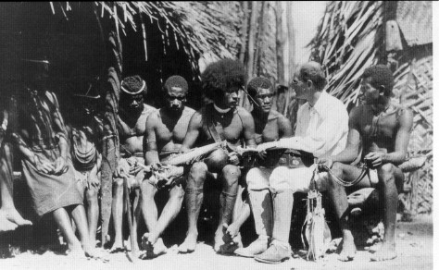
Or, Seminars Can Be for Studying Primary Experiences – without “Training Wheels”

Slide 8
How to ‘Play’ CRePT:
How to Read a Primary Text
What is the author saying insofar as the text strictly lets us say so?
This also means that what the author says must be squared, first, in terms of agreement with the internal context of the text;
We can also better understand what the author is saying by reference to the external context surrounding the text – the history, culture and ‘times’ in which the text was written.

