Slide 1
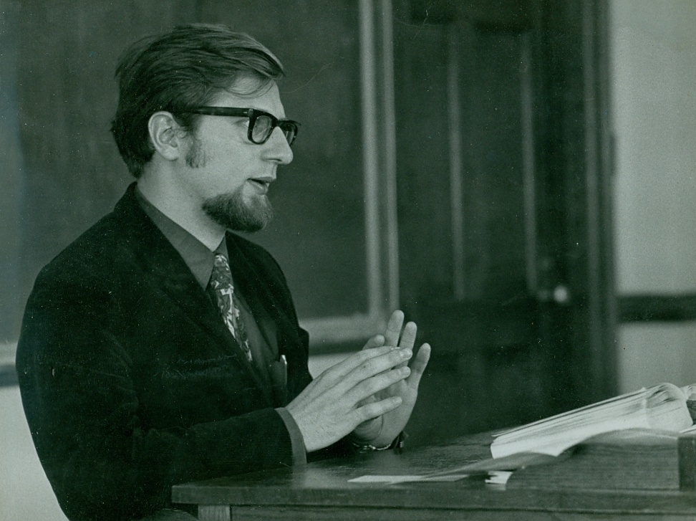
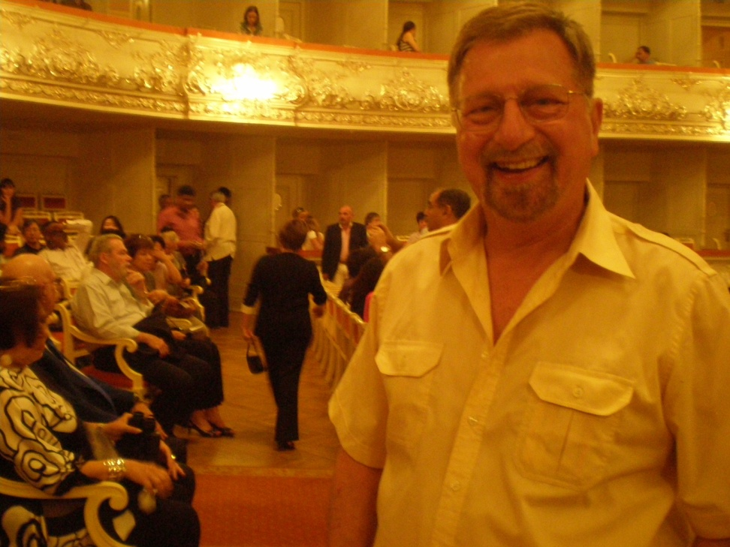
Crisis and Creativity: The Changing Faces of Religious Studies Programs
IAHR Quinquennial Meeting
Toronto, 17 August 2010
“Negotiating Generational Change”
Ivan Strenski
New London, CT 1970
St. Petersburg, RU 2010

Slide 2
Negotiating Generational Change
Modern Meets Post-Modern Meets….?

Slide 3
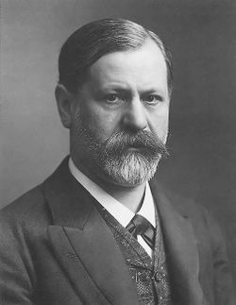
‘Father Killing’ as
Academic Practice?

Slide 4
D”””Dad! You Lied!”
ExbiCase A: Heidegger

Slide 5
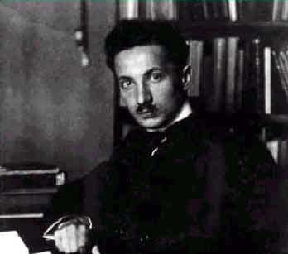
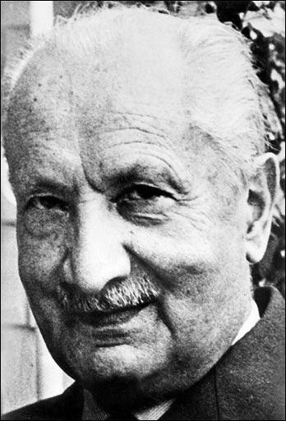
The Heidegger We “Know”

Slide 6
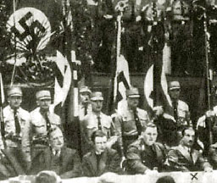
The Heidegger We Didn’t Know

Slide 7
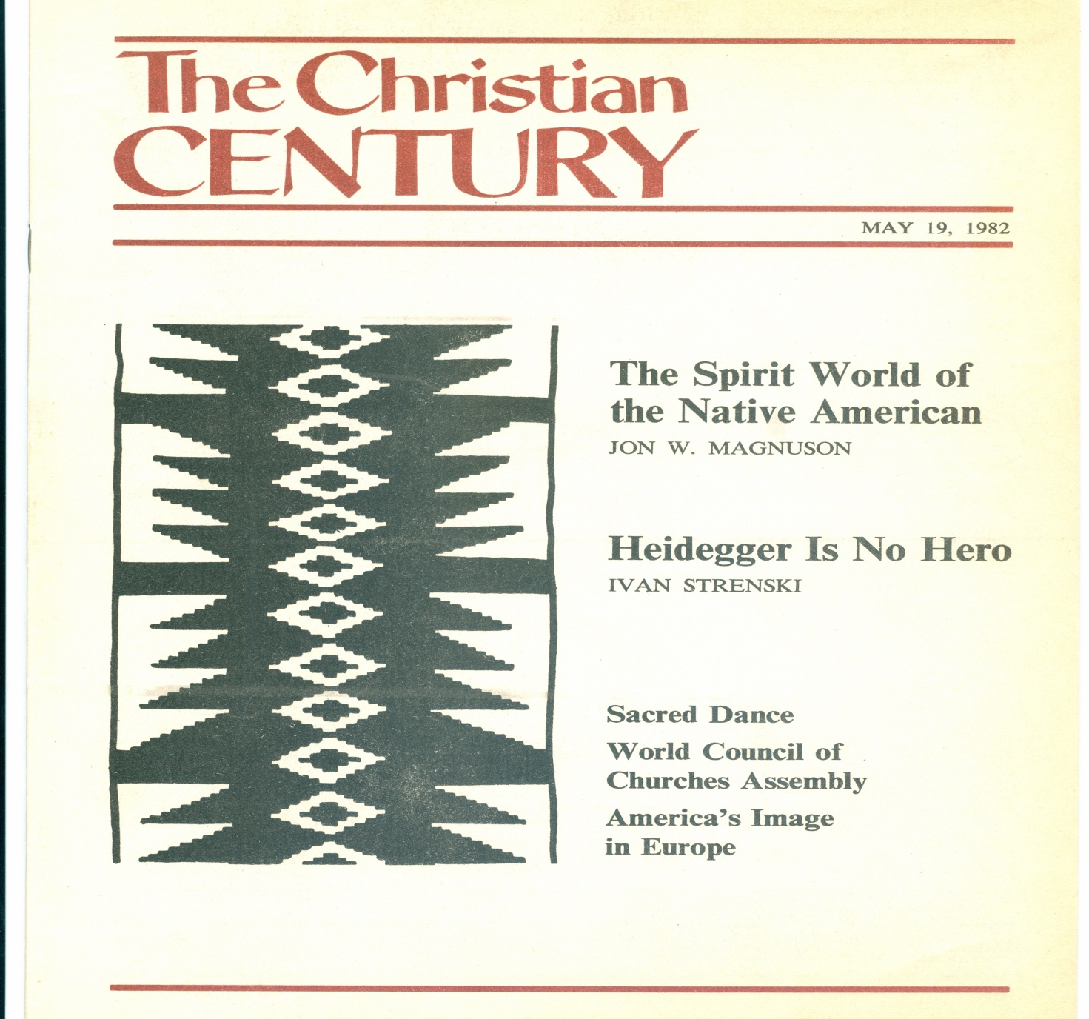
What Did You Do in the War, Daddy?

Slide 8
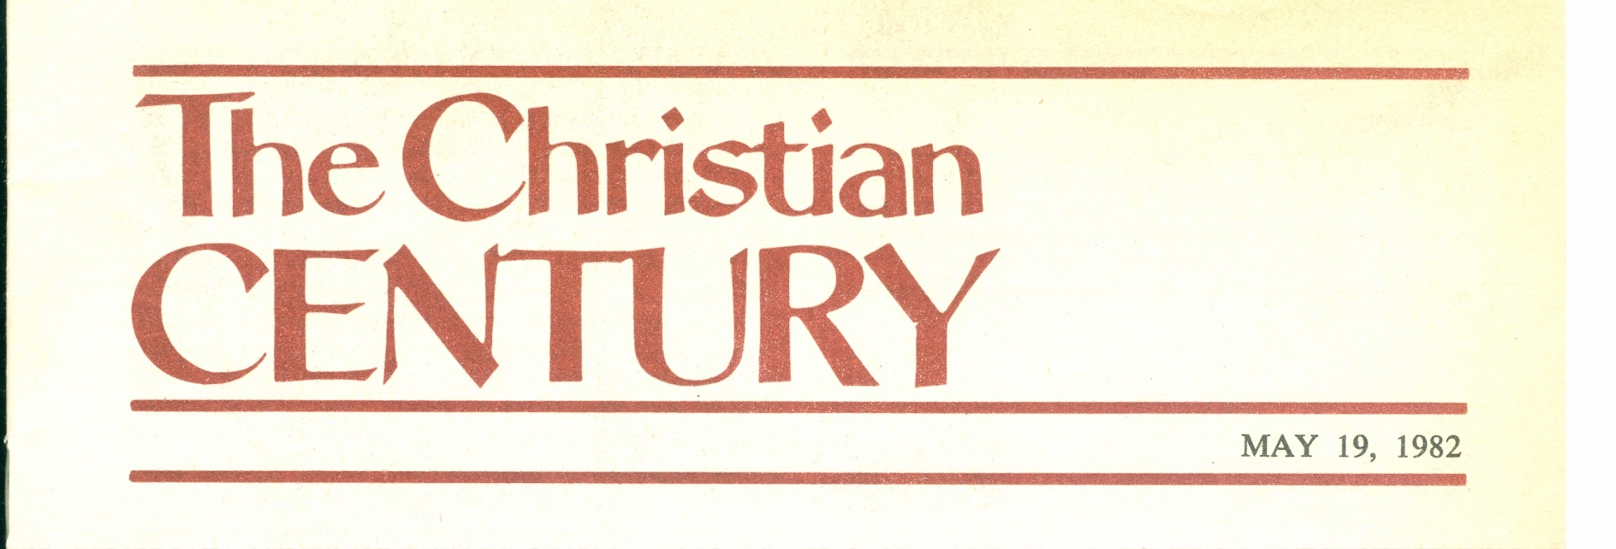


Slide 9
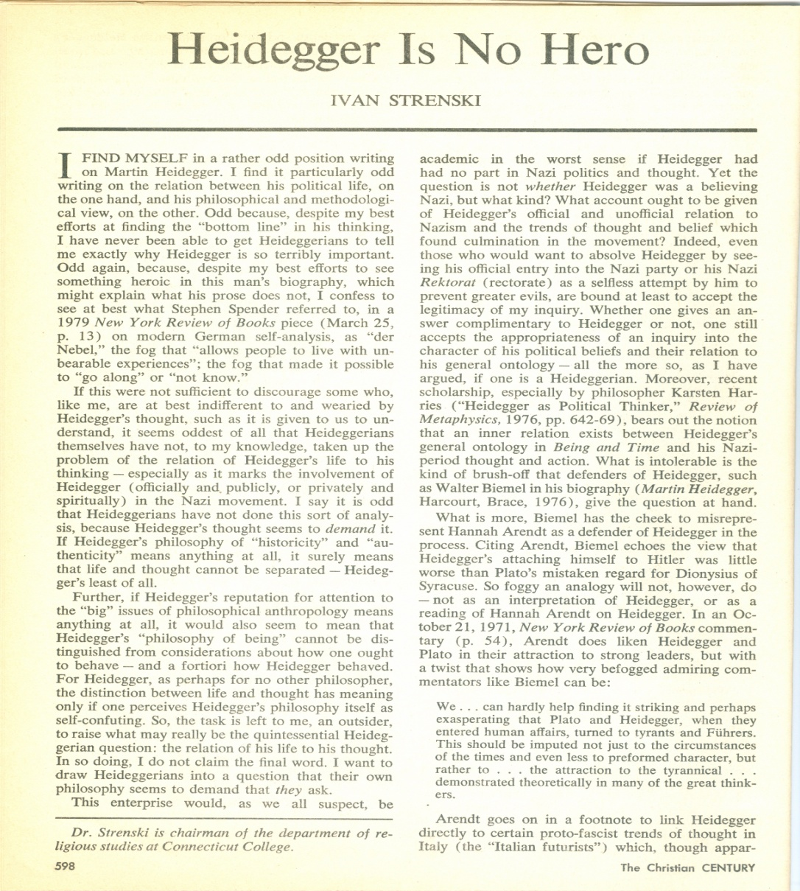
You Did What?! (1982)

Slide 10
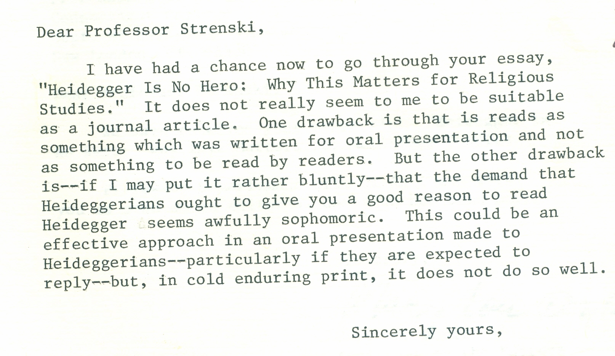
But, We’re Not Interested

Slide 11
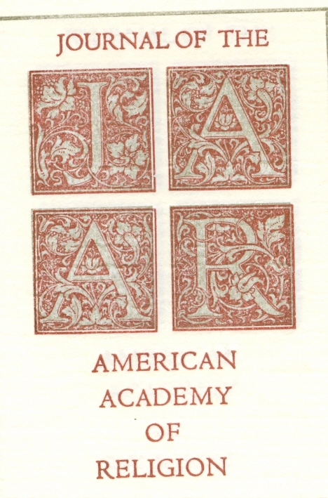
“We” Are the JAAR

Slide 12


Après… La Déluge
Farias’ ‘J’Accuse!’ (1987)
Neske’s Defence (1990)

Slide 13
“But, Dad! You Said…!”
Case B: Mircea Eliade

Slide 14
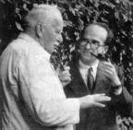
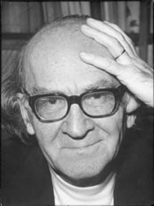
The Eliade Many Knew
with Carl Gustav Jung
Hyde Park Days

Slide 15
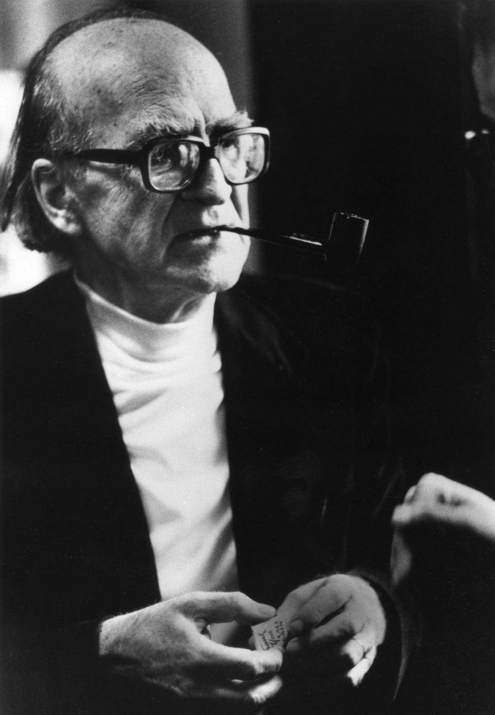
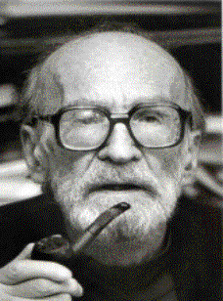
The Eliade Known & Loved
Chicago
Last Days

Slide 16
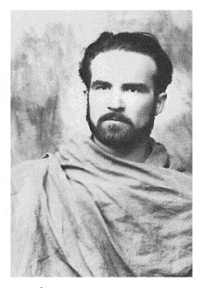
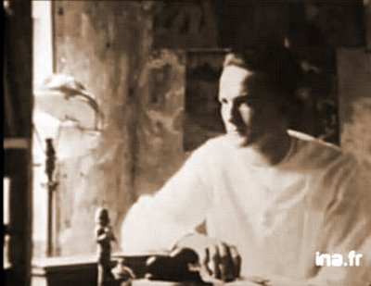
The Eliade We Knew a Bit
Young Yogi in India
S. N. Dasgupta’s Pupil

Slide 17
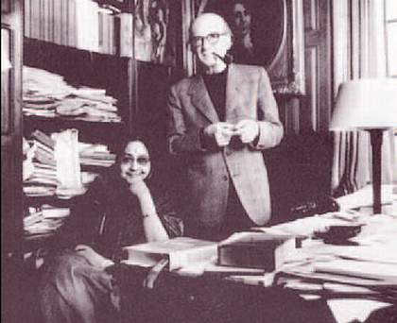
And, Oh Yes, Maitreyi Devi

Slide 18
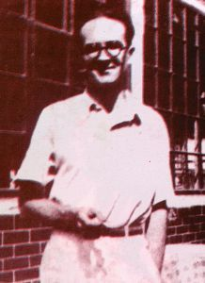
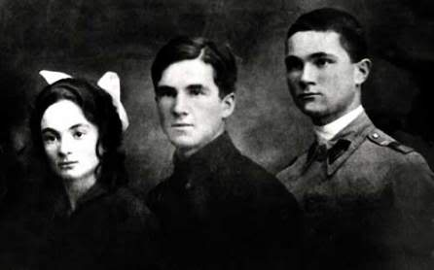
A Bucharest Eliade Few Knew
Artist
Schoolboy

Slide 19
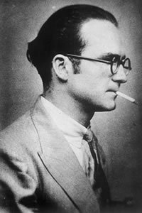
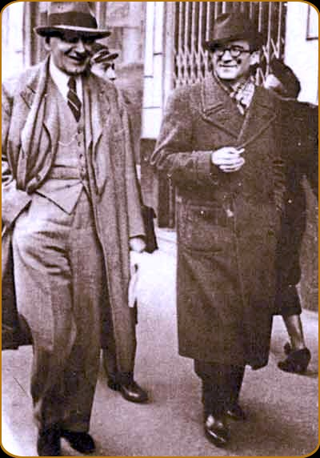
Or, The Eliade None Knew
(or would say they knew)
Voice of the
‘New Generation’
With the Romanian
Heidegger, Nae Ionescu

Slide 20
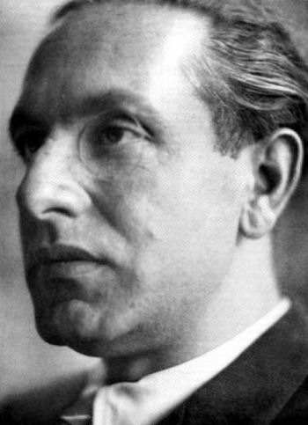

And, @ Eliade & “Traditionalism”
(Italian Style)
Who Knew?
Julius Evola
Tantra and Power

Slide 21
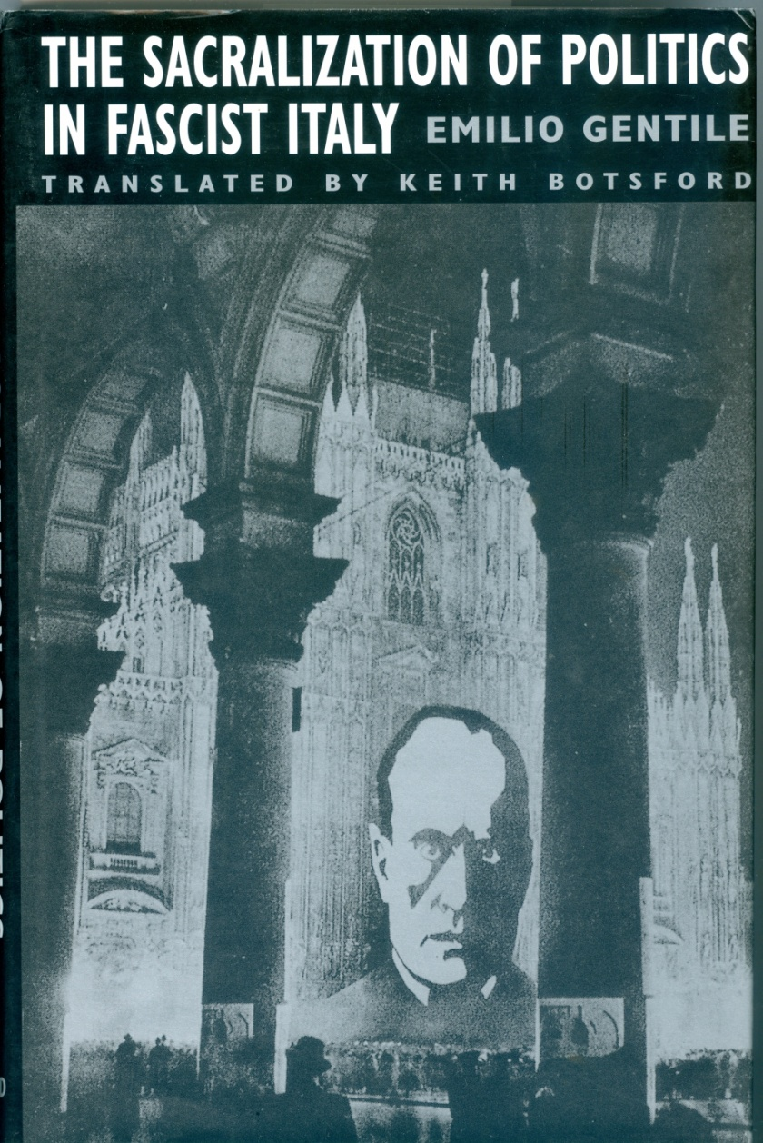
Religion & Politics:
Italy 1920’s and 1930’s

Slide 22

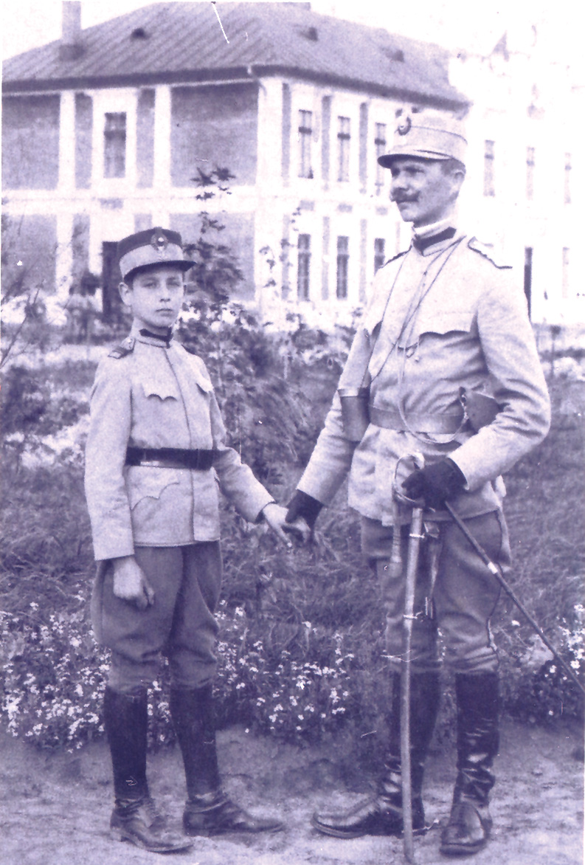
Likewise, Few Knew @This
Archangel Michael’s
Legionaires
The Boy Corneliu Codreanu
Legion’s Founder

Slide 23
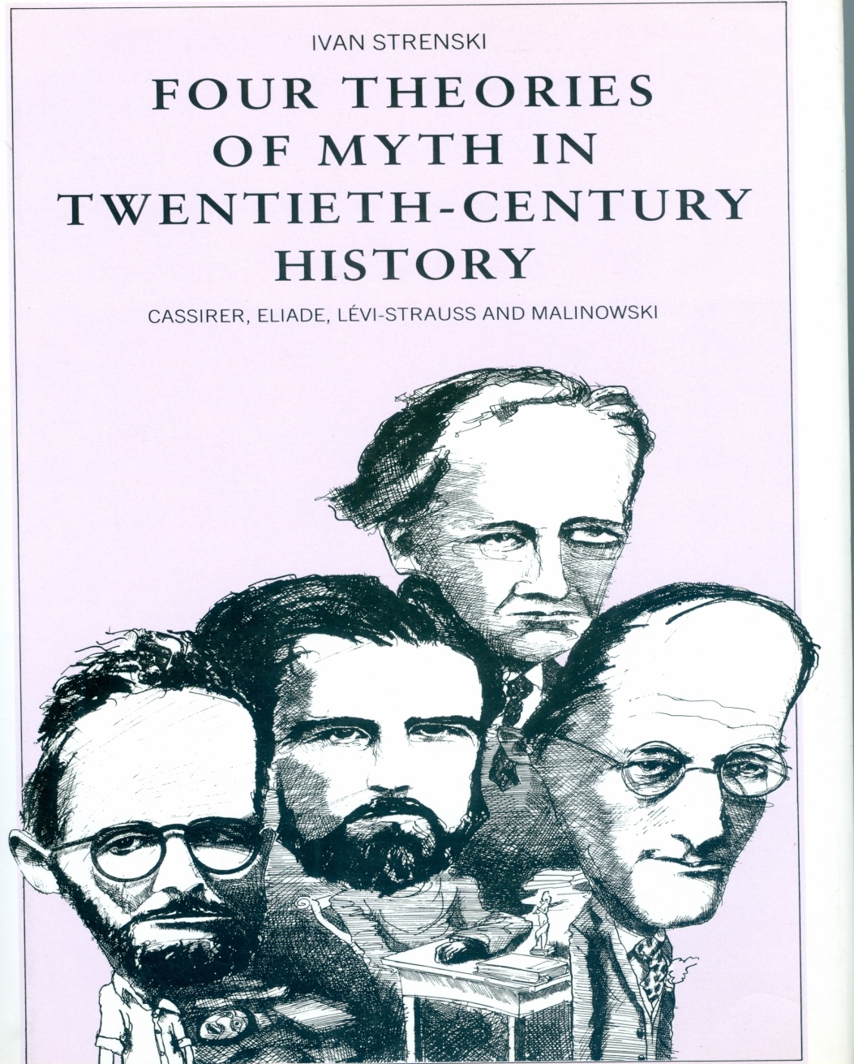
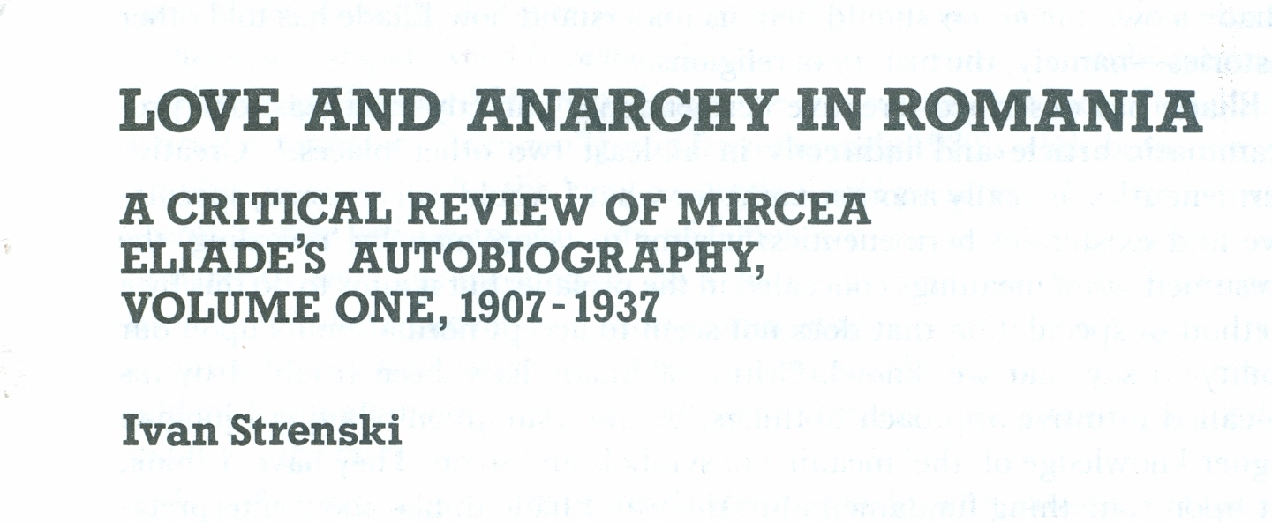
Telling Some of Eliade’s
Romanian “Traditionalist” Story

Slide 24
A Generational Shift?
Who Now Reads…?
Eliade
Lévi-Strauss
Malinowski
E. O. James
J. G. Frazer
The phenomenologists of religion
And, of course, Don Wiebe

Slide 25
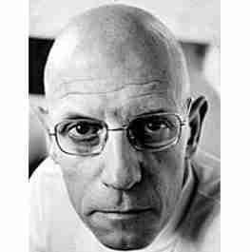
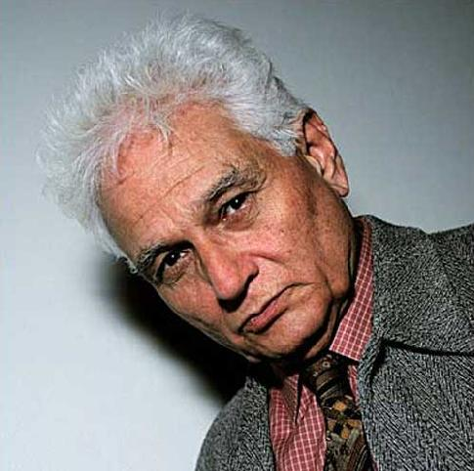
So, Who’s Your Daddy Now?
Foucault?
Derrida?

Slide 26
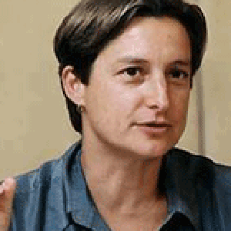
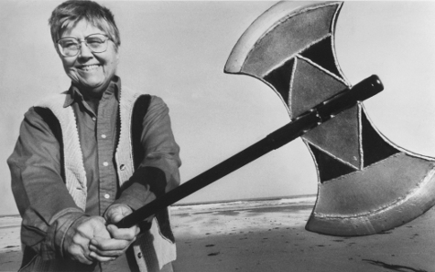
Or, Yo’ Momma?
Judith Butler
Mary Daly

Slide 27
The Problem
Can old and new integrate easily?
Can senior complacency co-exist with junior arrogance?
So? “Kill” fathers & mothers, or strangle Oedipus in the crib?
No. Foucault inverts Eliade, and Derrida dissolves Lévi-Strauss.
Not likely. Stodgy seniors won’t budge; arrogant juniors won’t zip it.
= Worst scenario of our state of play.

Slide 28
Exacerbating Factors
MLA = 900 lb gorilla sets the agenda;
A new generation’s need to ‘flock’;
A new generation’s thrill to make a mark;
An older generation’s ‘theory weariness’;
An older generation’s suspicions of ‘fad’;
Any incentives for inter-generationalism?
It has ever thus been so….

Slide 29
What Then Must Be Done?
Old dogs can learn new tricks (viz. “brainage”), and should take first steps!
Revive debating – but especially across generations! No holds barred. Have fun!
Refuse to let theory choice be arbitrary – another reason for debate-style colloquia.
Get everything out into the open – everything

Slide 30
Conclusion
“Lively up yourself”
(Bob Marley)

