Slide 1
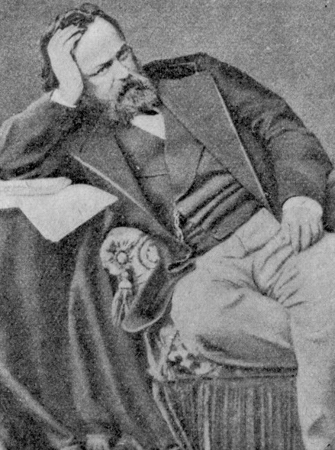
Empathy, a Many Splendored Thing?

Slide 2
“Empathy” = “Einfühlung” =
A ‘FEELING INTO’
A short-hand for an approach to knowing other sentient beings in which we try to see their world from their POV

Slide 3
Empathy: often likened to
Magical Knowing or Intuition
An ‘art,’ not a science;
A matter of sensitivity, and brain-power;
A talent. It can be taught. It can be learnt.
Practice is required: “just DO it!” won’t do it.
= the ”participant” in ‘participant observation’
There’s no ‘magic’ in it, altho’ some think so.
But, there’s a lot work….

Slide 4
What’s Good about Empathy?
Empathy encourages us to engage people and things different from ourselves;
Empathy gives us permission to employ emotional intelligence;
Empathy makes demands upon our imagination

Slide 5
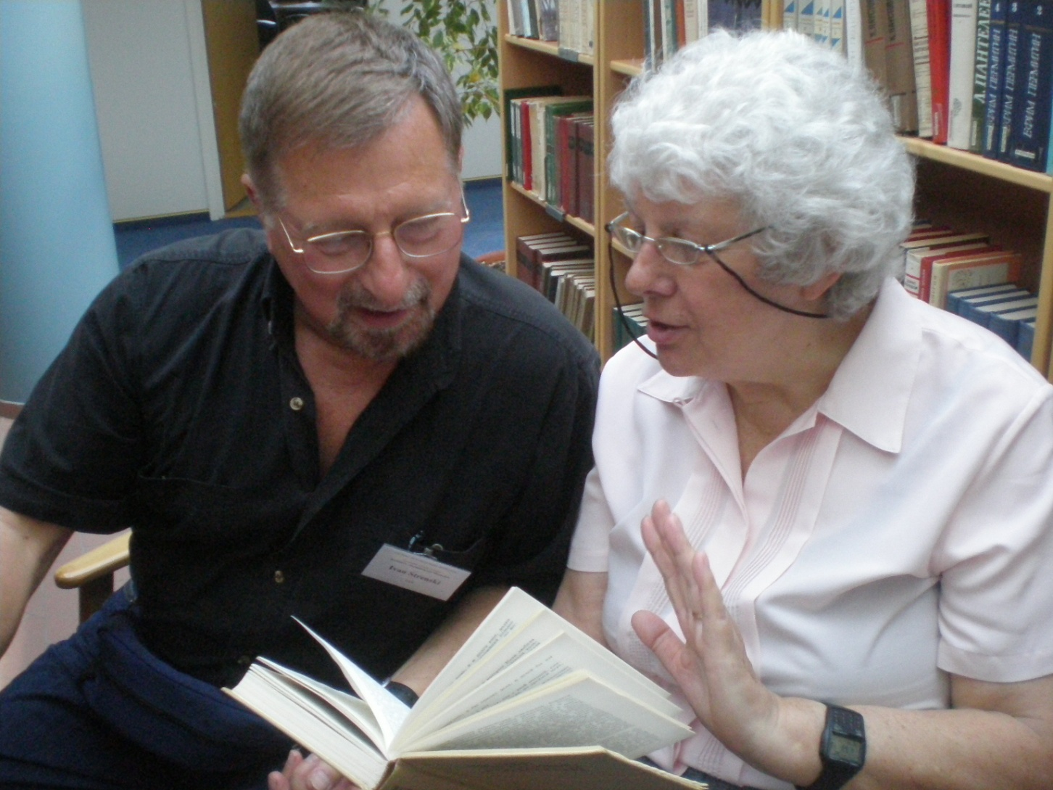
But, Is Empathy Possible?

