Slide 1

Overcoming
Empathy Fetishism

Slide 2
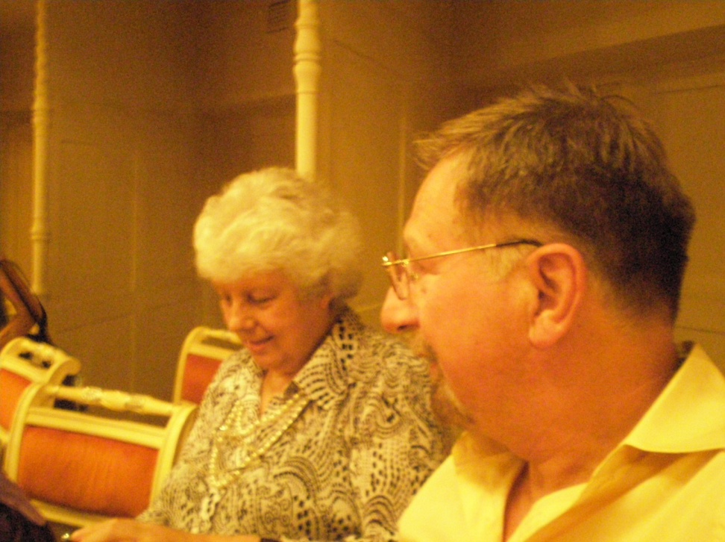
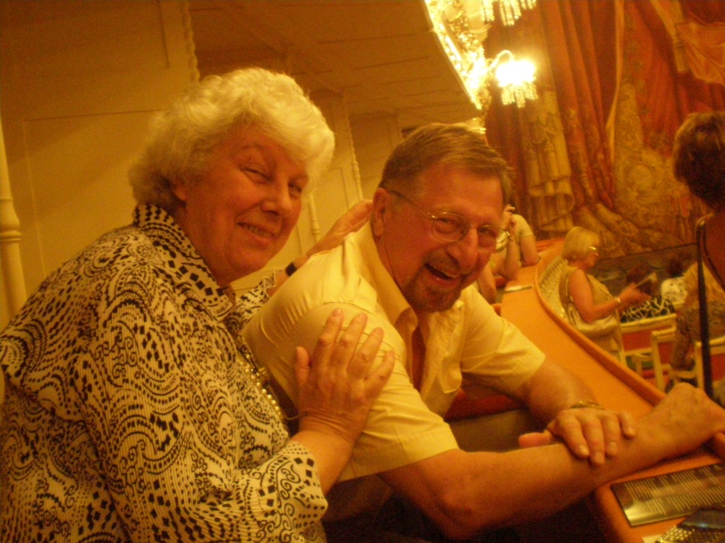
Empathy is NOT Sympathy
Well, I finally see your POV !
And… I really dig it !

Slide 3

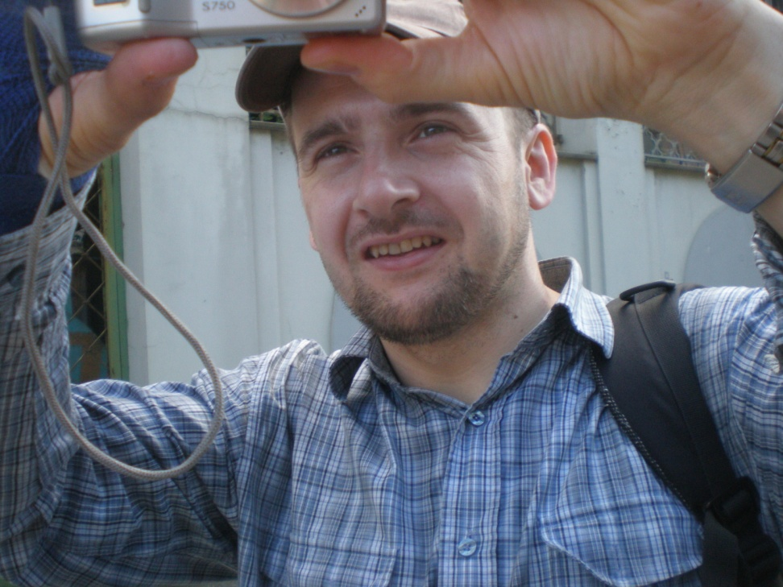
Empathy is NOT Mind-Reading
Empathy
takes mental muscle
And, doesn’t happen
in a (Aha!) flash

Slide 4
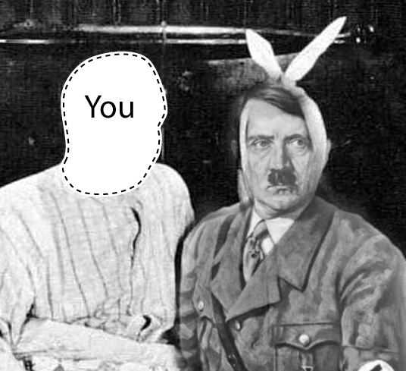
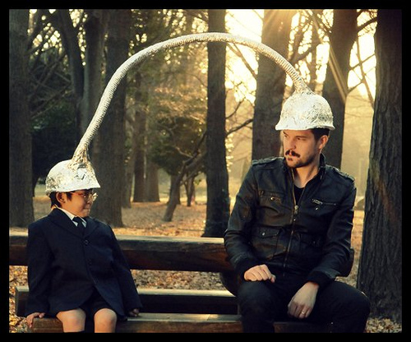
So, Empathy is…
Not Sympathy, because
(We Needn’t Agree)
Not Mind Reading, because
(It Is Not Magic)

Slide 5


Besides, Empathy Can Be Mistaken!
Sometimes, I feel we are in tune, Boss
But, then again,
I really wonder…..

Slide 6

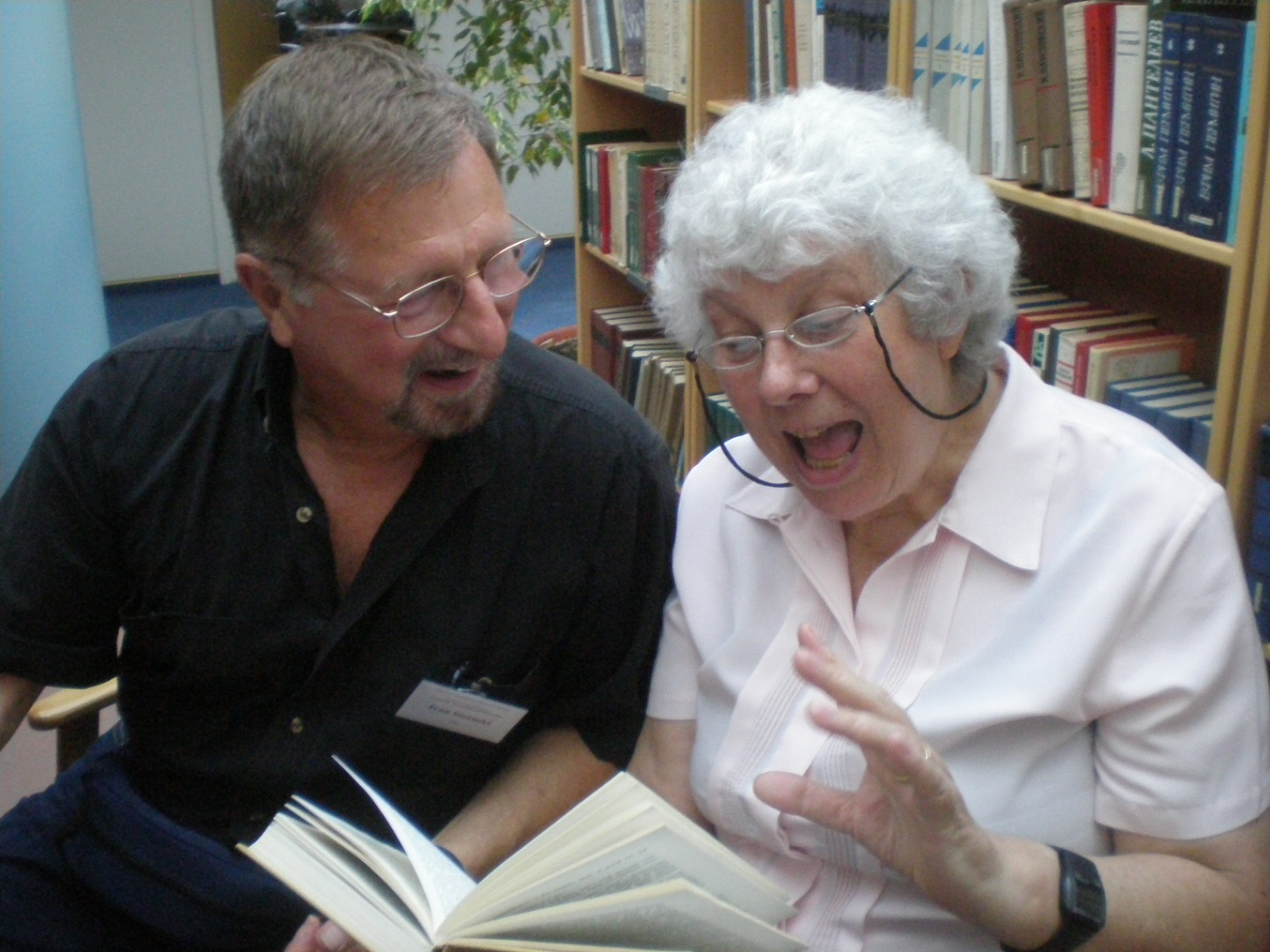
So, It Is Understanding
We Want and Need, Not Empathy

