Slide 1
Evolution:
Religion Changes by
Growing
E. B. Tylor, William Robertson Smith,
and
James George Frazer

Slide 2
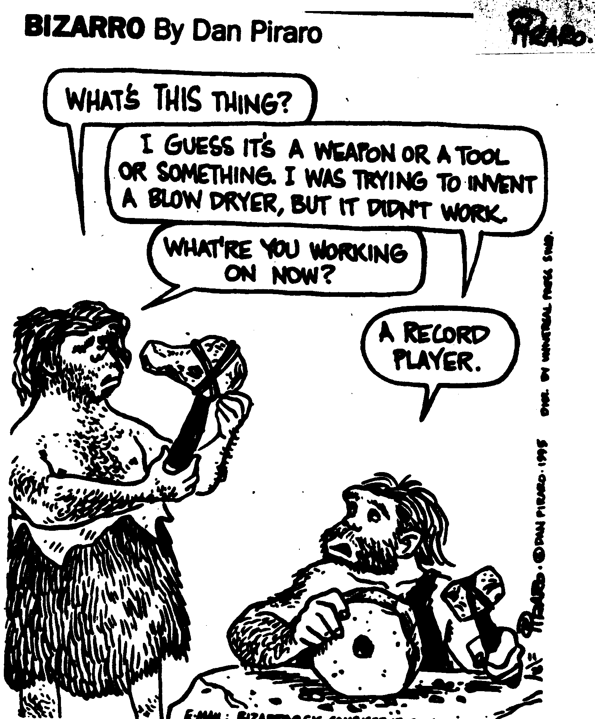
Evolution’s Big Idea:
We Grow in Stages, Not in One Go

Slide 3
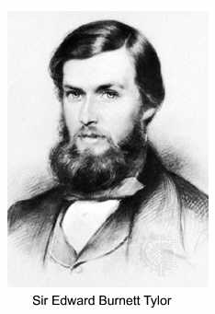
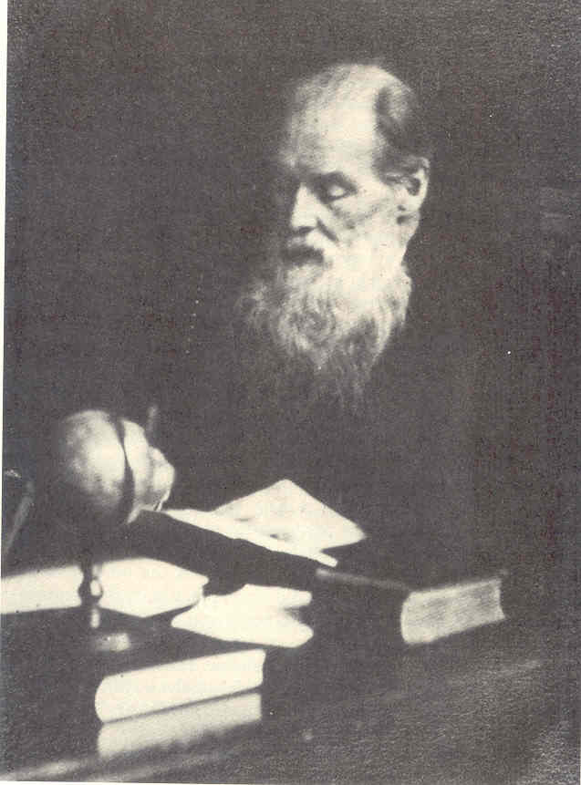
Edward B. Tylor (1832-1917)
Anthropology: “Mr Tylor’s Science”
“Anahuac” Days
”
Last of the “Armchairs”

Slide 4
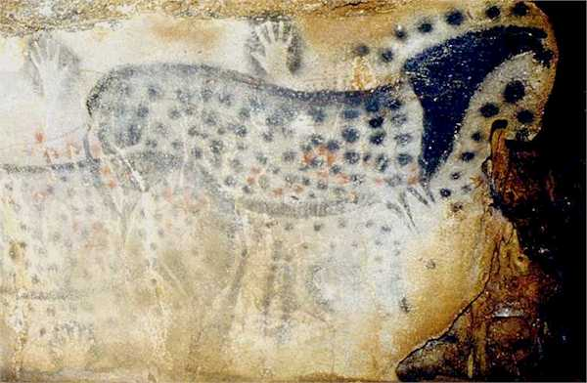
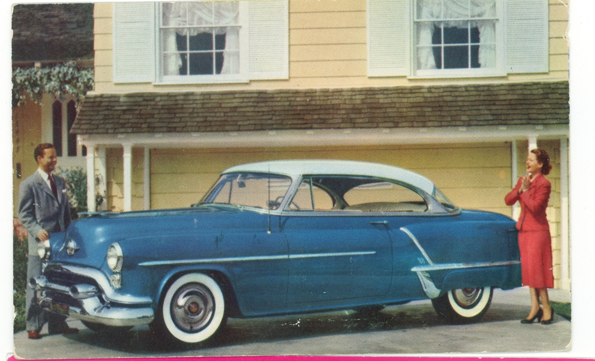
How Did We Get…?
From There to….
Here?

Slide 5
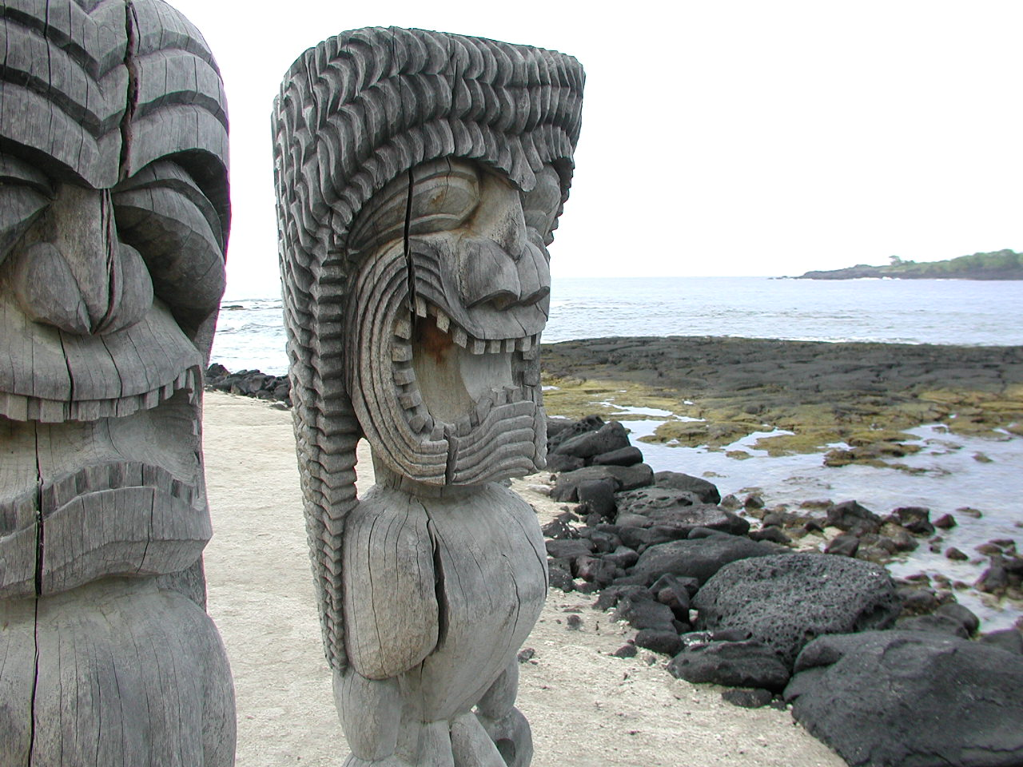

In Stages: We Grew (‘Evolved’) from
Animism to Science
Animism: Reality Is Personal:
Everything Has a Soul
“Science”: Reality Is Impersonal:
Everything Is Matter

Slide 6

But, Some Folks Just Don’t Evolve or Grow Up

Slide 7
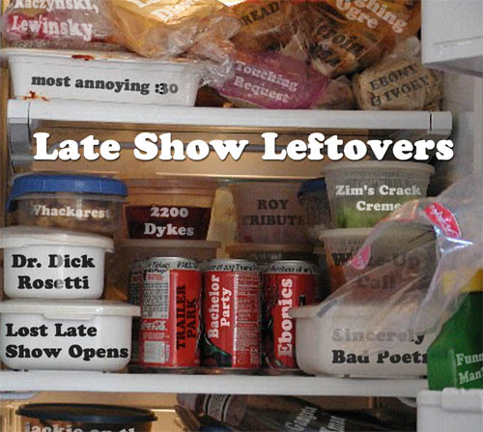
They Are “Survivals” of Past Stages

Slide 8
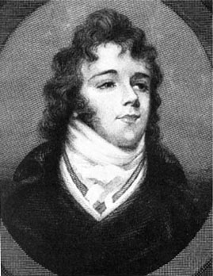

Like Men’s Neckties
Keeping Beau’s Neck Warm,
His Shirt Fastened, Then
But, Just an Ornament, Now

Slide 9
Yes….
Tylor Thinks All Religions Are Just Animism – Even Christianity.
It Is the Belief in One Great Spirit
(i.e. God)
Who Controls the World

Slide 10
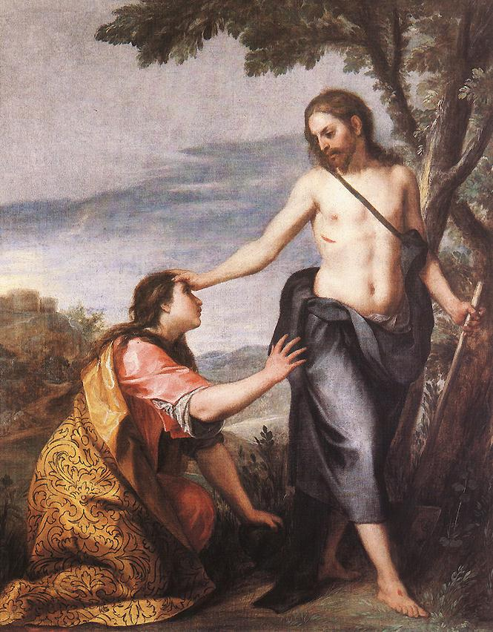
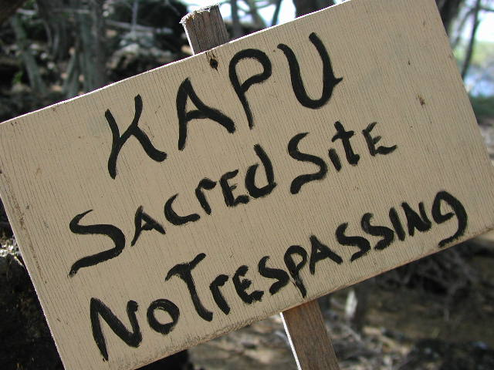
William Robertson Smith (1846-94)
How to Explain…?
Why Biblical Holiness
Seems Just Like ‘Primitive’ Tabu?

Slide 11
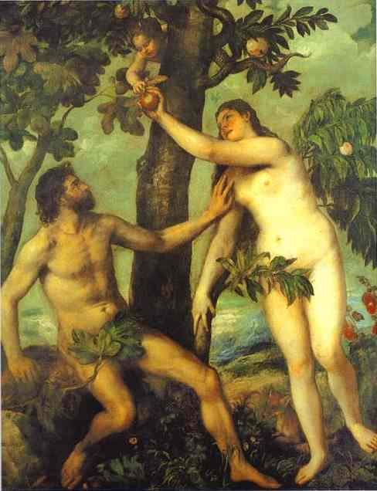
Because, They Are the Same

Slide 12
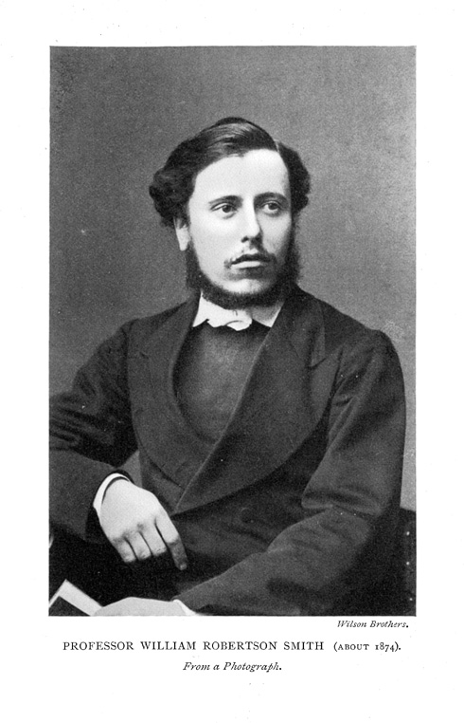
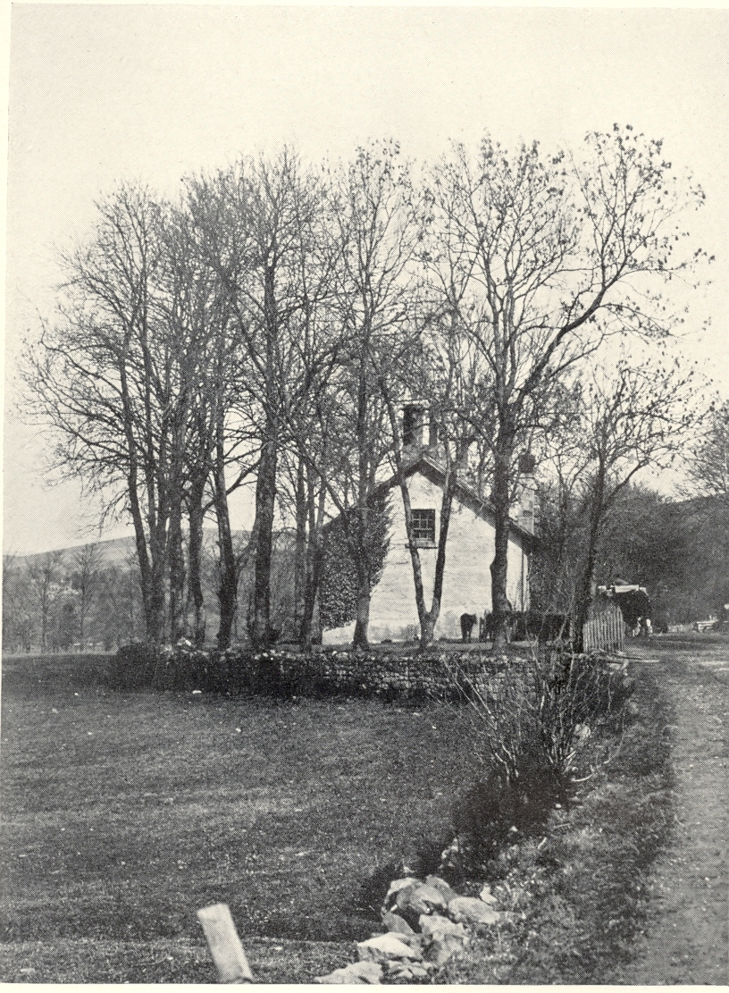
William Robertson Smith
In the Beginning
His “Wee Free”

Slide 13

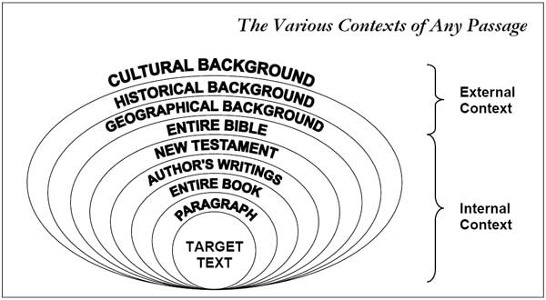
Off to Germany
To Study Bible, Critically
With Julius Wellhausen --
“Higher Criticism”
Locate Biblical Text in a Context
Find Out its “Sitz im Leben”!

Slide 14
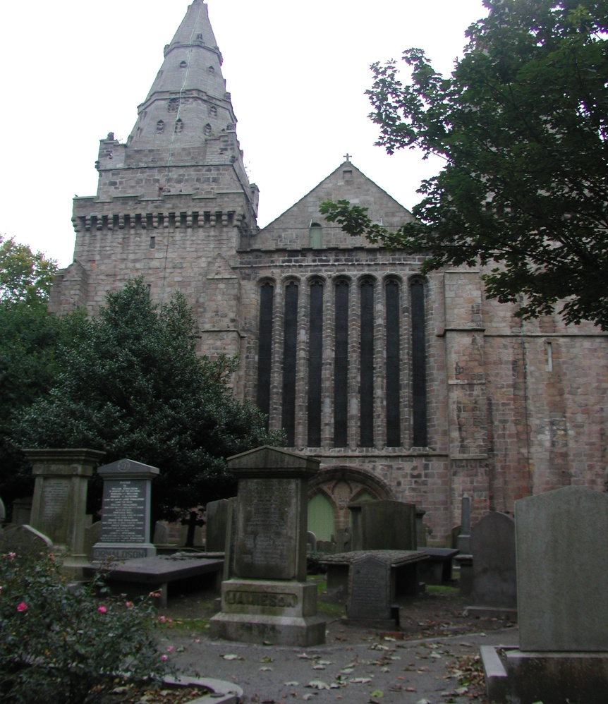
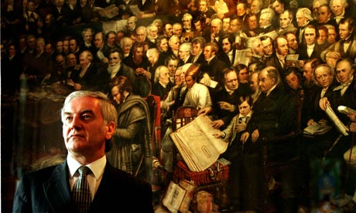
Back to Teach in Scotland (Aberdeen):
But, Big Trouble Because of His German Ideas
vs. Established Church
& His “Wee Free” Presbyterians

Slide 15
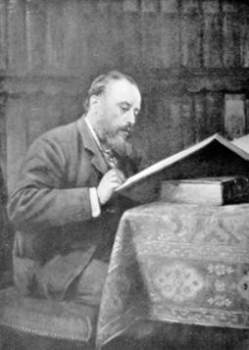
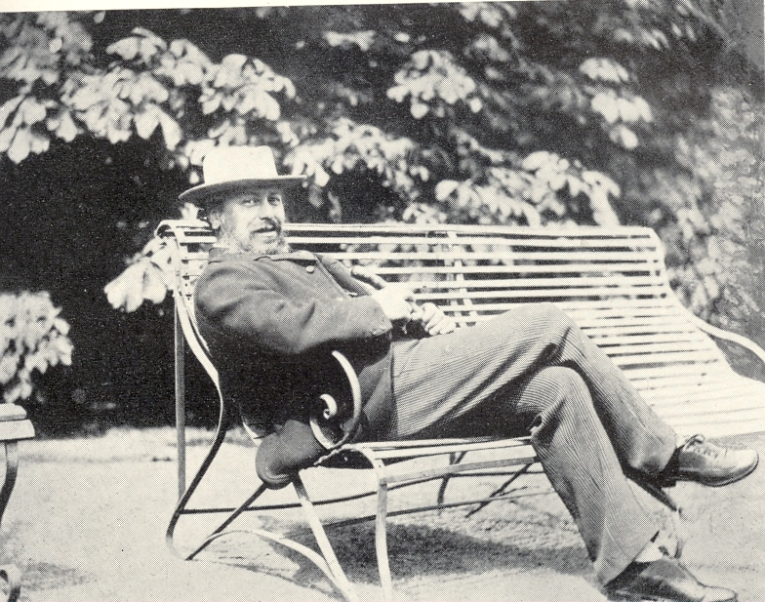
(Peaceful) Cambridge Years
Great Work
Lots of Play

Slide 16
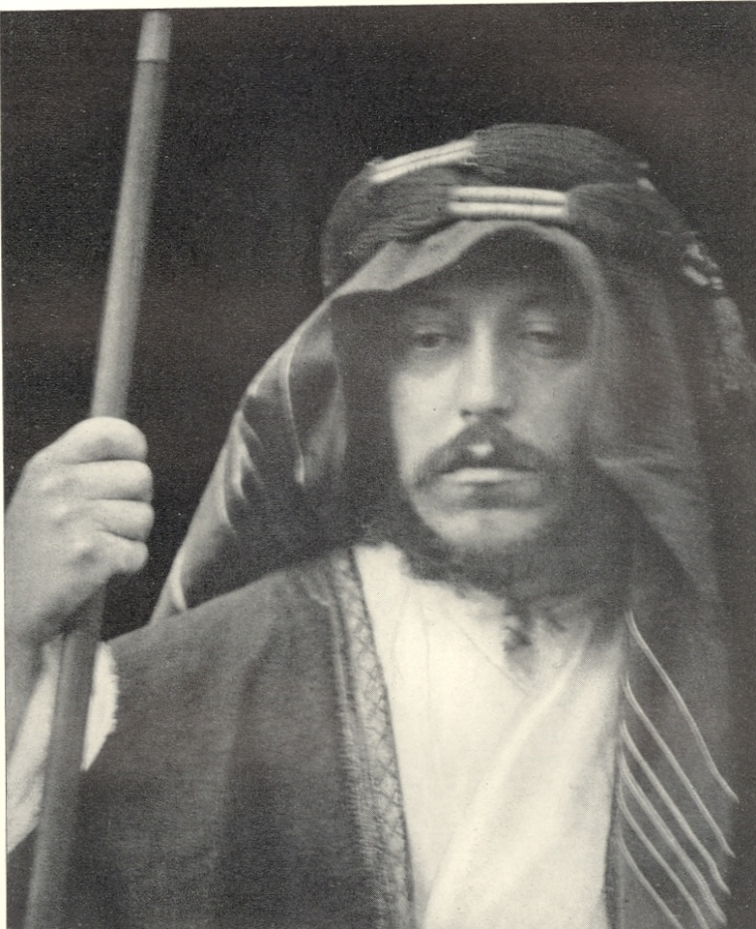
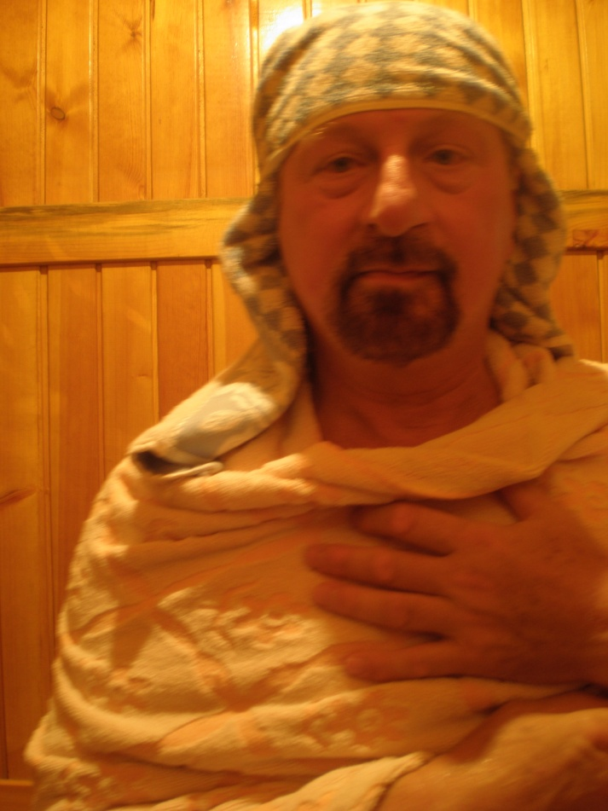
“Sitz im Leben” for Real:
Among the Semites as a ‘Semite’
Abdullah Efendi
Saladin Bey

Slide 17
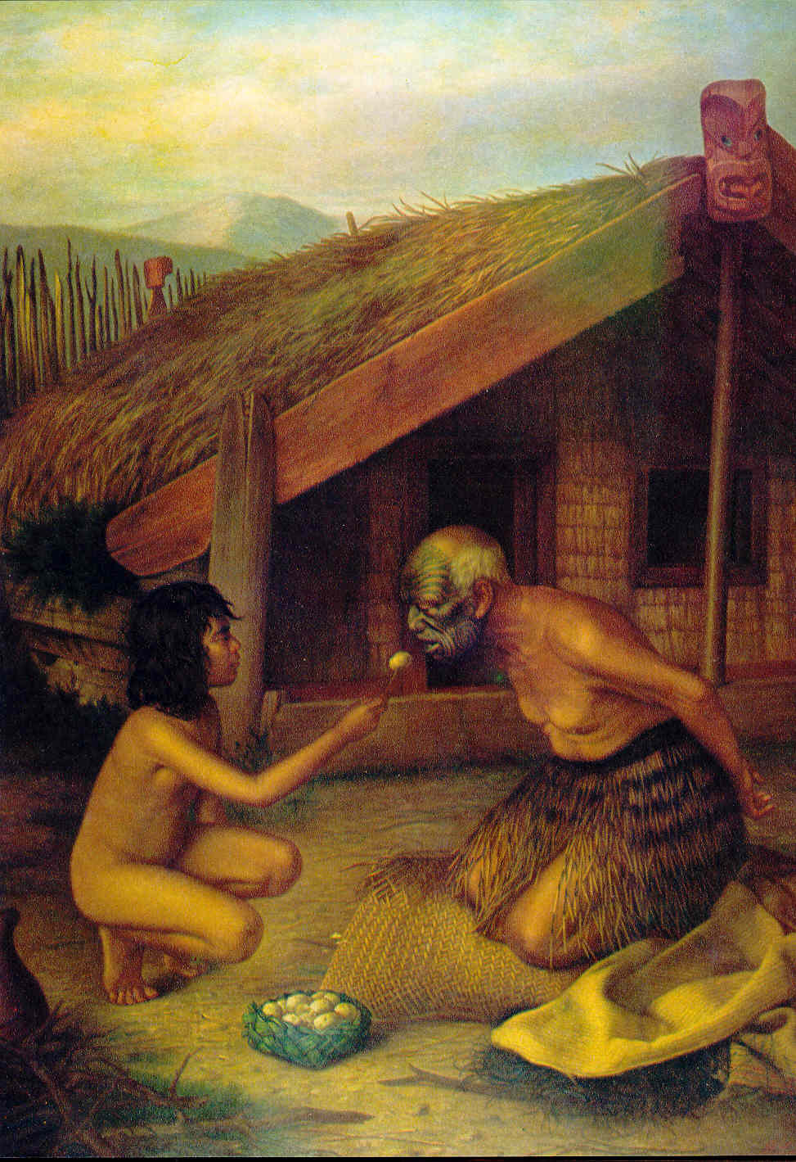
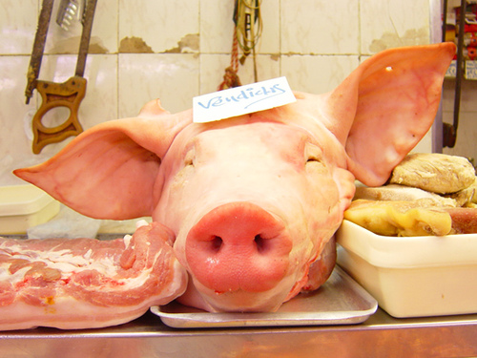
Comparison Means that:
Semites ≈ Maoris
Eating the Unclean -- Tabu
Touching the Holy, Tabu, Too

Slide 18
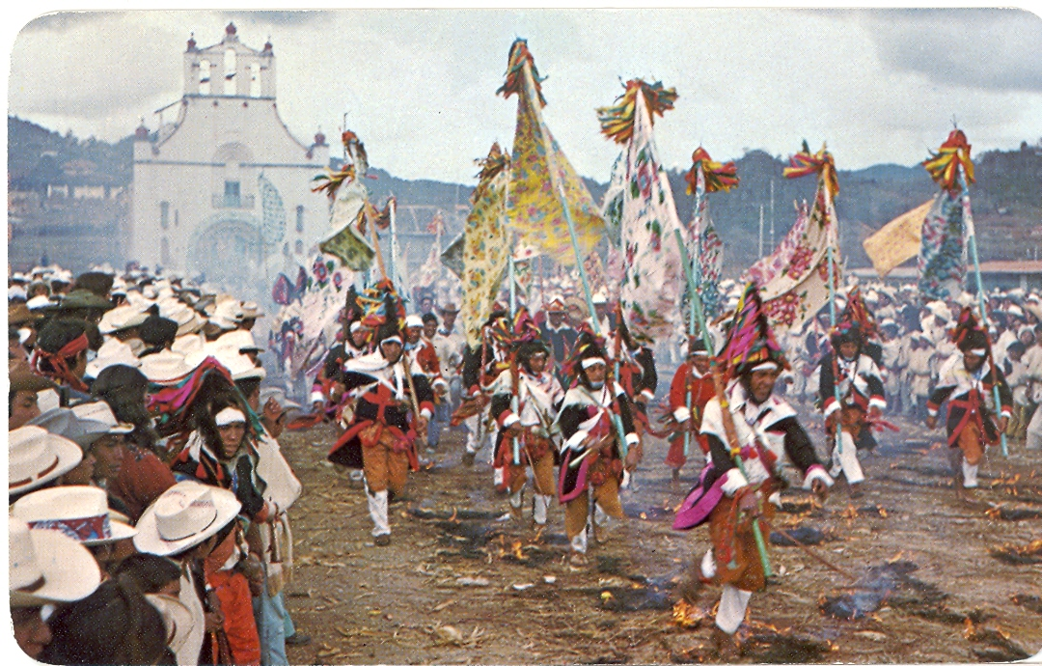

But “We” Are Higher -- “Exceptional”:
Our Religion Is Basically Morality & Beliefs
‘Their’ Material Religion = Rituals &Taboos
‘Our’ Spiritual Religion = Morality & Doctrines

Slide 19
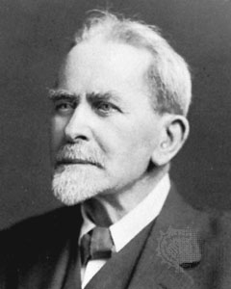
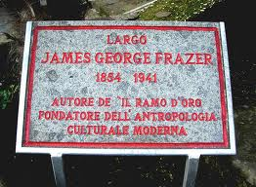
James George Frazer (1854-1941)
Another Scot
Lover of the Mediterranean

Slide 20


The Golden Bough
Frazer’s Big Book (11 Volumes)
A Study of Myth & Religion

Slide 21
Frazer Wondered about Two Things:
What Evolved?
And, BTW, Where Does Religion Come from?

Slide 22
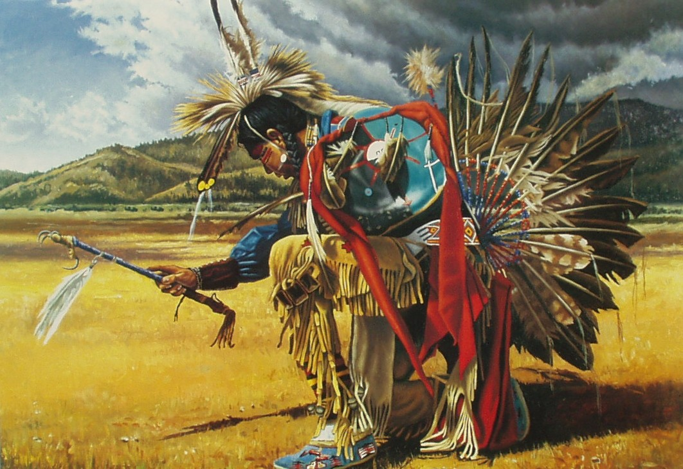
Our Attempts to Control Life Evolved:
First, We Tried “Magic”

Slide 23

But, “Magic” Didn’t Work

Slide 24

So, We Tried Calling on Higher Powers
AKA “Religion”

Slide 25

But, Religion Had Mixed Results, too

Slide 26

So, We Tried Again to Control Life….
This Time With Technology

Slide 27
The End?

