Slide 1
Friedrich Max Müller
(1823-1900)
The first real comparativist of religion, myth and one of the first comparative linguists;
The first Anglophone scholar of the religions of India;
He had a ‘theory’ about religion and myth;
He had a ‘method’ -- or technique -- for comparing religions, too, based on comparative historical linguistics ;
Editor, 50 volume Sacred Books of the East, anthologizing the scriptures of all the world’s religions – except Judaism and Christianity (!)

Slide 2
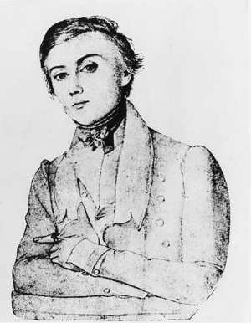
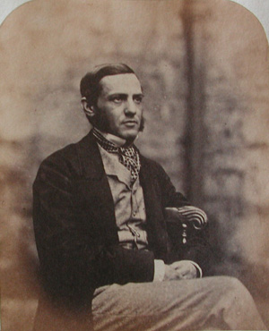
Soulful, Young Romantic

Slide 3
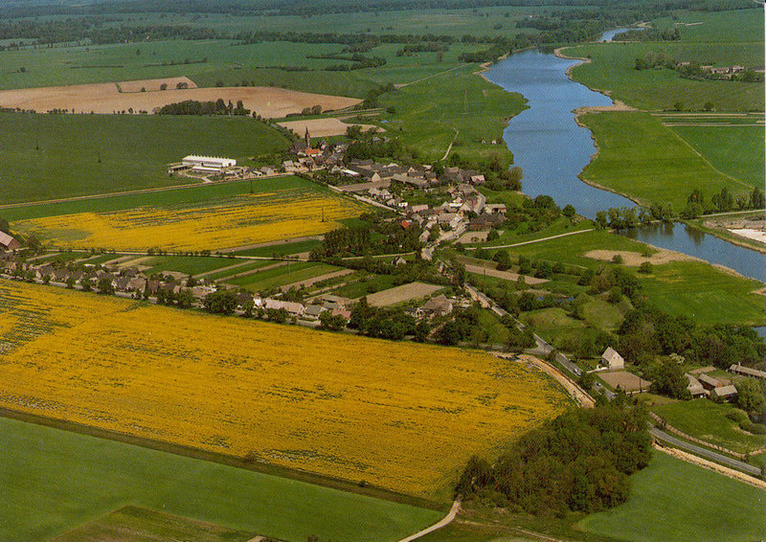
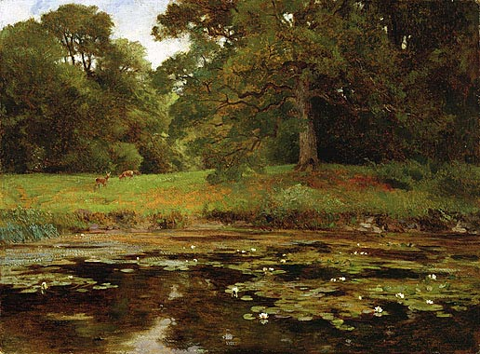
Dreamy, Pastoral Dessau:
The bucolic paradise of Max’s youth

Slide 4
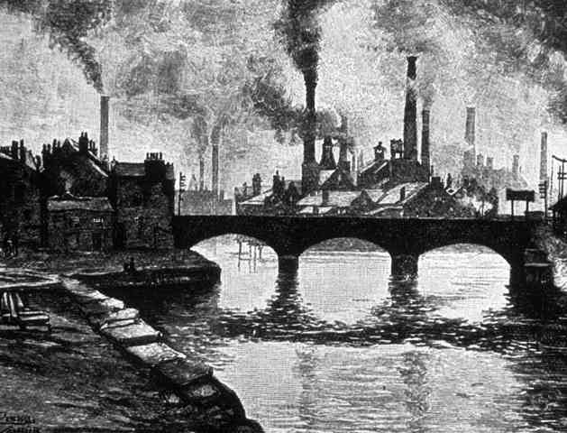
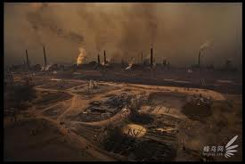
After Dessau:
19th Century’s “Dark Satanic Mills”

Slide 5
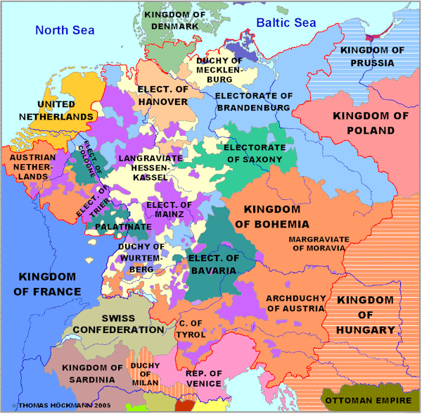
Also, Max’s Germany Was in Disarray

Slide 6
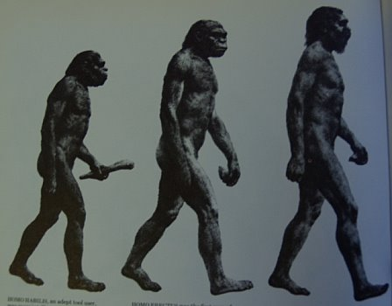
Modern Society: Progress or Regress?
Evolution or Devolution?

Slide 7
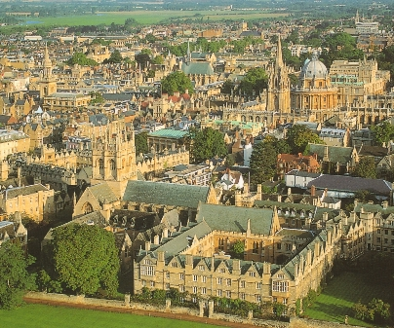
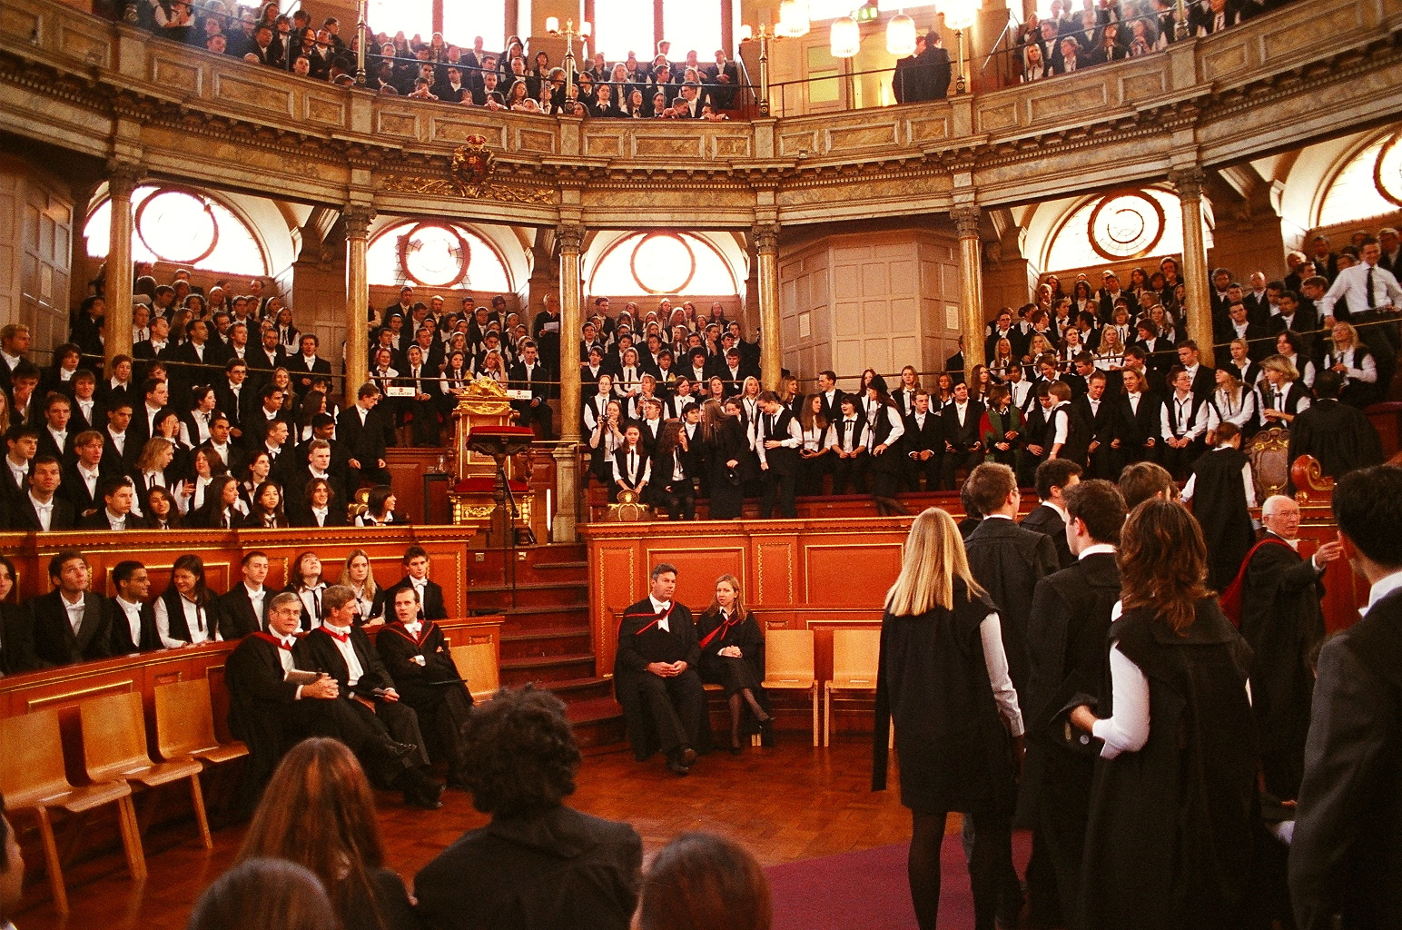
A Parenthesis in ‘History’:
The Sleepy, Tory Oxford of Max’s Maturity:
Scholarship, Privilege & Censorship: SBE – 2 = 50

Slide 8
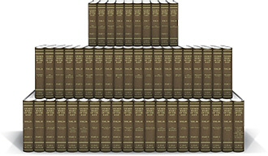
Max’s Life’s Work
His 50 Volume Sacred Books of the East
Psst….. Can You Find the Bible?

Slide 9
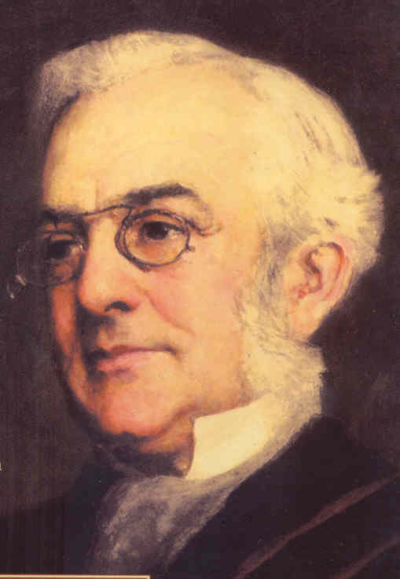
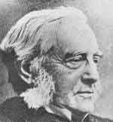
Old Perfesser or Old Radical?
Looked Anglo Tory; Was German Liberal

Slide 10
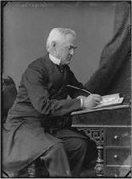
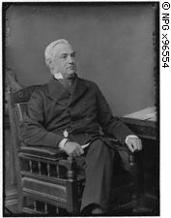
Office hours with ProfessorMax:
Looks innocent, But, was he?

Slide 11
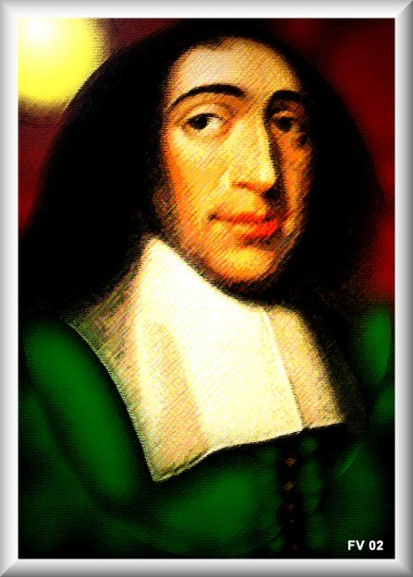
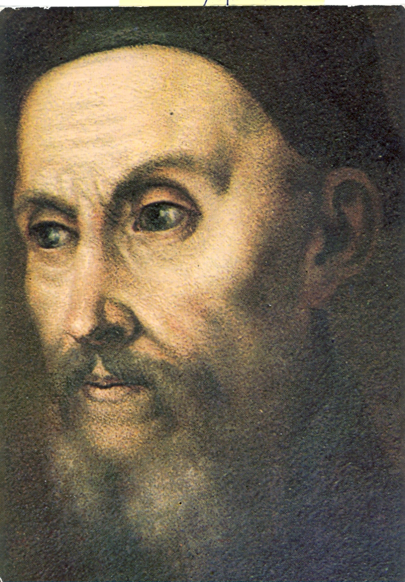
A Christian? But, What Kind?
Like Spinoza was Jewish?
Or, as Calvin was orthodox?

Slide 12
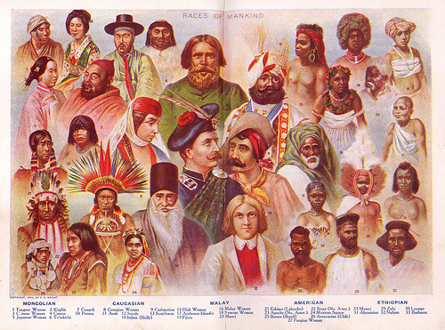
How Did He Respond to a Bigger World?

Slide 13
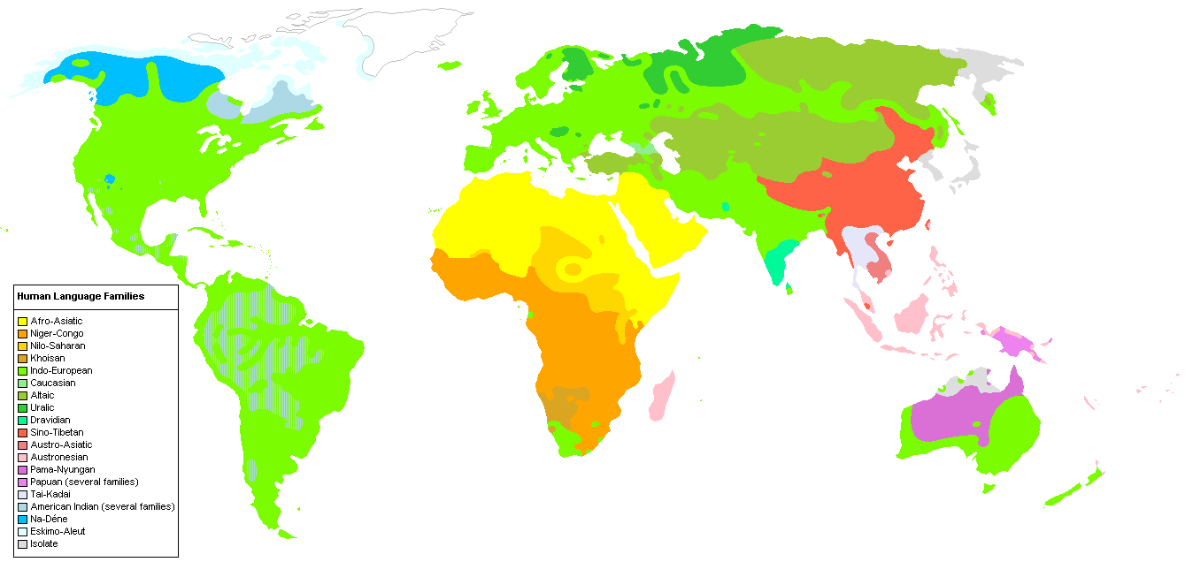
Max’s First Answer Was Language (Confused with Race)

Slide 14
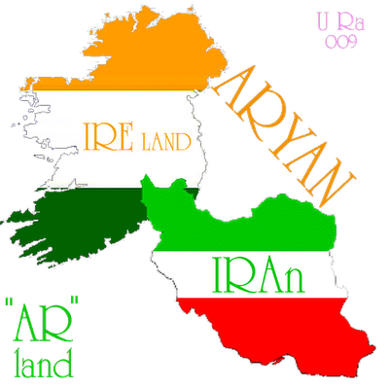
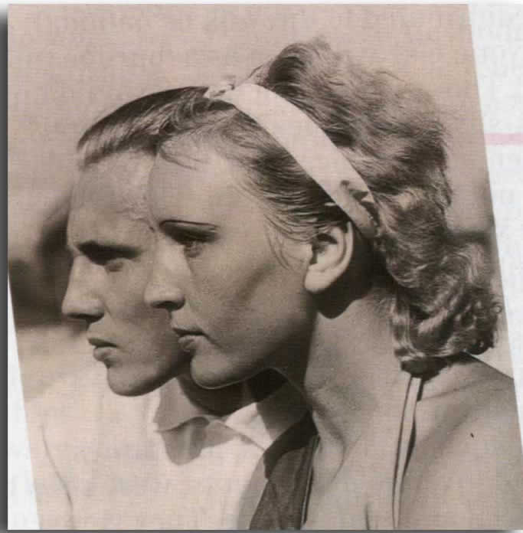
Oh, Yeah:
That “Aryan” Thing

Slide 15
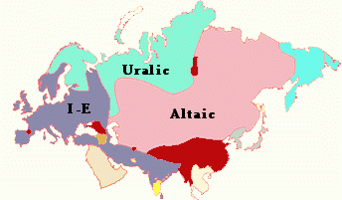
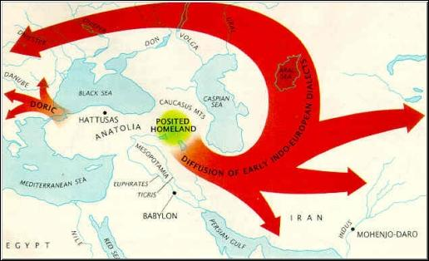
Then, He Asked: Who Are We (Westerners)?
Where Did We Come From?
(We Came from India!)
The Families of Humankind
“Our” Indo-Aryan Family
(Aryans, not a race)

Slide 16
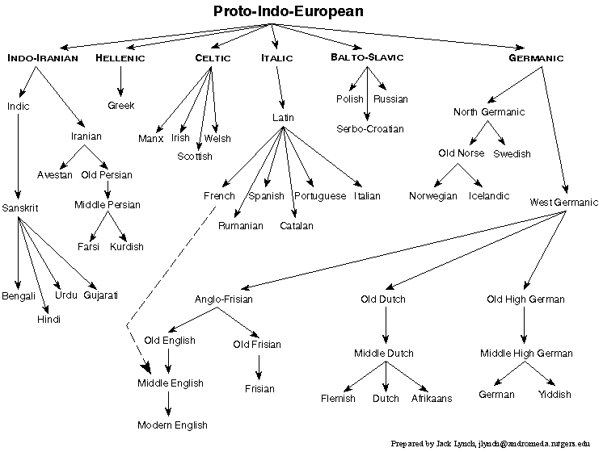
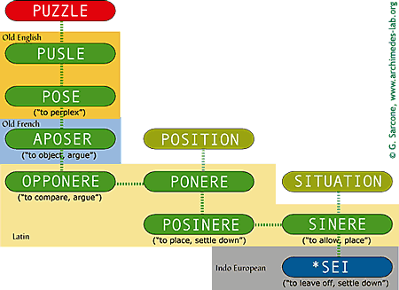
But, Our Indo-European
Language Family Has Changed
Our Big, Fat I-E Family
Some Cousins and Aunties

Slide 17
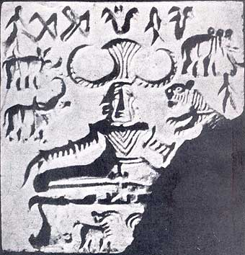
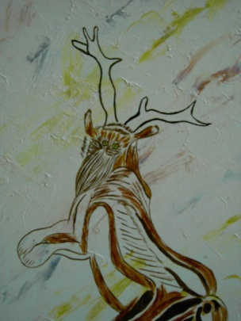
How Does Religion Come In?
It Comes In When We Compare
Us or Them?
Them or Us?

Slide 18
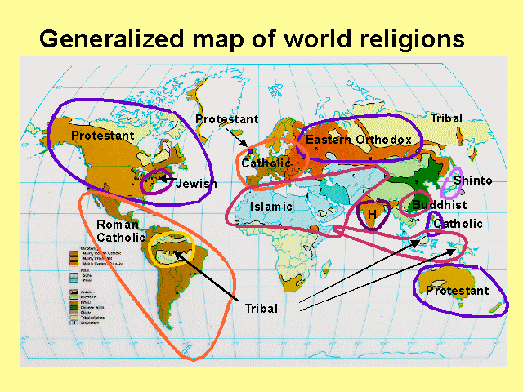
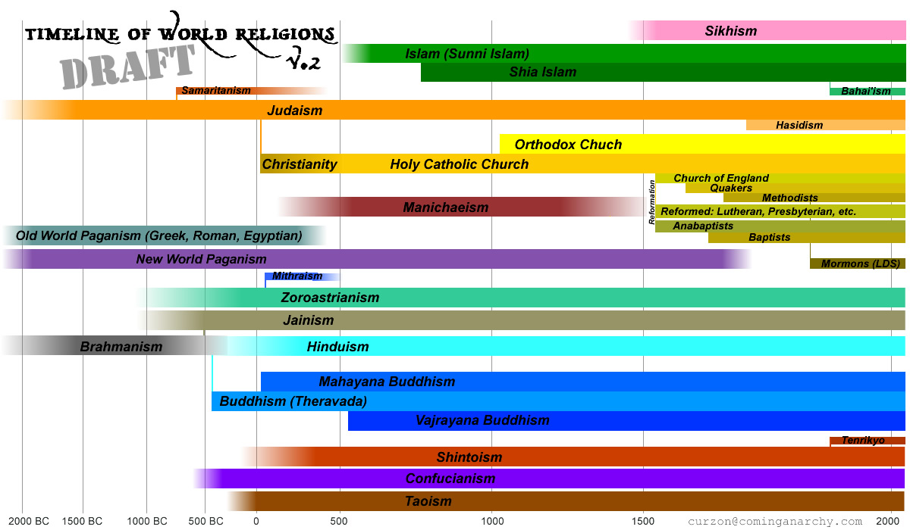
Max Compared Religions
Like He Did Languages
From where? And what shape?
How old, how new?

Slide 19
“Our Pitr Who Art in Heaven….”
Max observed the likenesses among the words for “God” or “father” in I-E languages
√*deiw = “to shine” = original Indo-European
Dyaus , deva, devi(Skt) pitr
Zeus (Grk) pateras
Deus (Lat) ‘divinitas’ pater, Jupiter
Tiwas (Ger) → Tuesday (Eng) Vater
Tiu (Eng) deity, divine, Diana father
Dios (Sp) padre
Dieu (Fr) pere
Dy’eea (Gaelic) athair

Slide 20

Max’s (Really, Really) Big Picture:
Overall, He Thought Religions Were in Decline from a Paradisaical State (like Dessau)

Slide 21
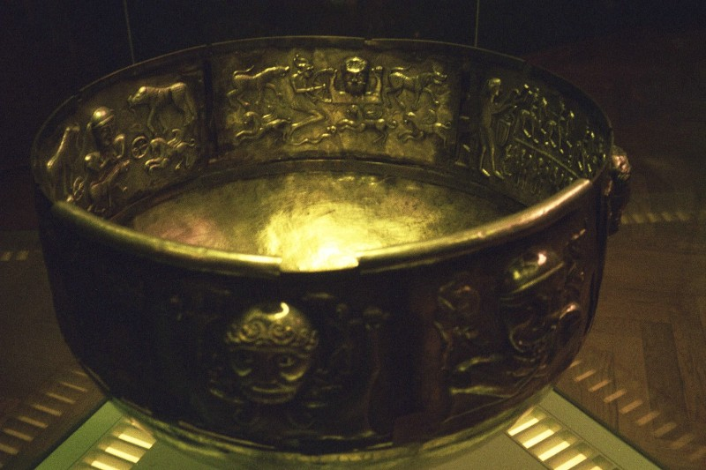
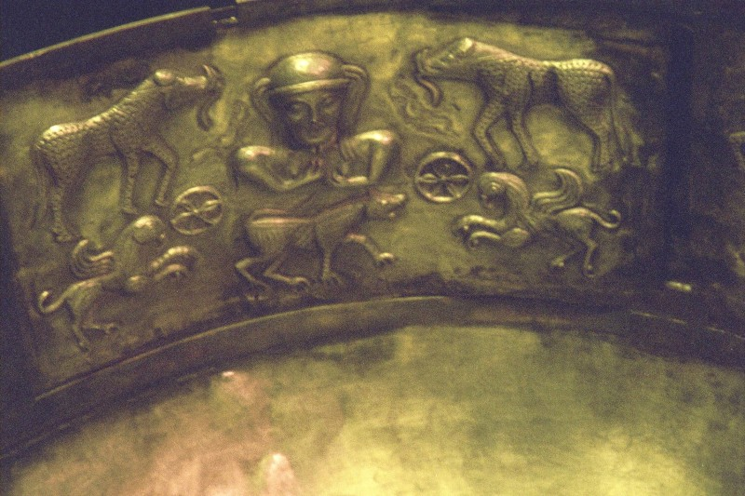
The Cauldron of Gundestrup (Denmark):
Tells of a Noble Past
A ‘High Tech’ and Artistic Pot
(But, what’s (who’s) for supper?)

Slide 22
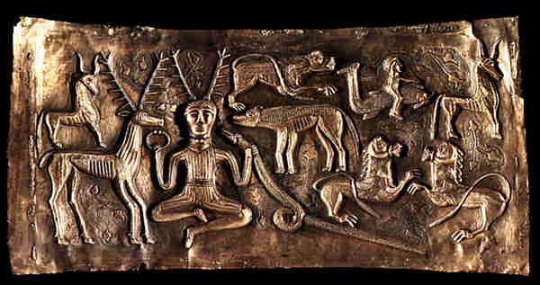
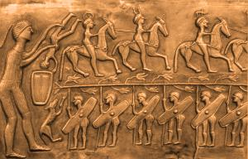
But, Max’s Critics Saw Our Past as Savage
E.g. for whom do we feast?
And, who’s dying to come?

Slide 23
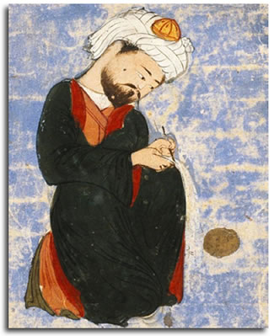
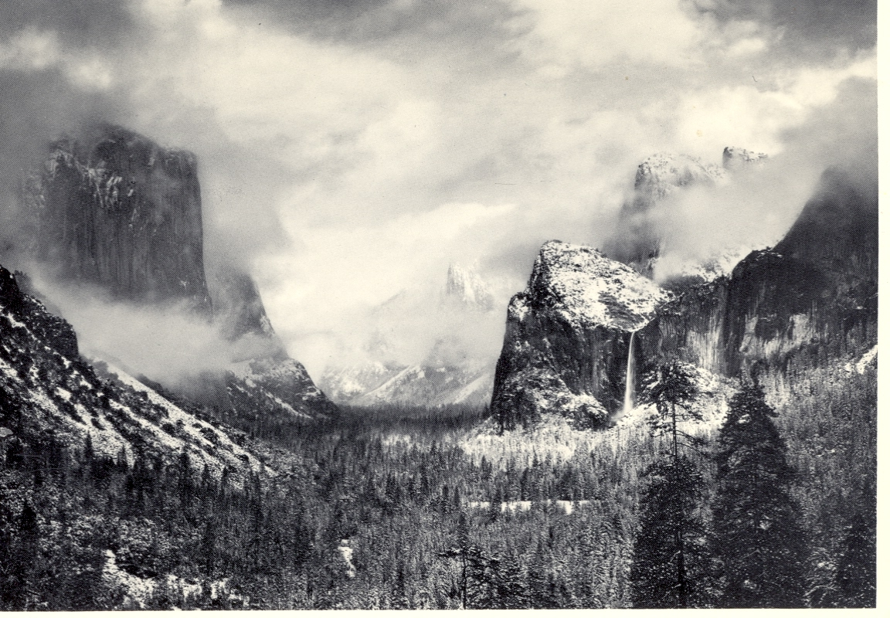
But, Max Held Out Hope for a
Return to Paradise
Experiencing pure unity
Immersion in Nature

