Slide 1
Religion, as If
Matter Mattered

Slide 2
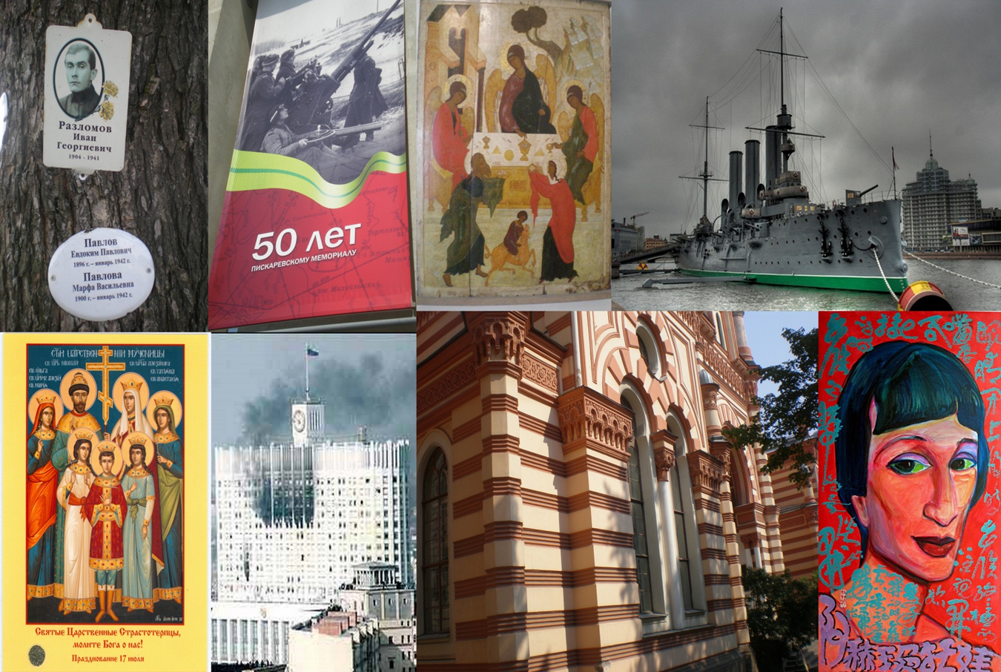

Slide 3
The Material Dimension of Religion
Where to Begin?

Slide 4
What’s (the) Matter?
Rather,
in what does
the material dimension of religion
consist?

Slide 5
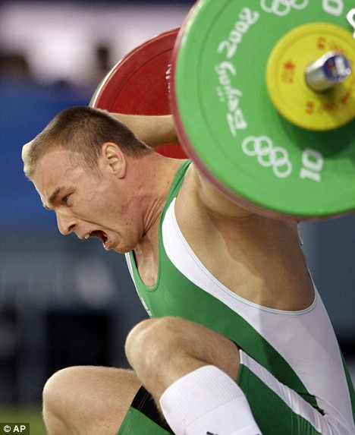
“Matter” Is Whatever…
Has
Weight
&…

Slide 6
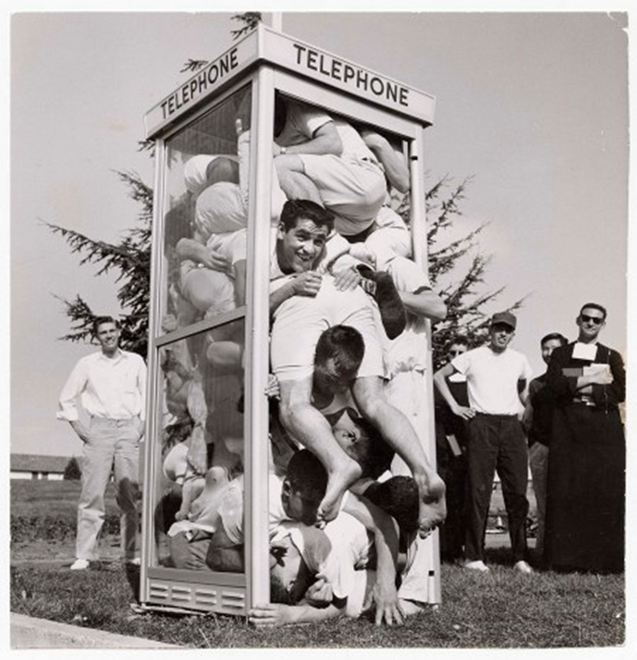
Takes up space

Slide 7
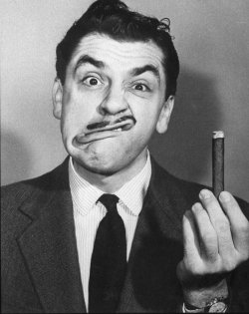
Even Smoke!
But, How Would We Weigh Smoke?

Slide 8
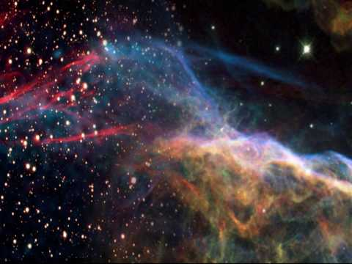
What’s (the) Matter in Religion?
“Space”

Slide 9

What’s (the) Matter in Religion?
“Place”

Slide 10
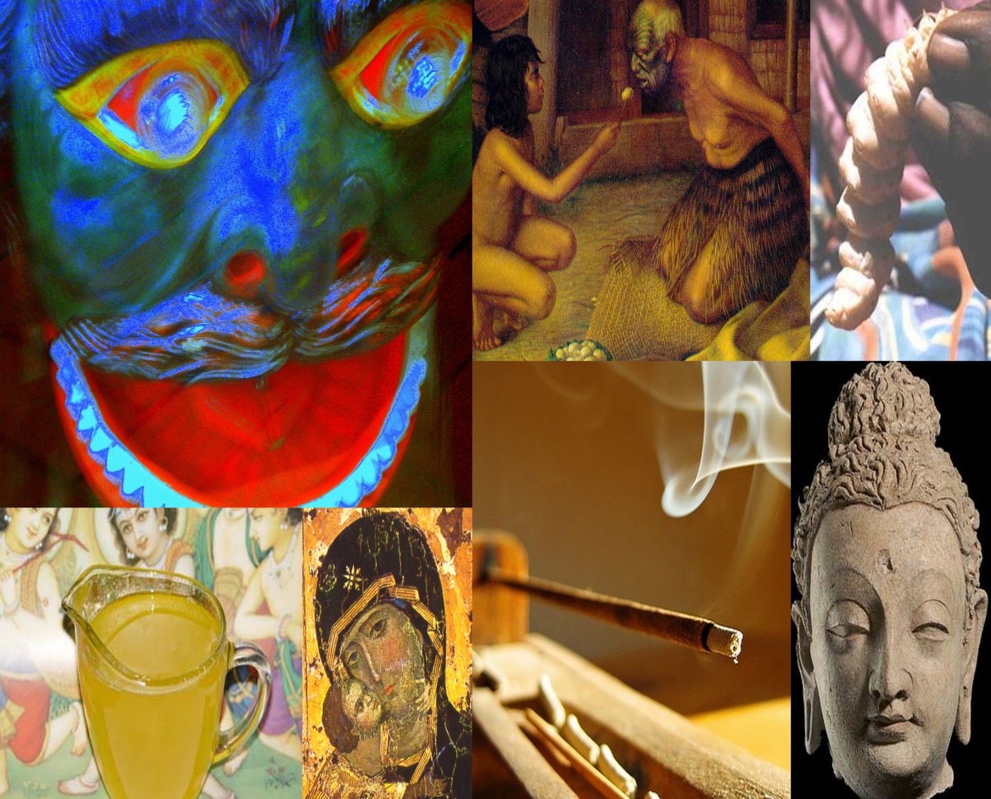
What “Space” Contains
Tools, ‘art’, music & other sounds, icons, statues, springs, fountains, odors, images, plants, buildings, altars, Bodhi trees, masks, dwellings… or, accessories, like ghee, food, fires, insects, water, oils, ashes, incense, smoke…

Slide 11
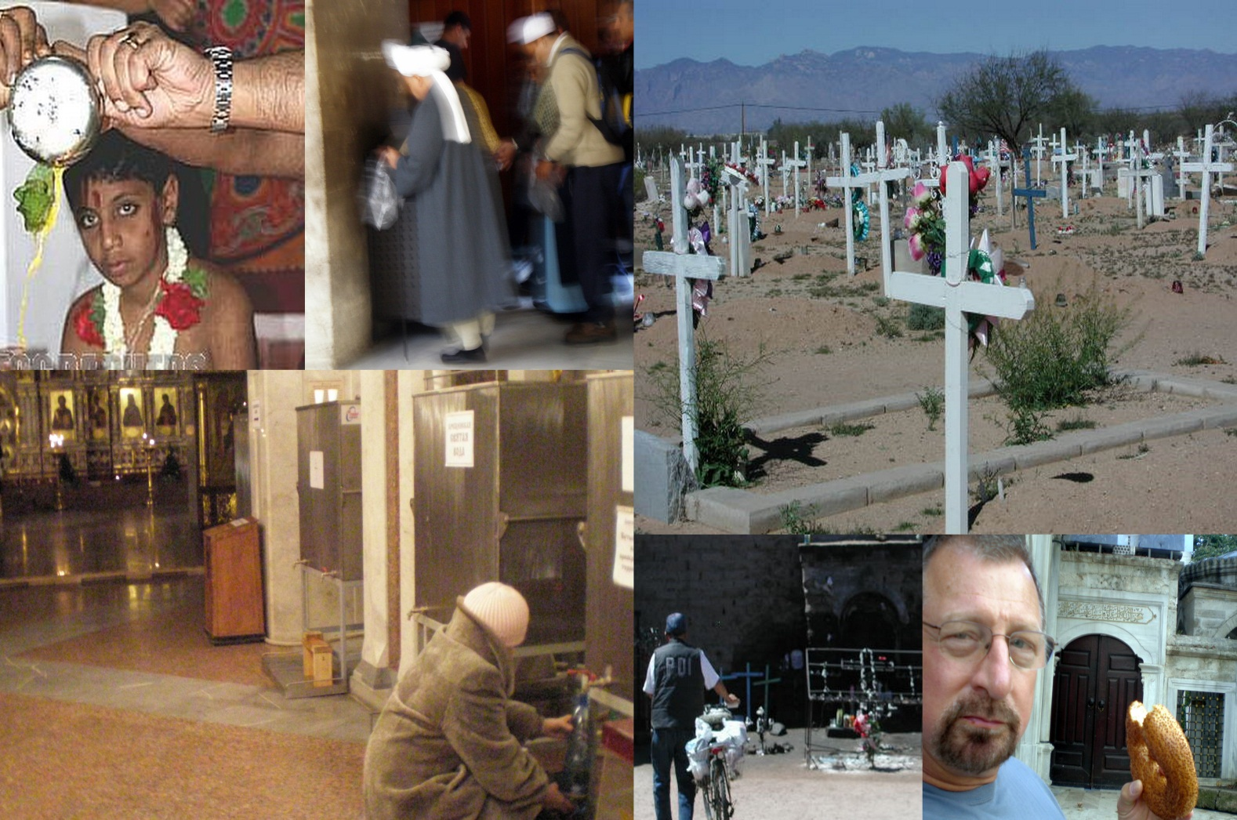
and yes, people, too
their bodies,
Alive,
Or, dead,
In part,
Or, whole….

Slide 12
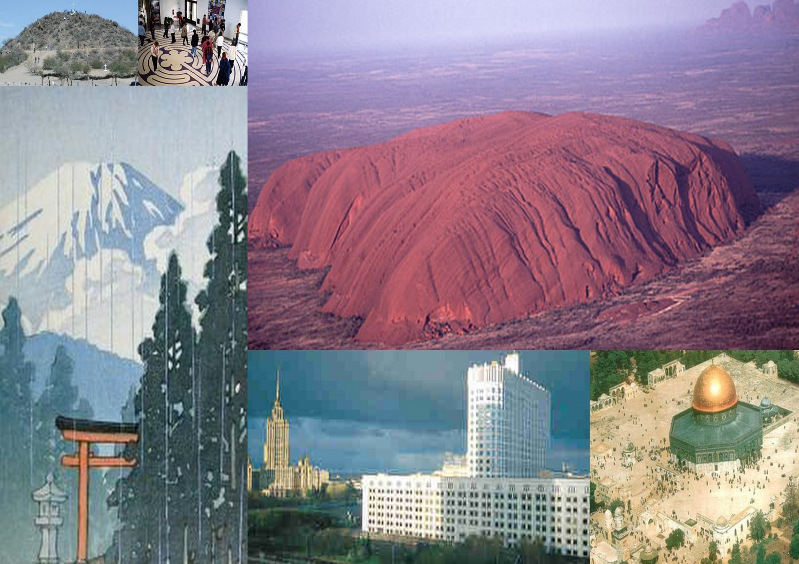
“Place”
Discrete locales: shrines, cities, memorials, territories, precincts, ‘centers’, Holy Land, jambudvipa, Dar-al-Islam, holy mounts, suvarnabhumi

Slide 13
What Is Excluded from
Space or Place… that
Could Be There?

Slide 14
Tabued, profane, outcaste, shunned, ostracized, forbidden, ill-fitting, excommunicated, heretical things or people: exiles iconoclasts, tref, haram, “them”, infidels, “Others”, kaffirs, mlecchas, impure, lepers, pagans, women!

Slide 15
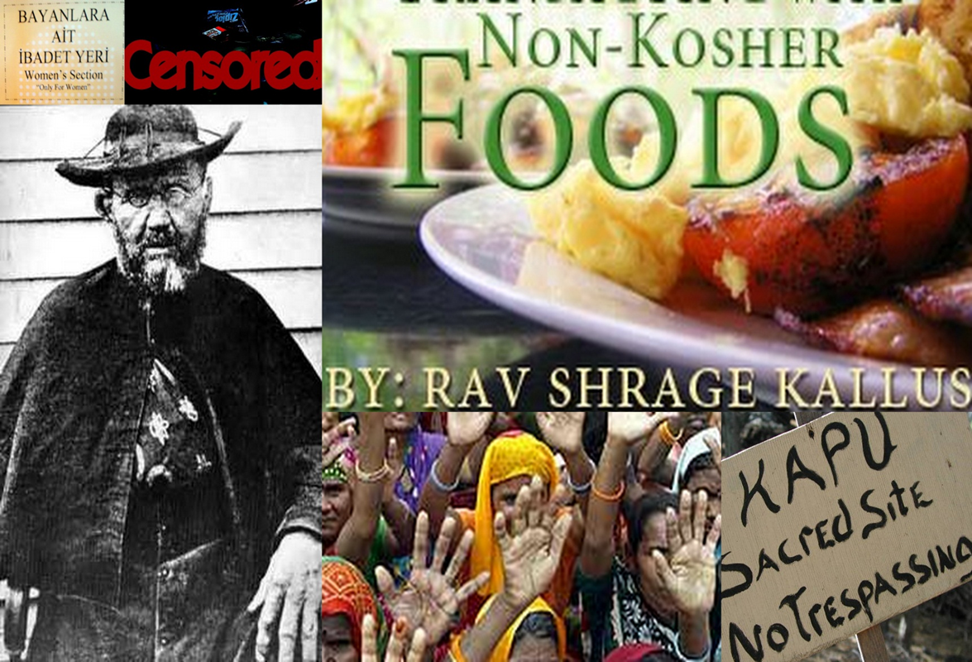

Slide 16
What Else Is (the) Matter in Religion?
Time

Slide 17
Divisions of Time
liturgical seasons, solar, lunar or calendrical periods, “golden ages”, Messianic times, auspicious times, eternity, kalpas, kali yugas, millennia, times of decline &fulfillment, end time

Slide 18
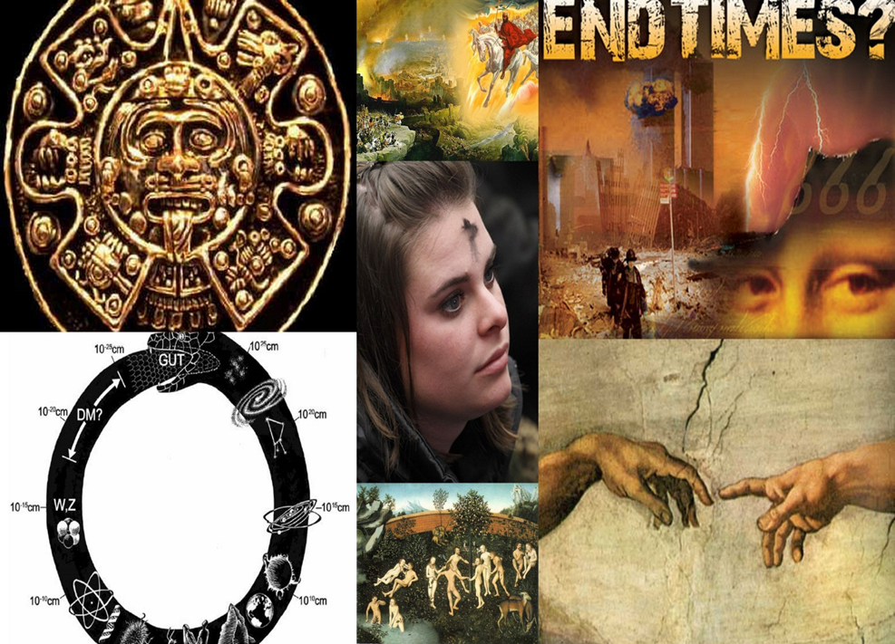

Slide 19
What We Rule Out… Temporally
too late, too early, before the beginning, not in time, after the end, inauspicious times, Samsara, boredom, routines, faintly remembered, the quotidian, the forgotten, the everyday, ‘practice’, intervals, filler, stalling, intermissions….

Slide 20
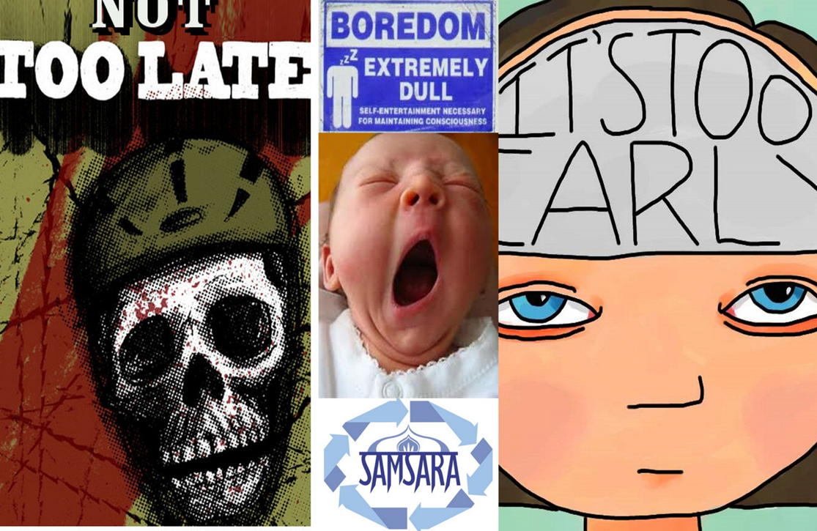

Slide 21
Where to Go Next?
Why Not with Definition of Religion?

Slide 22
Let “Religion” Be Defined as
“the administration of the sacred”

Slide 23
But, What
Is the “Sacred”?

Slide 24
People Have Proposed Many Definitions

Slide 25
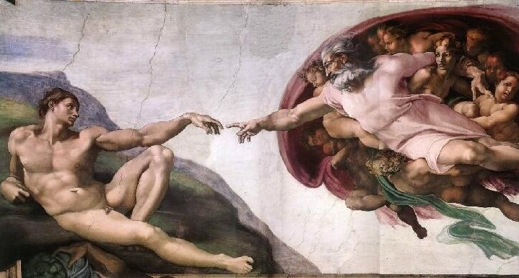
Sacred = What Belongs to God
(But, how can we tell what that is?)

Slide 26
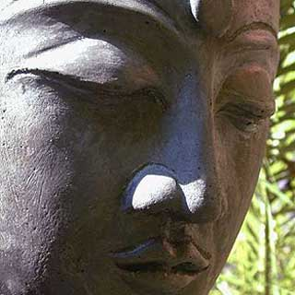
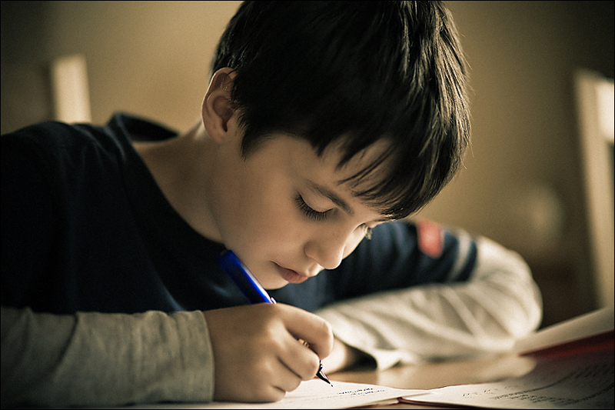
Sacred = Also What Suggests Mokşa
(everthing?)
Not Just
Excellence of Mind
But, Our Everyday
Focused Mental States, too

Slide 27
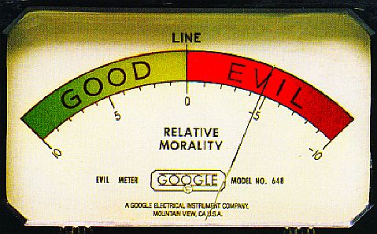
Sacred = “Completely Good”
(But, is religion just morality?)

Slide 28
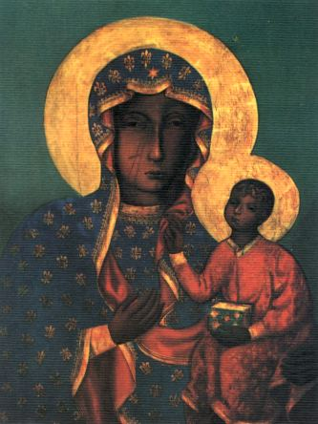
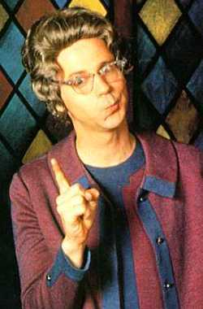
The Sacred = the “Numinous” (Otto)
( ≠ the “completely good”)
Church Lady:
“Completely Good”
Our Lady of Częstahowa: Numinous

Slide 29
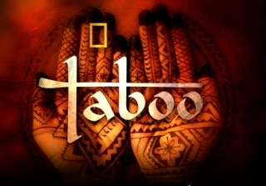
At Least, Sacred & Tabu Are Separate
(says who?)

Slide 30
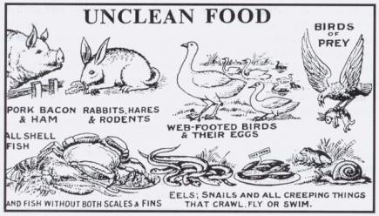
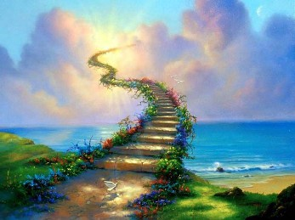
So Robertson Smith Thinks….
Taboo = Material, Fixed
(“Primitive”)
Holy = Spiritual, Free
(“Modern”)

Slide 31
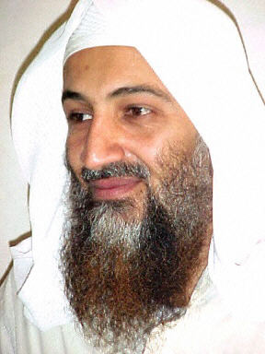
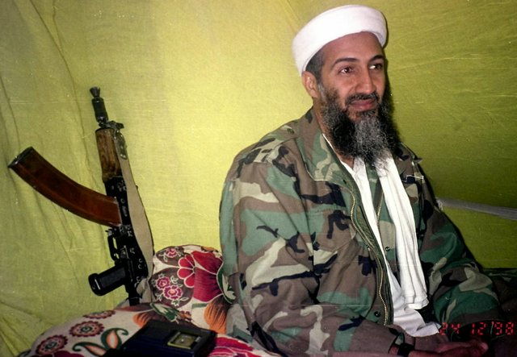
But, Are Tabu & Sacred Separate?
Murderer, and/or…
Martyr, too?

Slide 32
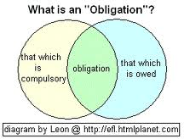
Whatever Else May Be True,
The Sacred → Obligation
(Kind of Negative, eh?)

Slide 33

Durkheim, for example, Thought
The Sacred Was Mostly @ Obligation

Slide 34
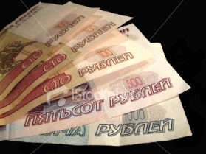
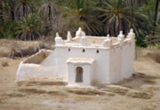
Durkheim (& Eliade’s)
Minimal (and “Formal”) Definition:
Sacred = Whatever Is Not Profane
Money = Profane or Unholy
Such as, “Filthy Lucre”
Shrines of Marabout =
Sacred or Holy

Slide 35
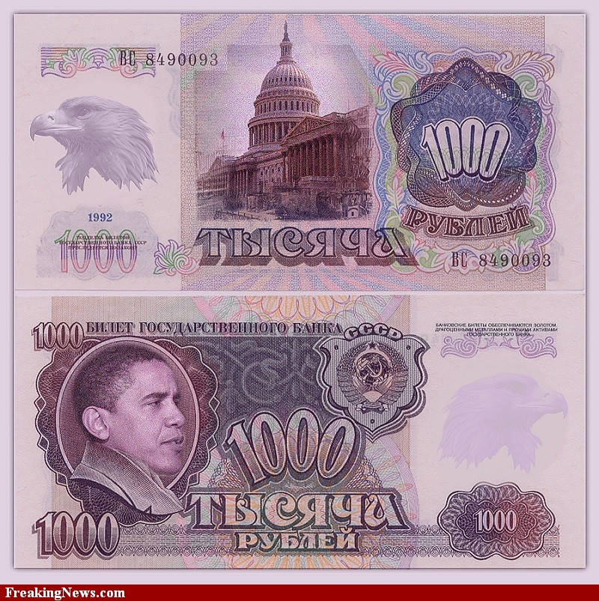
Profanity on Top of Profanity

Slide 36
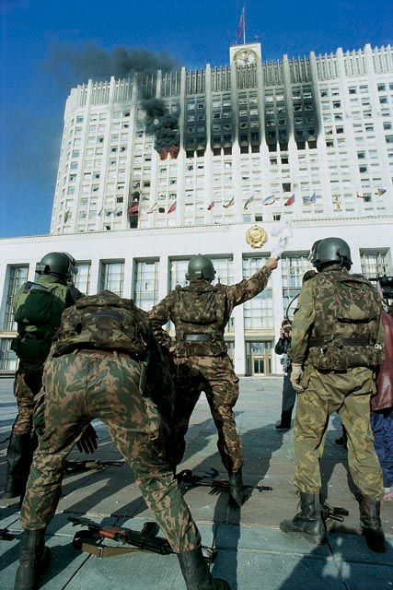
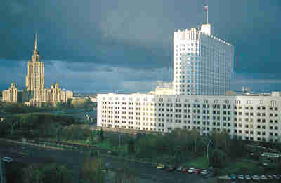
Durkheim’s Theory of Sacred Space
National Heart-break?
National Heart

Slide 37
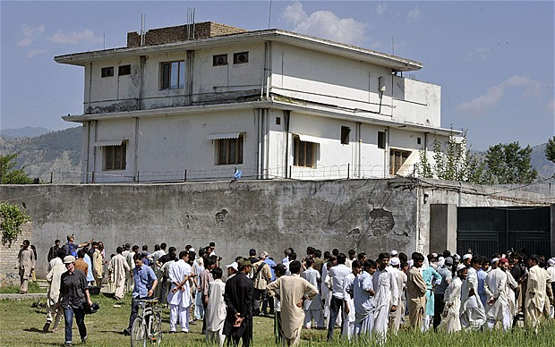
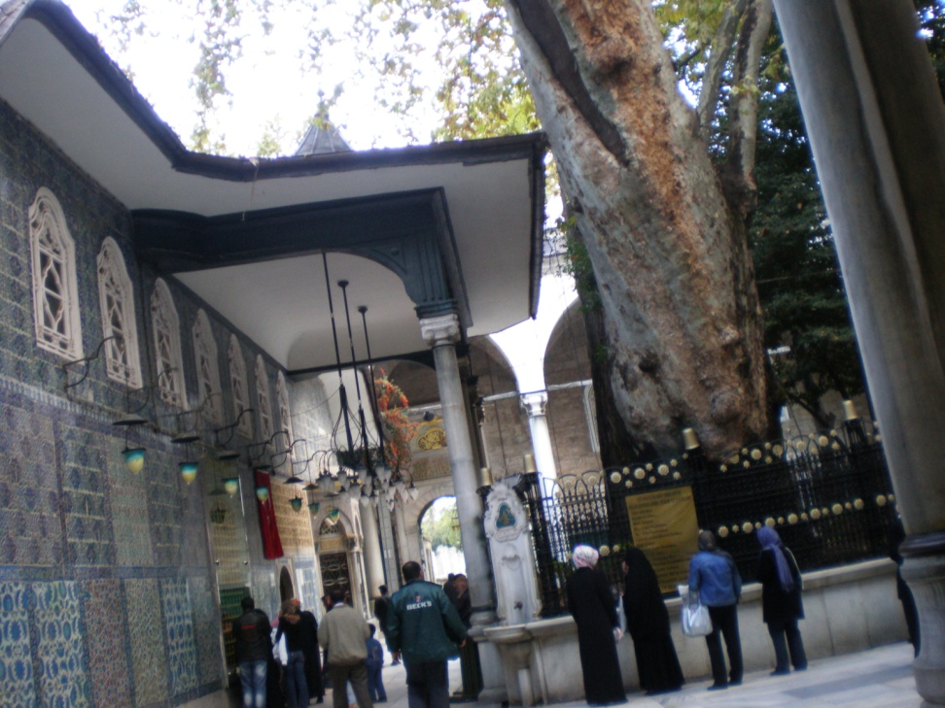
Durkheim: Matter Matters
Will UBL’s Abbottabad Villa Become a Shrine?
As Eyub Sultan Cami
Already Is?
(Istanbul)

Slide 38
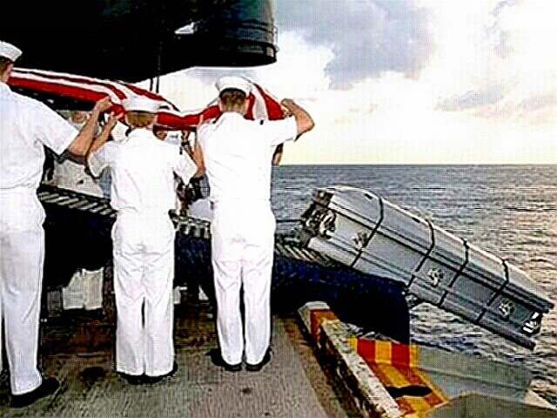
Maybe, Why UBL Was Buried at Sea?

Slide 39

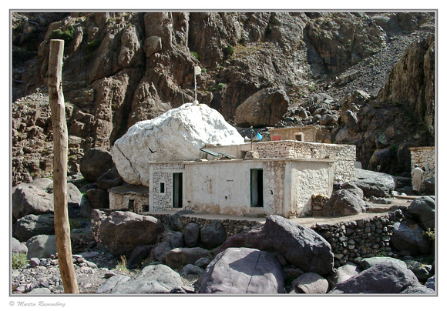
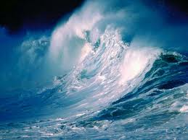
Shrines Are Places, Not Just Spaces
Some Place→ Some Shrine
No Place→ No Shrine

Slide 40
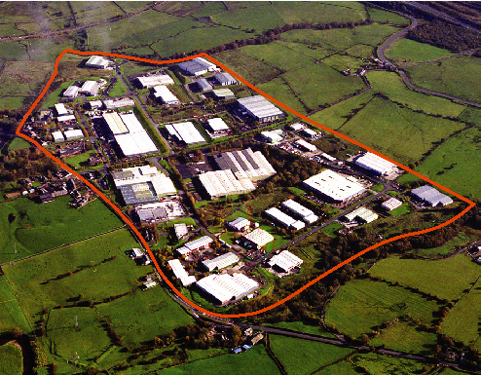
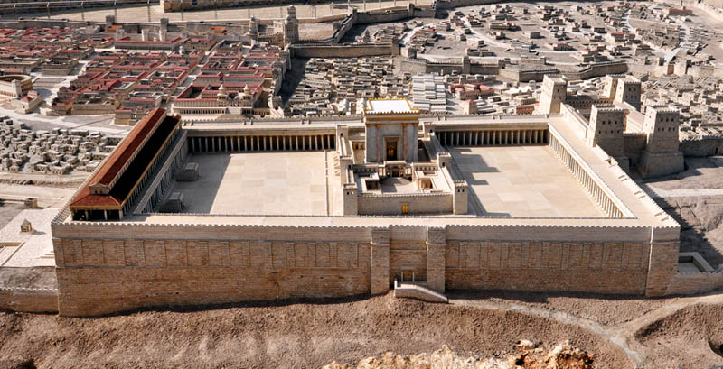
Thus, Places & Shrines Are Bounded:
The Sacred Is about Setting Boundaries
Between ‘Us’ & ‘Others’
Between Sacred & Profane
Between the Holy of Holies
&
The (Profane) World

Slide 41
But, at Sea, no “Place” for UBL
→No “Shrine”
→No “Sacred” UBL Space
Nothing

Slide 42
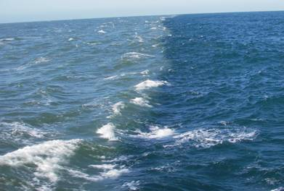
Lost at Sea

Slide 43

The Sacred Tells Us Who We Are
by setting personal boundaries

Slide 44
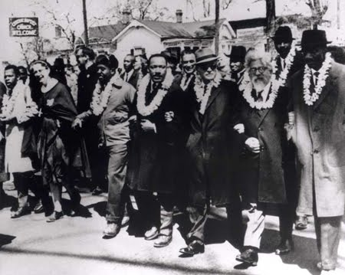
The Sacred Also Tells Us Who We Are
By binding us together in community

Slide 45
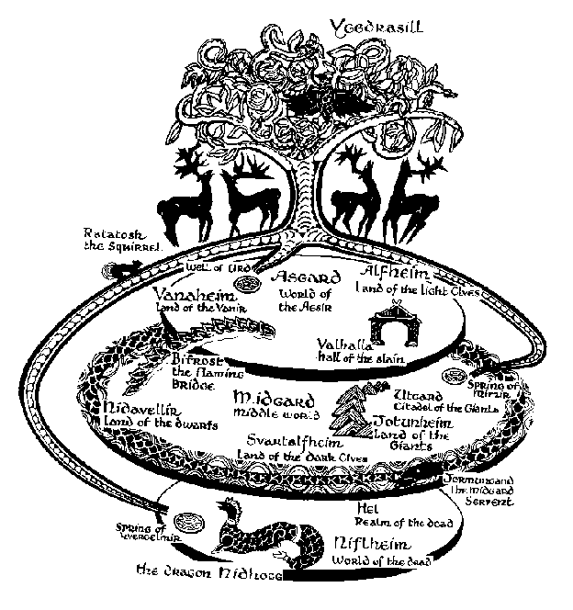
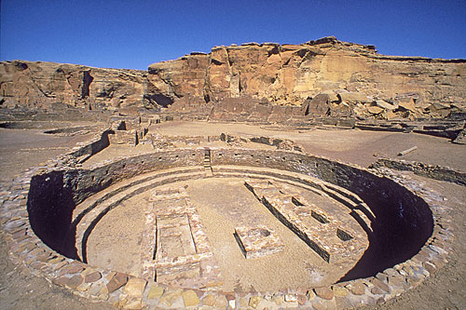
Eliade’s Theory of Sacred Space
Reality Arises Out of the “Center”
“Archaic” Center: “World Tree”
The “Great Kiva”
Navajo “Center”

Slide 46
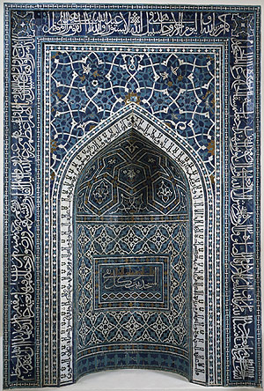
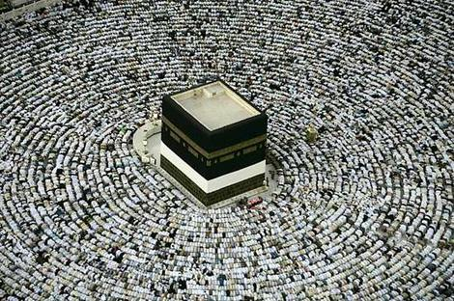
The Center in Islam
Mirab: points the way
To the Ka’aba in Mecca

Slide 47
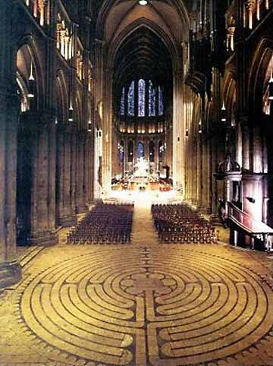
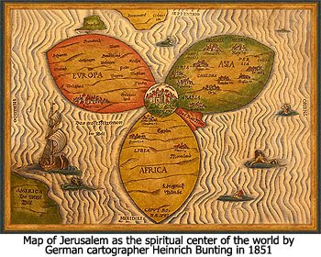
In Christianity
Chartres Cathedral = Pilgrim’s Center
Imitates Jerusalem Archetype
Jerusalem = Center of the World
Imitates Archaic Archetype

Slide 48
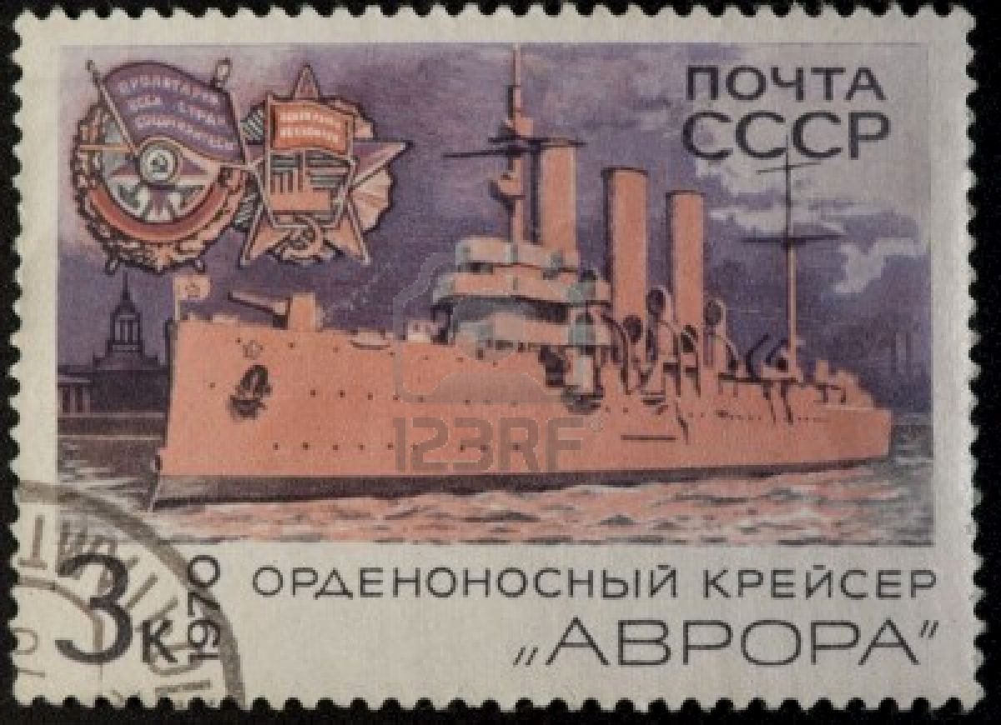
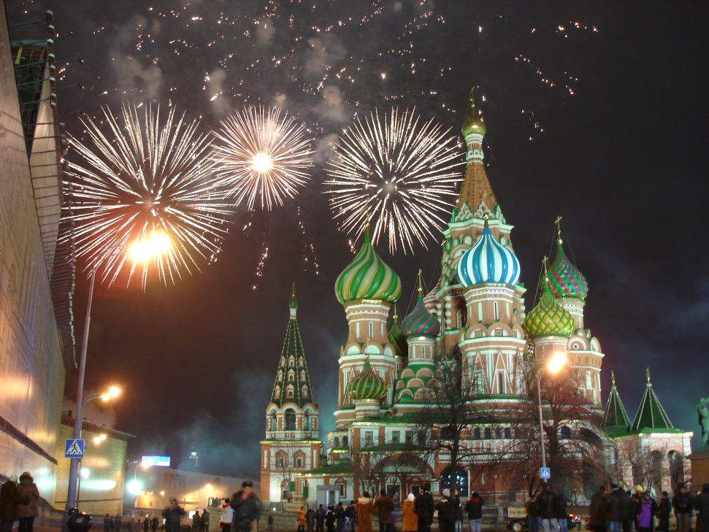
What Is the Russian Sacred Center?
Revolutionary Past?
Orthodox Heritage?

Slide 49
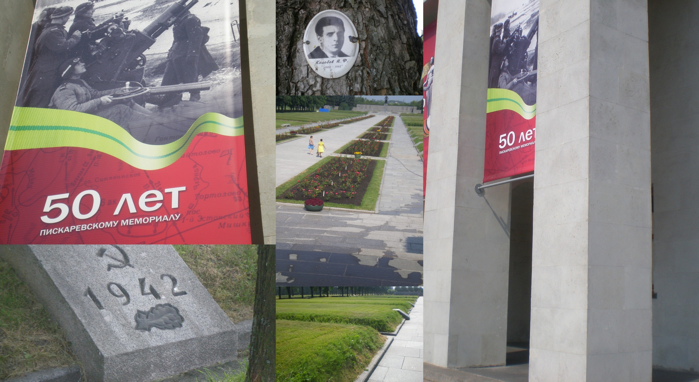
Or, Something Like
St Petersburg’s Sacred Space?
Pisaryovskoe

Slide 50
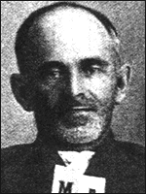
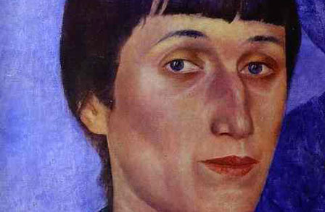
People Can Also Be Our Sacred Centers

Slide 51
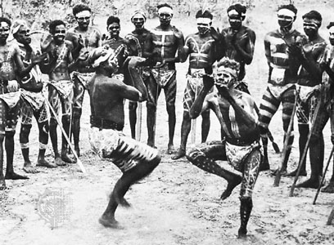
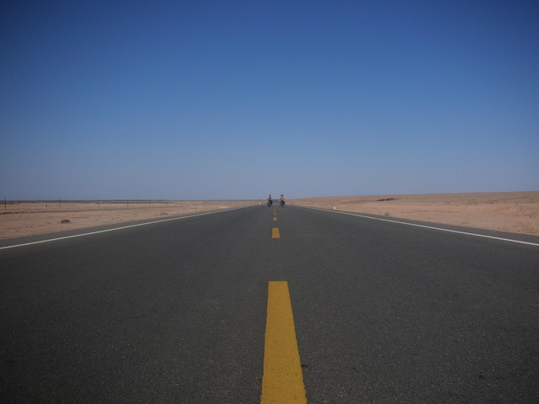
Not to Omit Theories of Sacred Time
Australia’s
Recurrent Rituals of Revival
Eliade’s
“Timeless Time”

Slide 52


The Siege as Sacred Time

Slide 53


Children Feel What Sacred Is

Slide 54


Question:
Sacred vs Profane,
Opposed in Form, But, in Content Too?
Ghee, Profane
Ghee, Sacred….

Slide 55
But, What Content?

Slide 56

Content:
The Sacred, the Holy = The Pure
(But, Is Cleanliness Next to Godliness?)

Slide 57

The Profane Is the Impure
(or, Is it?)

Slide 58


“Mais Non!” Say These 2 Frenchmen:
Sacred as Transgression
Georges Bataille (1897-1956)
Roger Caillois (1913-78)

Slide 59


Maybe the Sacred Can Also Be Impure?
Krishna Holi in Utah
The Magdalene Compromise?

Slide 60


Violation of the Sacred as Sacred
To Destroy Conventional Sacreds?
Or, to Create New Sacreds?

Slide 61


Thus, the Sacred Can Be Both
“Right-Handed”, and…
“Left-Handed”

Slide 62

But, How Far Left Can It Go?

Slide 63
Try This…
Easier To Take

Slide 64


New Sacred = the Non-Utilitarian?
Contrast Utility or Labor to …
Altruism or Pleasure

Slide 65

No! to Max Weber and Capitalism

Slide 66


Profane: Use :: Sacred: Altruism
Utility, for a Purpose
(e.g. trade & commerce
Done In & For Itself
(e.g. art, Shiva’s Cosmic Dance)

Slide 67
One More

Slide 68

The Sacred as a Revivifying Force
Created by Ritual

Slide 69

The Sacred as Energy
Unleashed by Collective Ritual Action

Slide 70

That’s All, Folks!

