Slide 1
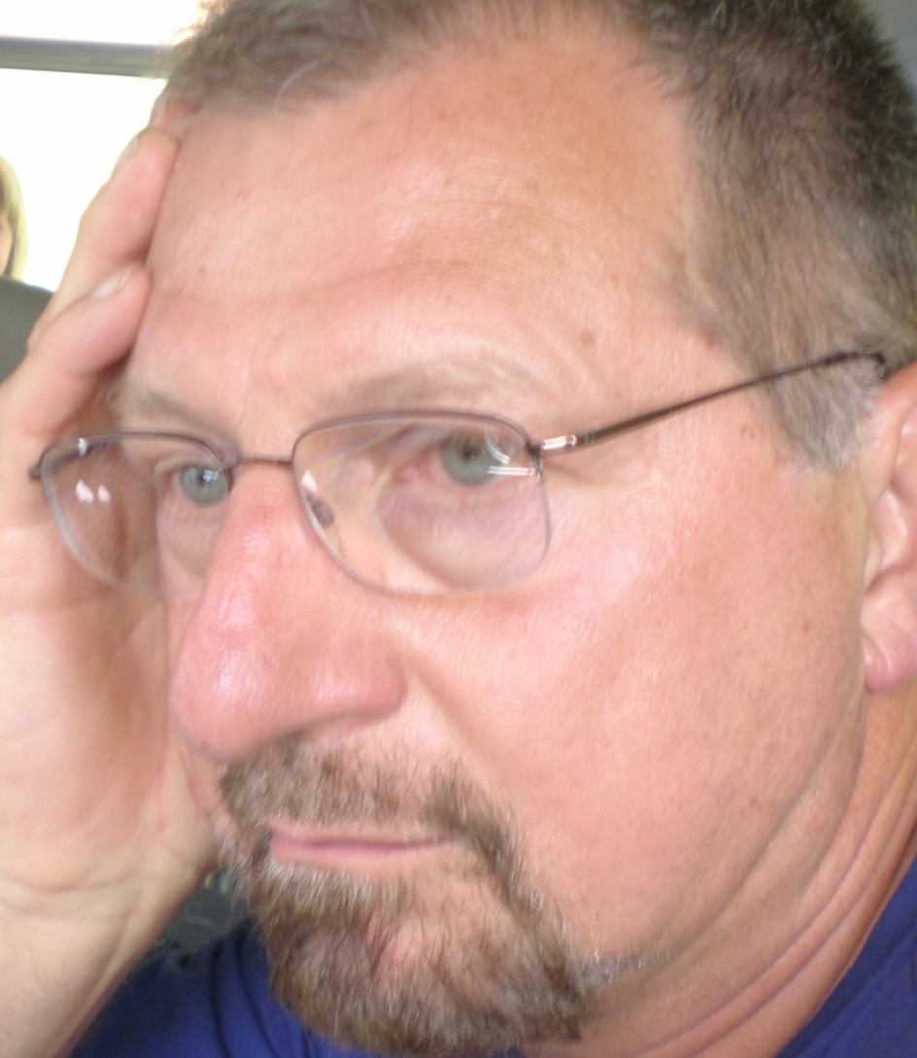
A New Philosophy of Religion?
Ivan Strenski
IAHR, Toronto, 16 August 2010

Slide 2
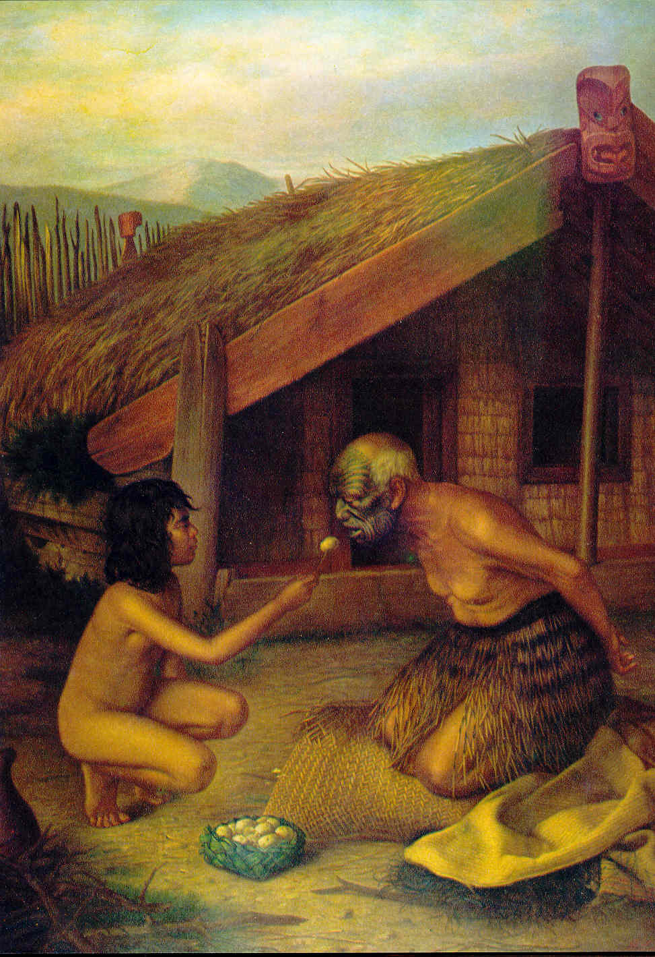
Philosophy of (Lived) Religion

Slide 3
“Philosophy of Religion”
‘philosophy’ AND ‘religion’
Both terms need to be unpacked, scrutinized, fleshed out.
Neither term can be left unanalyzed.

Slide 4
“philosophy”
By ‘philosophy, ’ I mean ‘analytic philosophy’
  Constructive philosophy and theologies are put on hold.

Slide 5
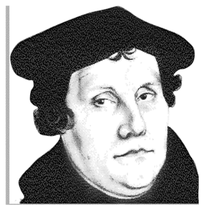
“Religion” has taken its cues, in large part, from this guy

Slide 6
Thus, for classic analytic philosophy,
‘religion’ =
‘Beliefs’, ‘doctrines’;
Moral imperatives;
‘Theologies’;
Arguments;
= “Cognitivism”
Internal and Private

Slide 7
Classic analytic philosophy of religion presumes that
it is about religious words.
‘religion’ conforms to the Christian model
creeds – ‘confessions of faith’ – are normal;
Classical Western philosophy is normative: the Greeks and Medievals;
Modern Western philosophy -- from Descartes & Empiricism to contemporary successors -- is normative

Slide 8
Classic analytic philosophy of religion presumes religion...
= propositional – statements, at times routinely identified with “theology”;
= “spiritual,” disembodied,
= ‘internal,’ private
has ‘neither weight nor takes up space;
= neither temporal, nor historical;
= neither cultural, social, nor inter-subjective;
presumes a discrete, bodiless, personal and ‘interventionist’ deity

Slide 9
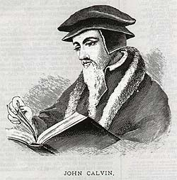
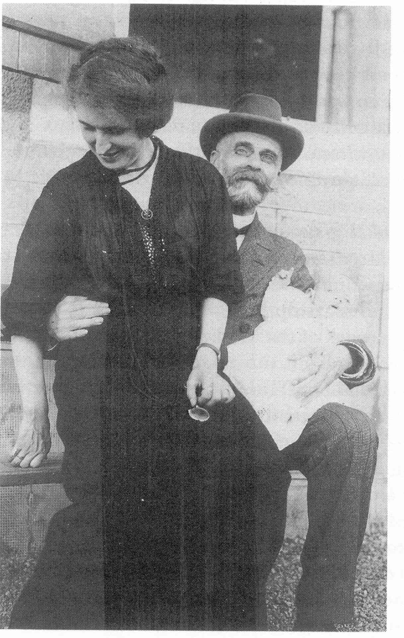
But if “religion” differs, philosophy of religion should, too

Slide 10
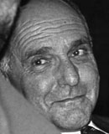
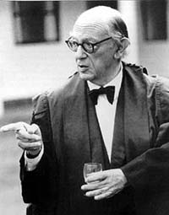
Analytic political philosophy could serve as our model of a new philosophy of religion: viz. Ernest Gellner and Isaiah Berlin

Slide 11
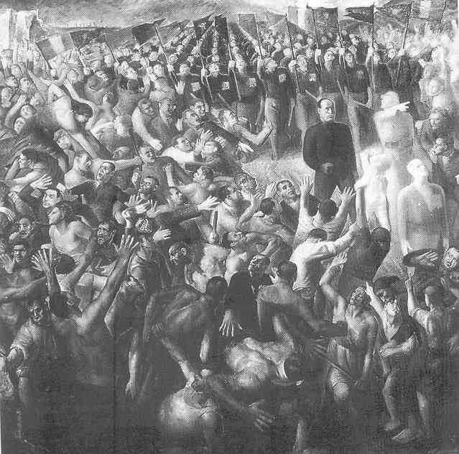
Their kind of political philosophy reflected on toleration, ideology, liberty, equality, diversity, modernity, nationalism, civil society, authority, despotism, power, republics, totalitarianism, servitude, sovereignty -- a “lived” politics -- historically & analytically articulated

Slide 12
What Concept of
“Religion,”
Then?

Slide 13
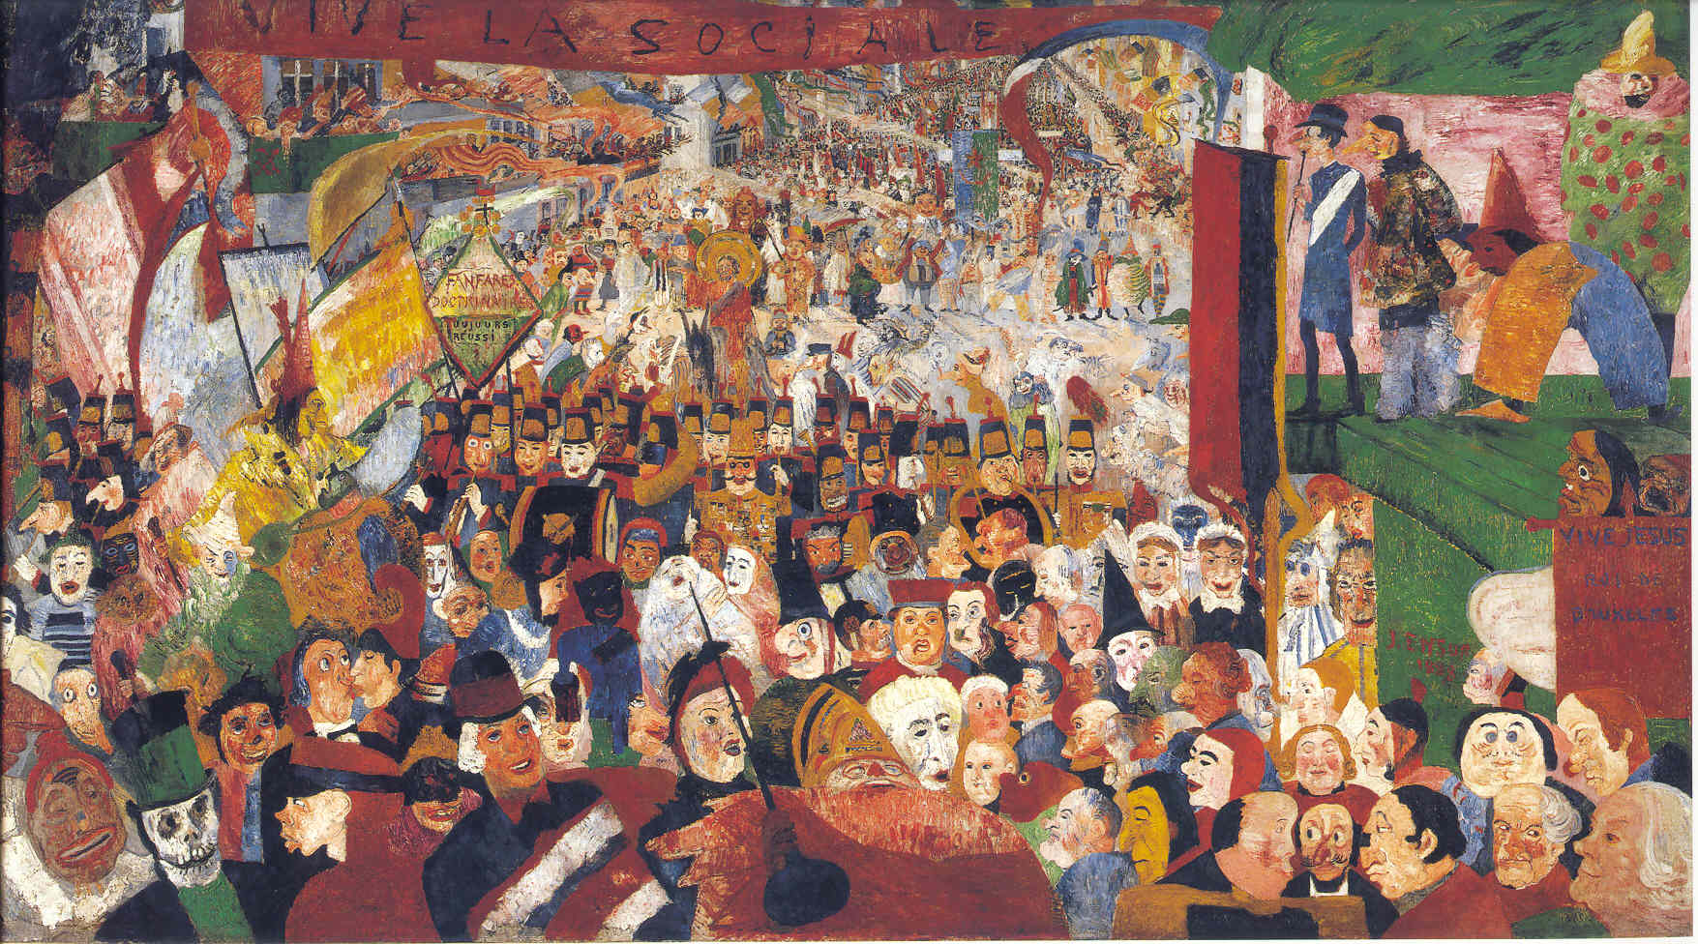
“Lived” Religion

Slide 14
“Religion” as
“the administration of the sacred”
(Durkheim)
An abiding source of energy,
A basis for identity,
Basis of authority, legitimacy, purpose,
A foundation for human flourishing,
Immanent in everyday life,
An environment in time and space.

Slide 15
Religion Is Not, Therefore
about discrete acts of divine intervention;
about existential crises;
about the extraordinary or weird;
even about superhuman beings;

Slide 16
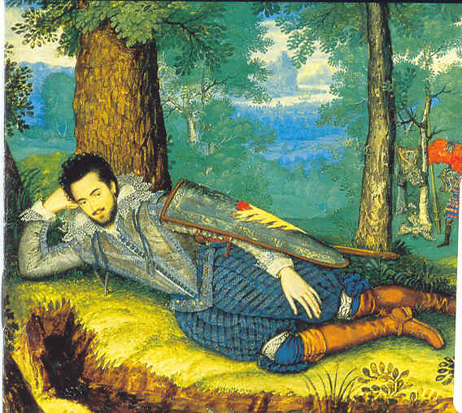
This New Philosophy of
Lived Religion
Would Do What with Religion, Exactly?

Slide 17
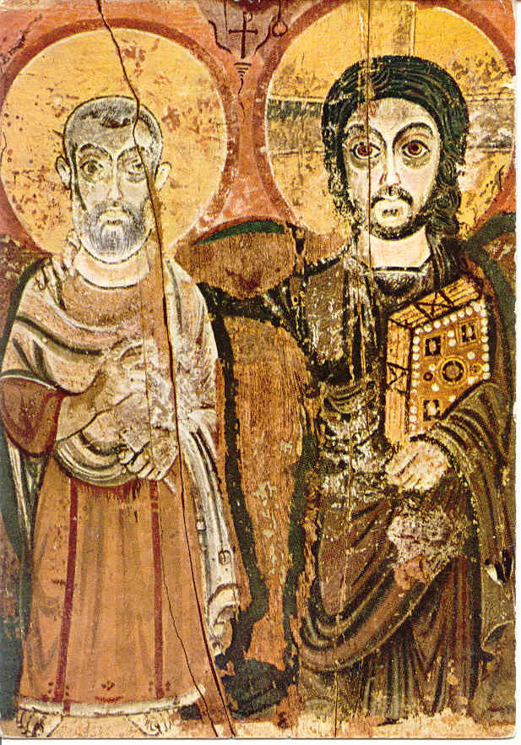
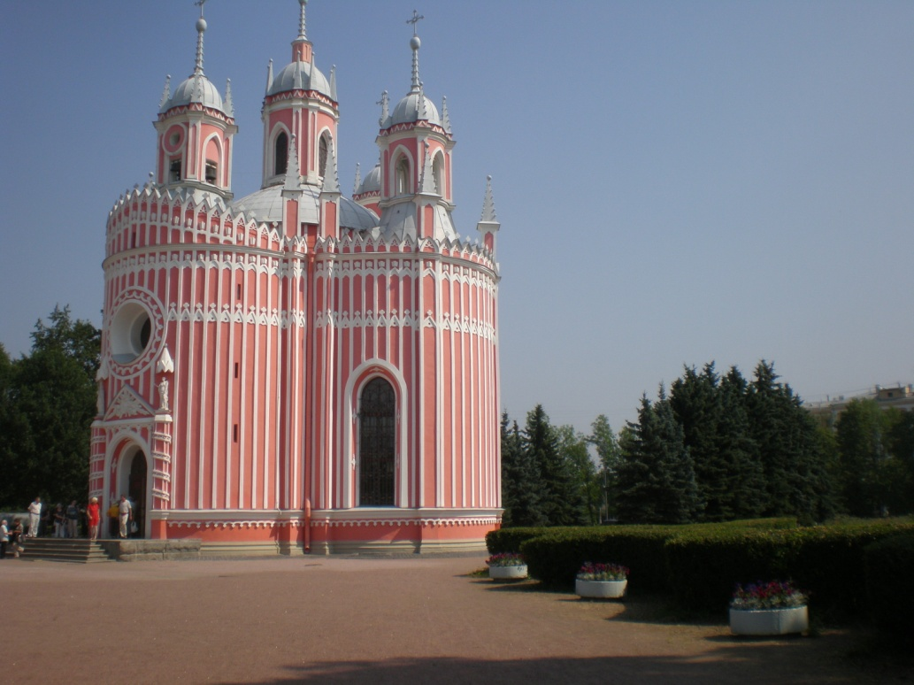
Reflect on the conditions of
Affiliation
Material Culture

Slide 18
For Example….
Affiliation
Material Culture
Is religious affiliation essentially hierarchical?
Must it be authoritarian?
How do rites establish affiliation?
Why are bonds of affiliation formed in religions often stronger than natural ones?
What physical changes would make a particular sacred site more so, or less?
Is there a general or even universal language of sacred space?
Under what conditions does the materiality of religion serve or hinder a religion?

Slide 19
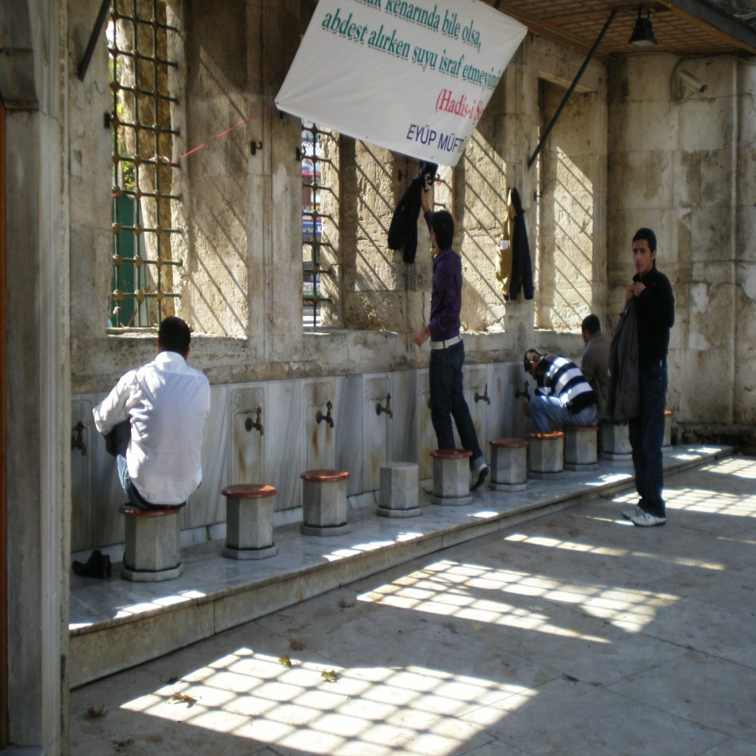
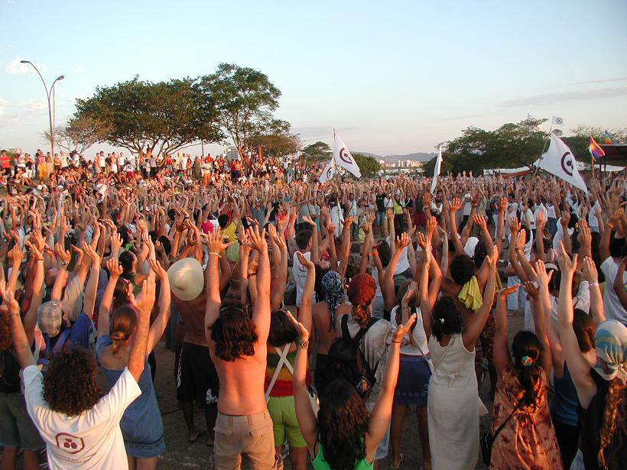
Reflect on the conditions of
Practices
Emotional life

Slide 20
For Example…..
Practices
Emotional life
Is there a sense in which practices are merely external?
To what extent can a regime of religious practices exist in the absence of beliefs?
How do religious practices and moral principles articulate? Can they?
Why are religious music and the emotions so closely linked? And, ‘emotions’ in what sense? Moods?
Do religious emotions have cognitive value?
Is there such a thing as religious emotional intelligence?

Slide 21
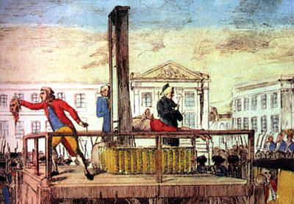
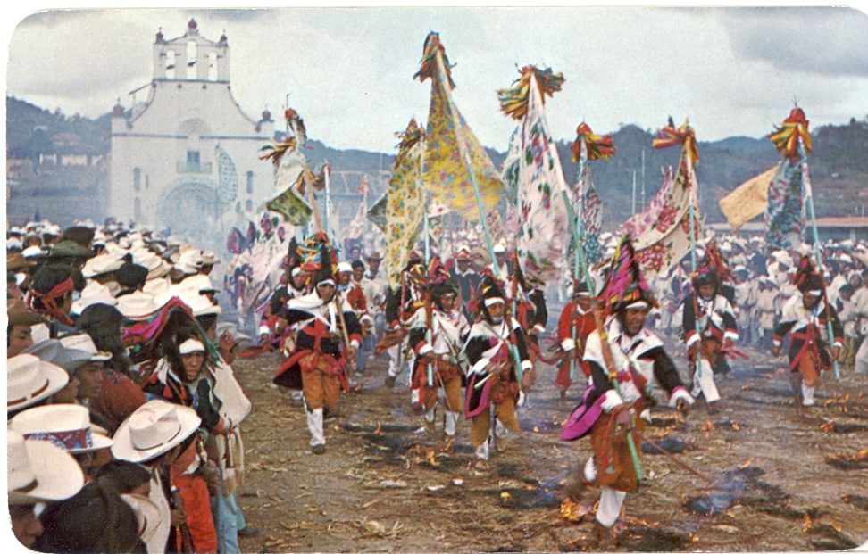
Reflect on the conditions of
Bodies
Cultures
Communities

Slide 22
For Example….
Bodies
Cultures
Communities
C
Male or female, Race: How do they make a difference?
Age, Virility, Nubility: How do they make a difference?
Whole or parts: what matters most?
Fundamental biology: its role, if any?
Can there be ‘society ‘ without sacrifice?
What are the minimum conditions for speaking of a religious culture or society?
Why do men rule?
Why is the Buddhist Sangha the longest lived voluntary community in the world?

Slide 23
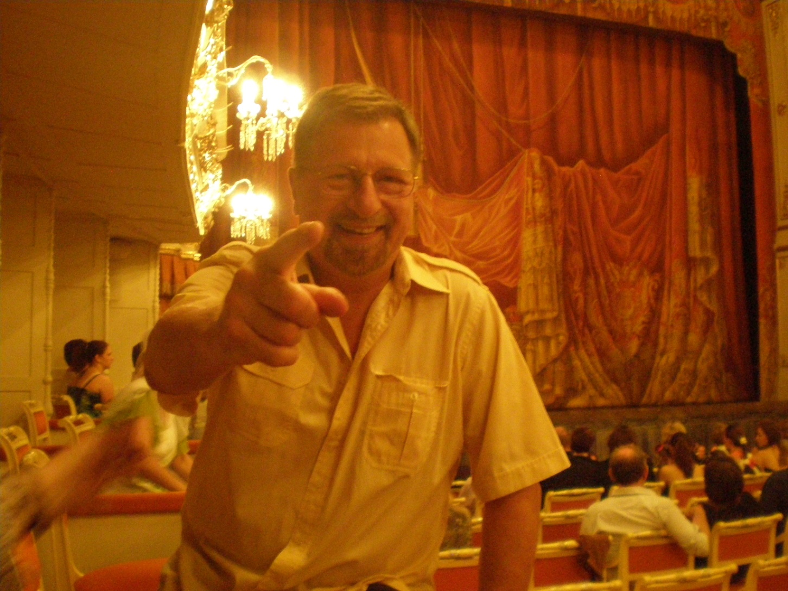
One More Thing ….

Slide 24
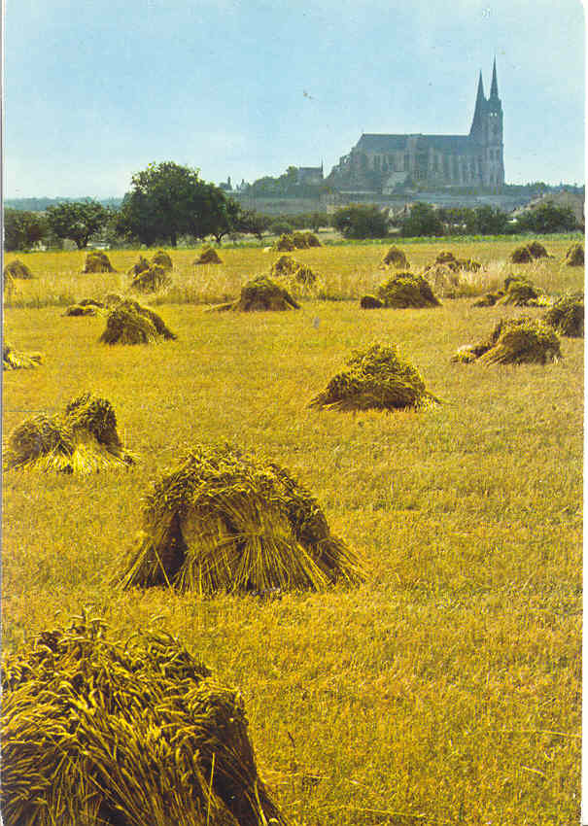
Is This Just Pre-Modern Religion?

Slide 25
Or, Is It Post-Post-Modern?

Slide 26
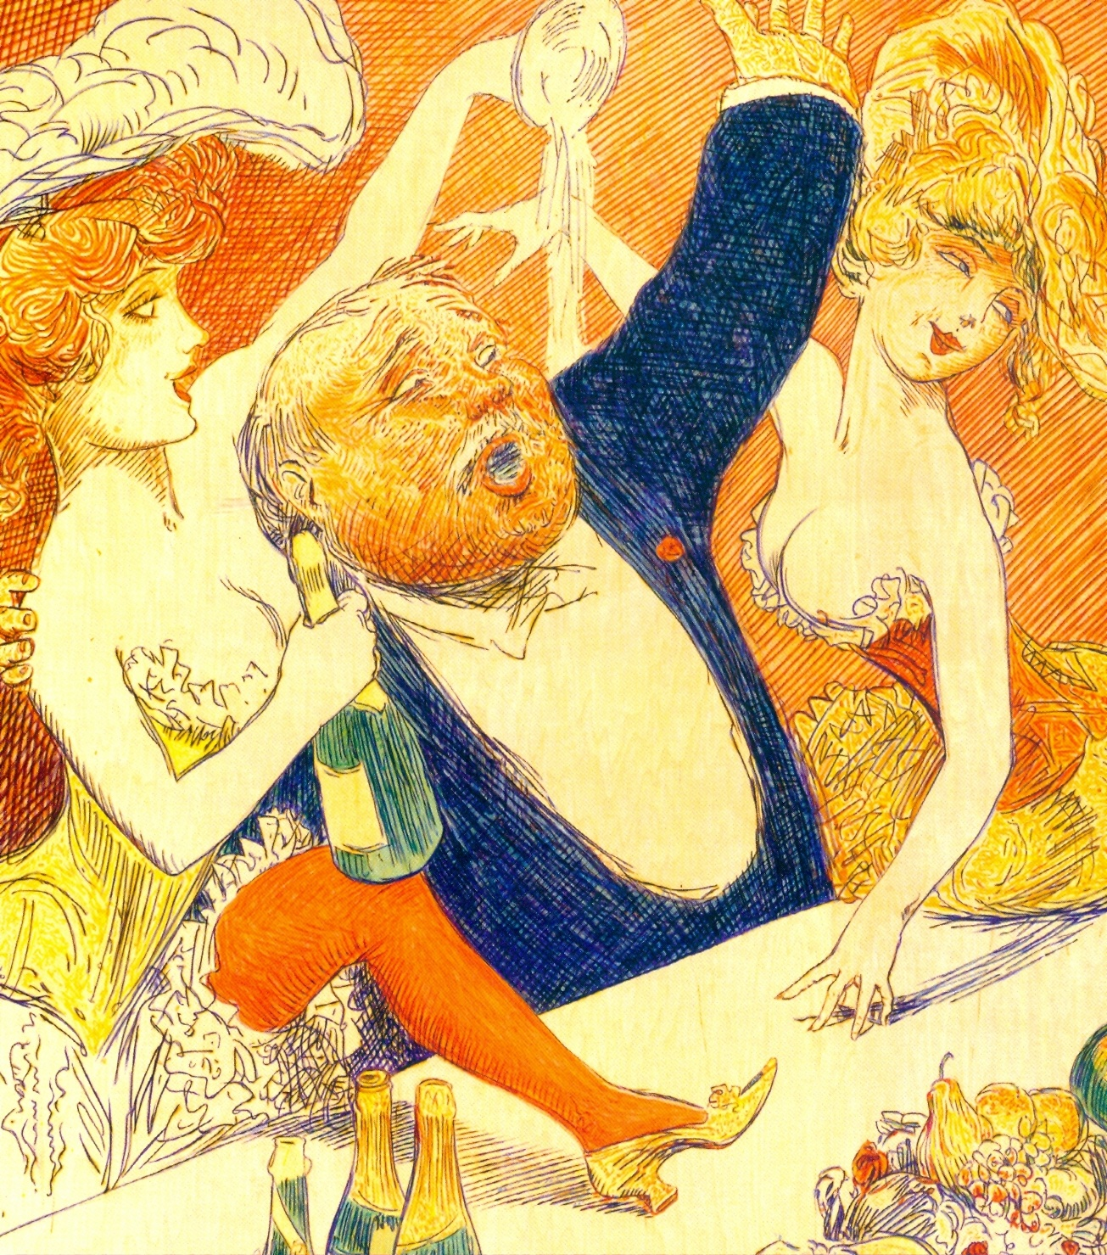
Have I Given Up On Philosophy?

Slide 27
Maybe

Slide 28
But, Not Very Likely

Slide 29
Congenial Ideas for
Future Thinking, #1
“It is no use walking anywhere to preach unless our walking is our preaching.”

Slide 30
Congenial Ideas for
Future Thinking, #2
“Preach the Gospel at all times, and when necessary use words.”

Slide 31
Francis of Assisi
(1181-1226)
FinisFinis

