Slide 1
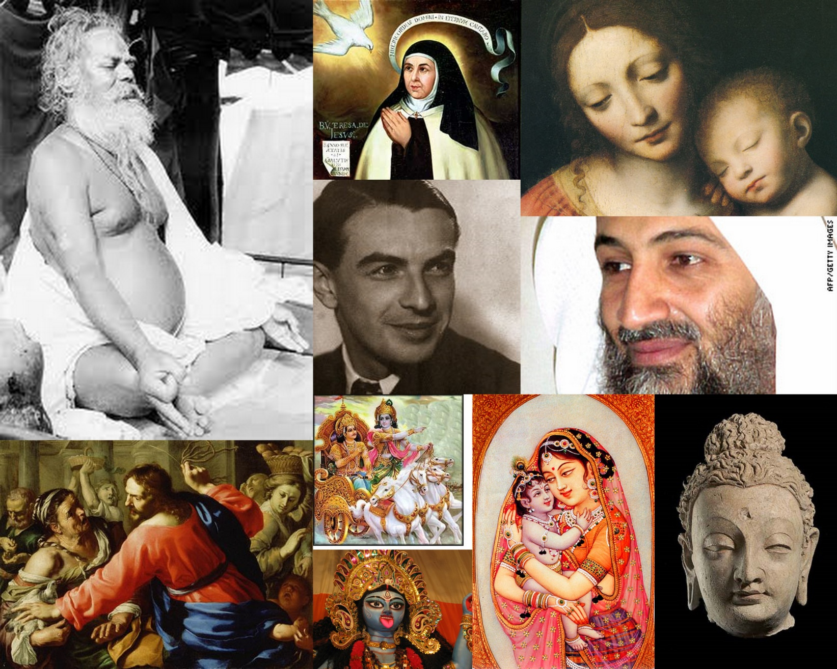
Thinking about Tabu &Sacred

Slide 2
What Is the Sacred or Holy?

Slide 3
People Have Proposed Many Definitions

Slide 4
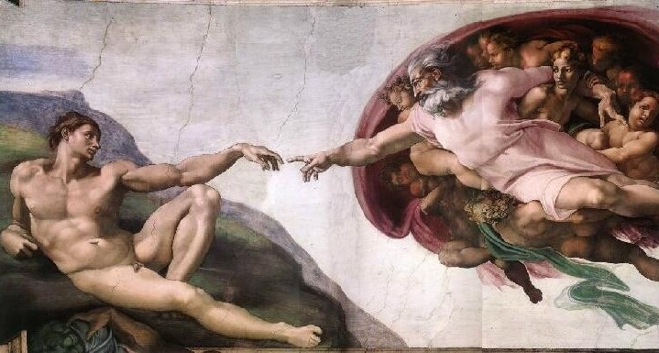
Holy = What Belongs to God
(But, how can we tell what that is?)

Slide 5
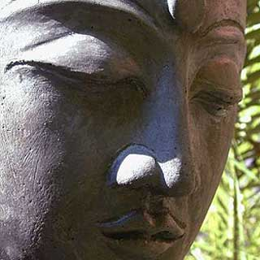

Holy = Also What Suggests Mokşa
(everthing?)
Not Just
Excellence of Mind
But, Our Everyday
Focused Mental States, too

Slide 6
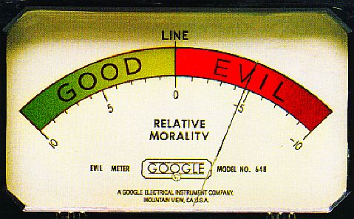
Holiness = “Completely Good”
(But, is religion just morality?)

Slide 7
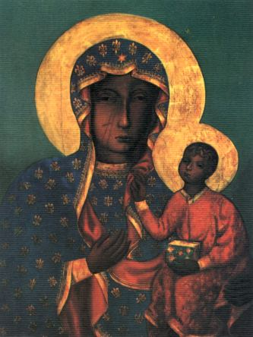
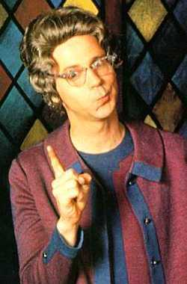
The Holy = the “Numinous” (Otto)
( ≠ the “completely good”)
Church Lady:
“Completely Good”
Our Lady of Częstahowa: Numinous

Slide 8
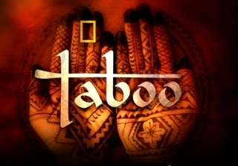
At Least, Holy & Tabu Are Separate
(says who?)

Slide 9
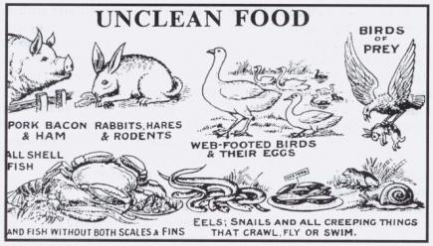
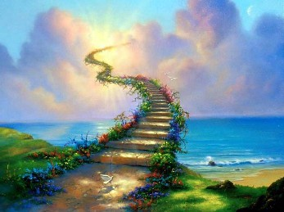
So Robertson Smith Thinks….
Taboo = Material, Fixed
(“Primitive”)
Holy = Spiritual, Free
(“Modern”)

Slide 10
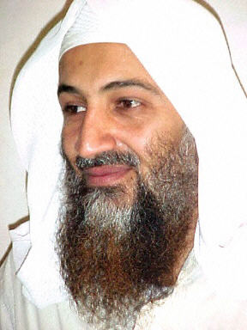
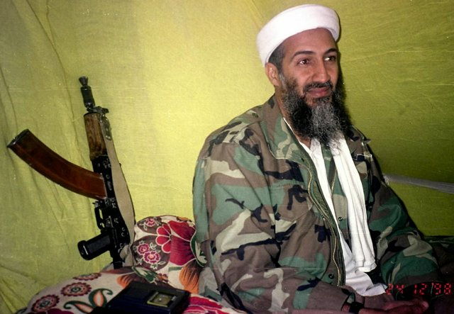
But, Are Tabu & Sacred Separate?
Murderer, and/or…
Martyr, too?

Slide 11
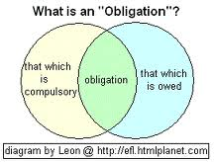
Whatever Else May Be True,
The Sacred → Obligation
(Kind of Negative, eh?)

Slide 12

But, Durkheim First Thought
The Sacred Was Mostly @ Obligation

Slide 13
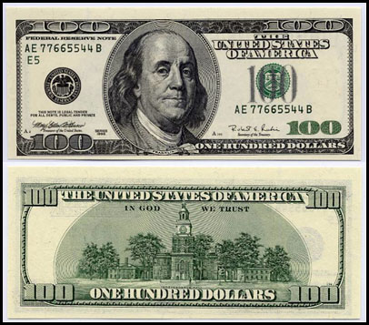
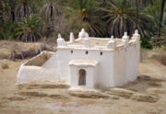
Durkheim (& Eliade’s)
Minimal (and “Formal”) Definition:
Sacred = Whatever Is Not Profane
$$$ = Profane or Unholy
Such as, “Filthy Lucre”
Shrines of Marabout =
Sacred or Holy

Slide 14
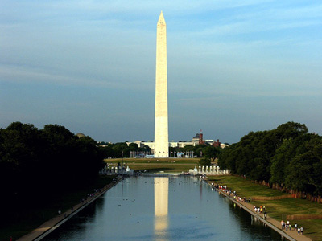
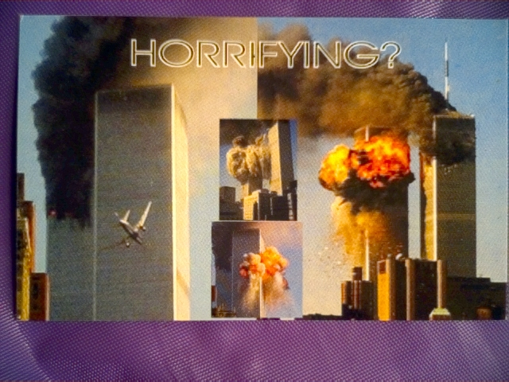
Durkheim’s Theory of Sacred Space
National Heart-break
National Heart

Slide 15
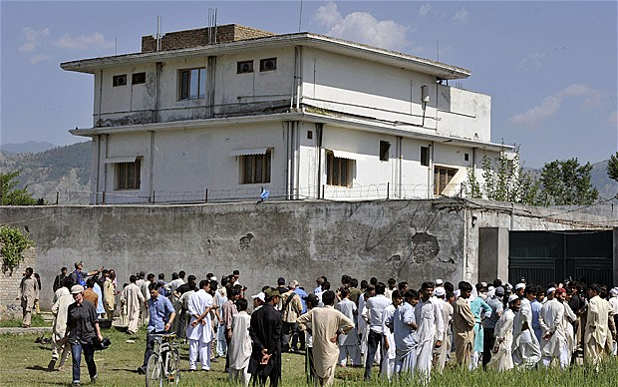
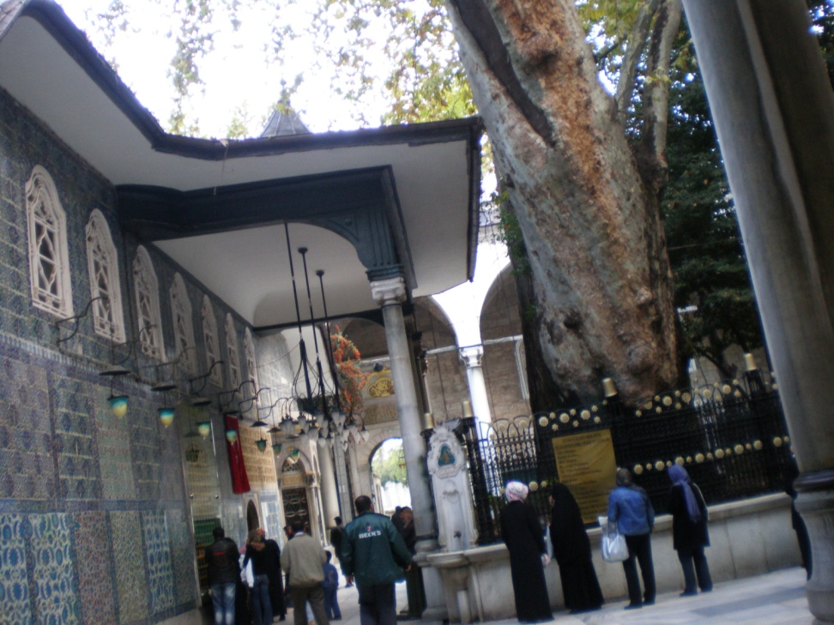
Durkheim: Matter Matters
Will UBL’s Abbottabad Villa Become a Shrine?
As Eyub Sultan Cami
Already Is?
(Istanbul)

Slide 16

That’s Why UBL’s Burial at Sea?

Slide 17
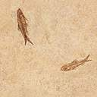
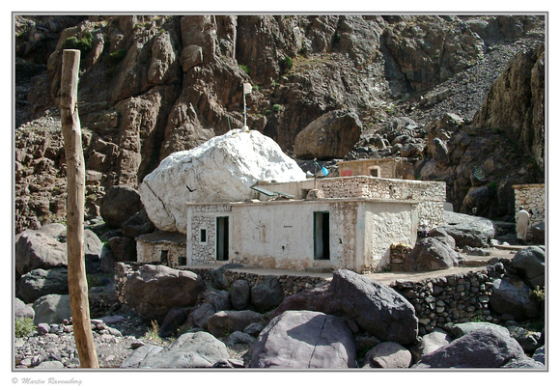
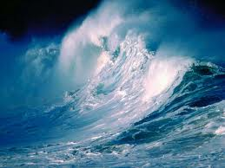
Shrines Are Places, Not Just Spaces
Some Place→ Some Shrine
No Place→ No Shrine

Slide 18
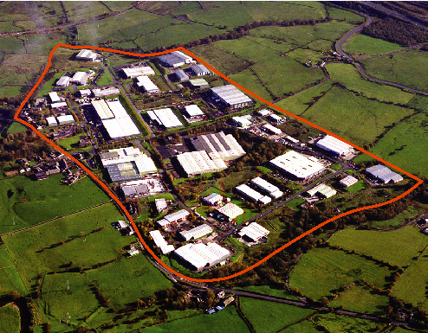
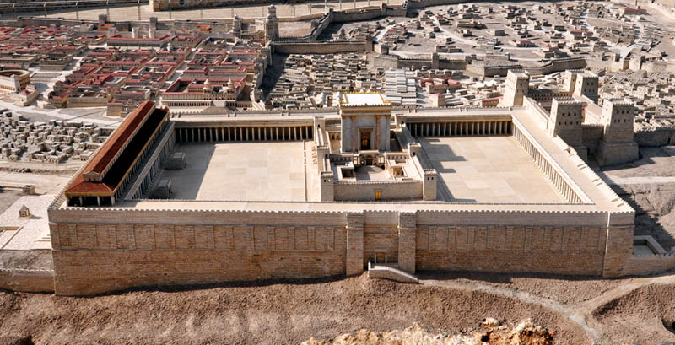
Thus, Places & Shrines Are Bounded:
The Sacred Is about Setting Boundaries
Between ‘Us’ & ‘Others’
Between Sacred & Profane
Between the Holy of Holies
&
The (Profane) World

Slide 19
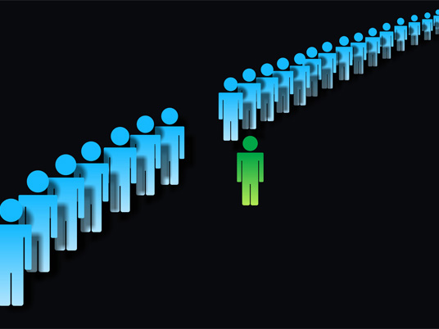
The Sacred Tells Us Who We Are
by setting personal boundaries

Slide 20
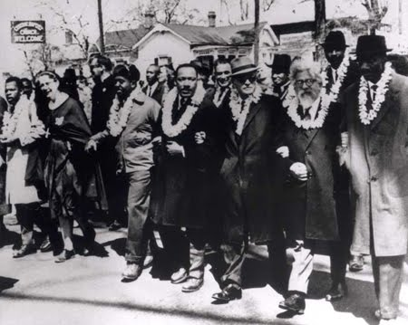
The Sacred Also Tells Us Who We Are
By binding us together in community

Slide 21
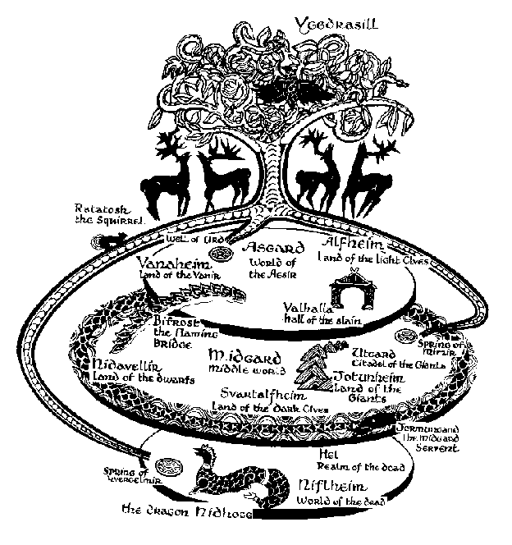
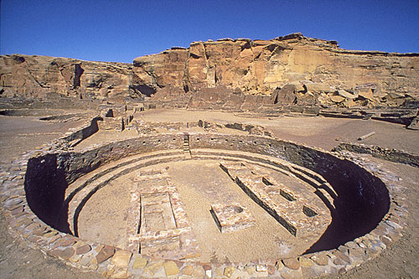
Eliade’s Theory of Sacred Space
Reality Arises Out of the “Center”
“Archaic” Center: “World Tree”
The “Great Kiva”
Navajo “Center”

Slide 22
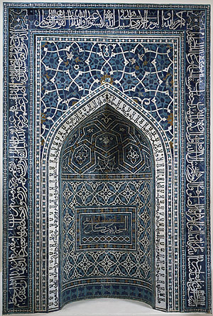
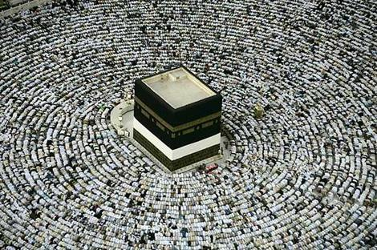
The Center in Islam
Mirab: points the way
To the Ka’aba in Mecca

Slide 23
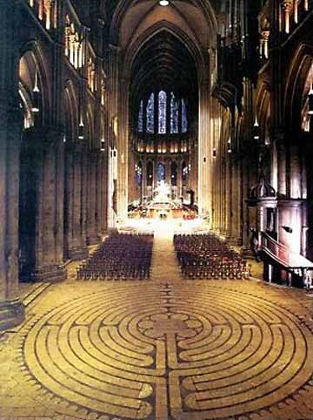
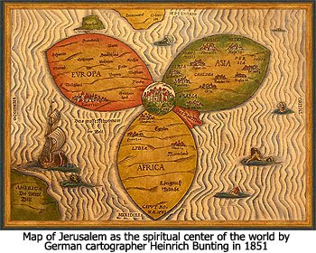
In Christianity
Chartres Cathedral = Pilgrim’s Center
Imitates Jerusalem Archetype
Jerusalem = Center of the World
Imitates Archaic Archetype

Slide 24
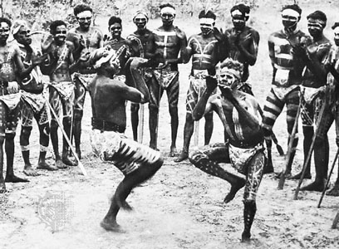
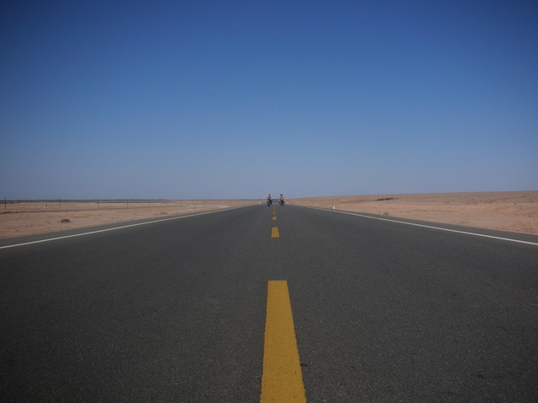
And, Theories of Sacred Time
Australia’s
Recurrent Rituals of Revival
Eliade’s
“Timeless Time”

Slide 25
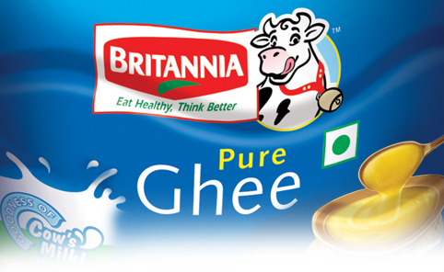
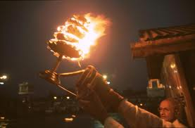
Question:
Sacred vs Profane,
Opposed in Form, But, in Content Too?
Ghee, Profane
Ghee, Sacred….

Slide 26
But, What Content?

Slide 27
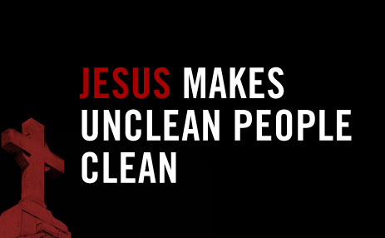
Content: The Holy = The Pure
(But, Is Cleanliness Next to Godliness?)

Slide 28
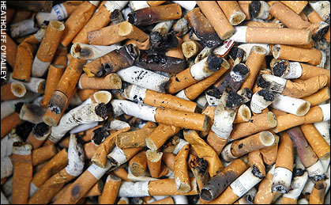
The Profane Is the Impure
(or, Is it?)

Slide 29
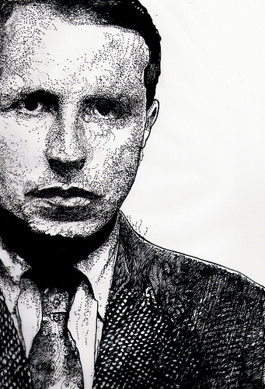
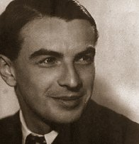
“Mais Non!” Say These 2 Frenchmen:
Sacred as Transgression
Georges Bataille (1897-1956)
Roger Caillois (1913-78)

Slide 30
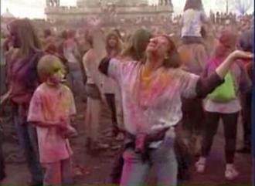
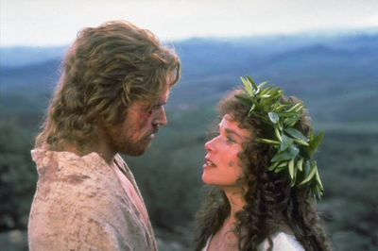
Maybe the Sacred Can Also Be Impure?
Krishna Holi in Utah
The Magdalene Compromise?

Slide 31
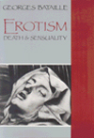
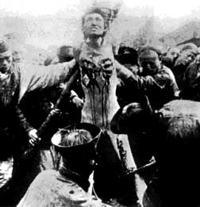
Violation of the Sacred as Sacred
To Destroy Conventional Sacreds?
Or, to Create New Sacreds?

Slide 32
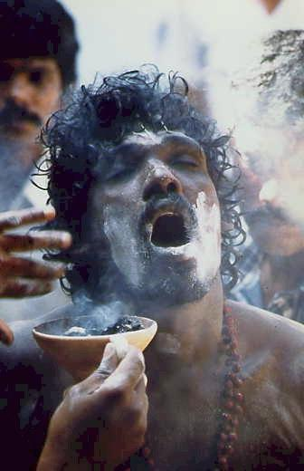
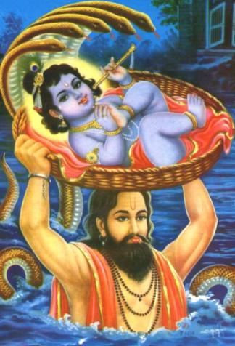
Thus, the Sacred Can Be Both
“Right-Handed”, and…
“Left-Handed”

Slide 33

But, How Far Left Can It Go?

Slide 34
Try This…
Easier To Take

Slide 35
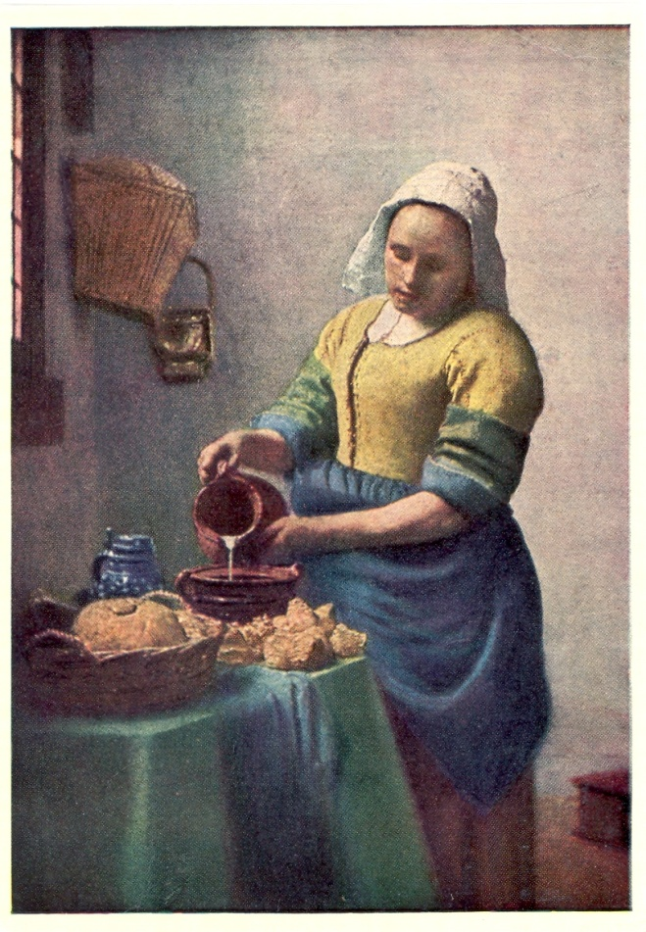
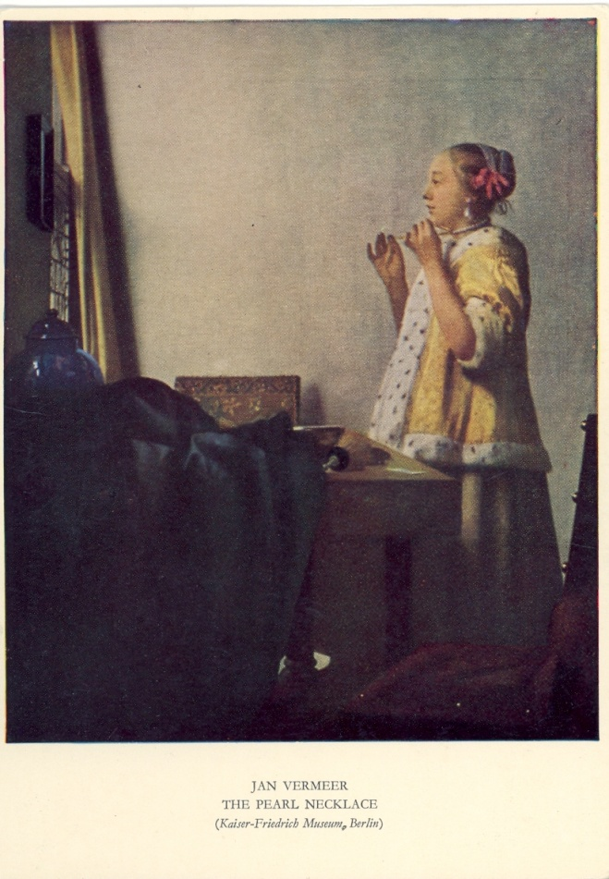
New Sacred = the Non-Utilitarian?
Contrast Utility or Labor to …
Altruism or Pleasure

Slide 36
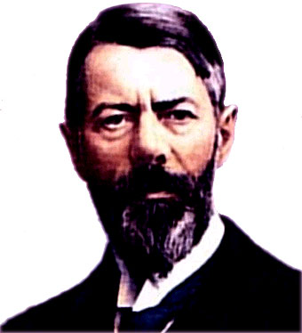
No! to Max Weber and Capitalism

Slide 37
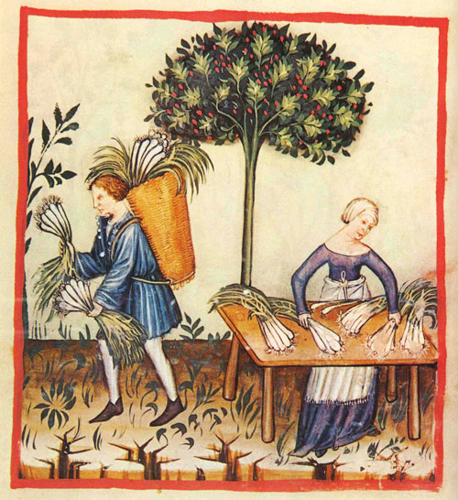
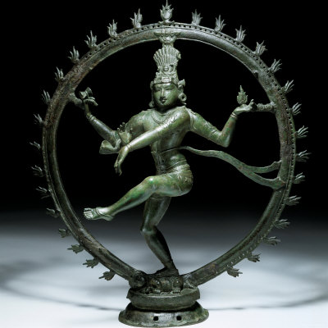
Profane: Use :: Sacred: Altruism
Utility, for a Purpose
(e.g. trade & commerce
Done In & For Itself
(e.g. art, Shiva’s Cosmic Dance)

Slide 38
One More

Slide 39

The Sacred as a Revivifying Force
Created by Ritual

Slide 40

The Sacred as Energy
Unleashed by Collective Ritual Action

Slide 41

That’s All, Folks!

