Slide 1

The Religion in
Globalization
Legitimacy,
Natural Law and Empire

Slide 2
Globalization: What Is It?
universal exchange
or
communication of…

Slide 3
Exchange & communication of
Goods,
services,
People,
information,
Capital,
Fashion,
Languages,
cultures , etc.
across boarders,
into territories of others,
without limit

Slide 4


Slide 5
Beyer tells us to “get real”
For Beyer,
technology & practice are critical:
“potential for worldwide communication”
“translated into actual practice”

Slide 6
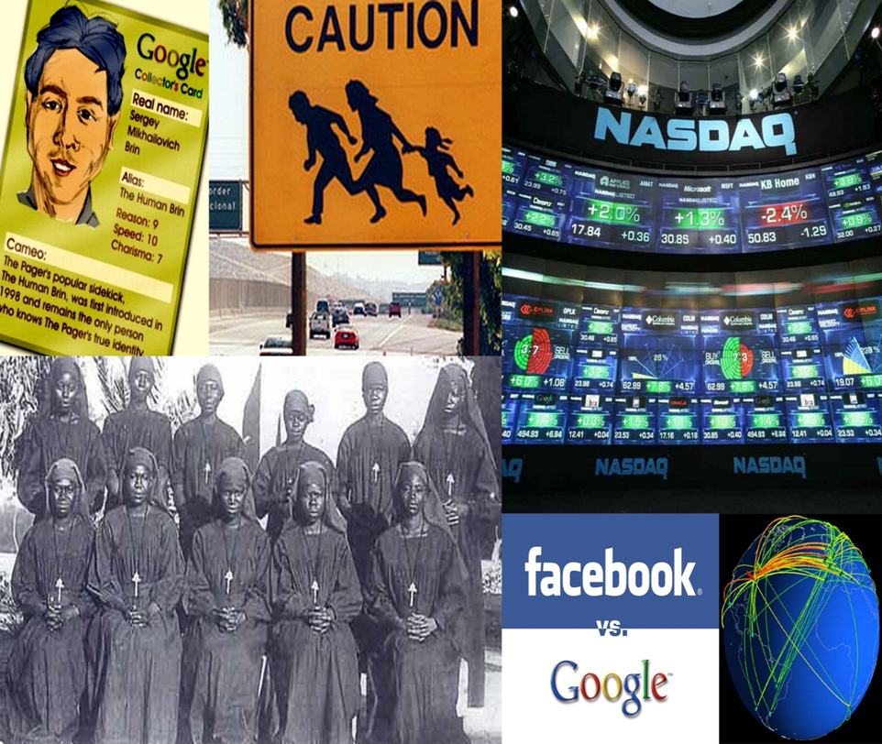
Like this….

Slide 7
So,
How Did Globalization Happen?

Slide 8
Is Globalization “Natural”?
I mean…

Slide 9
#1. Have we, humans, always sought to communicate widely with each other, moved about globally, traded with each other, invaded other territories from the very beginning ?

Slide 10
Or, #2, have we preferred, or been required, to live in relatively isolated, self-sustaining groups, inside our own territories?

Slide 11
Put otherwise, #3, have we always sought, or had to be, in the widest possible communication with others?

Slide 12
Or, #4, have we preferred
NOT to be, or been UNable to extend and perfect, universal communication with one another ?

Slide 13
Answer
All of the above

Slide 14
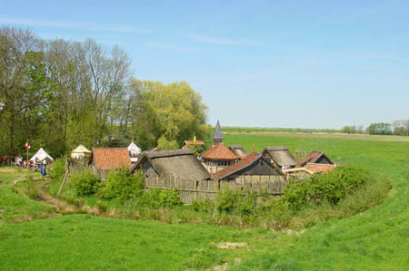
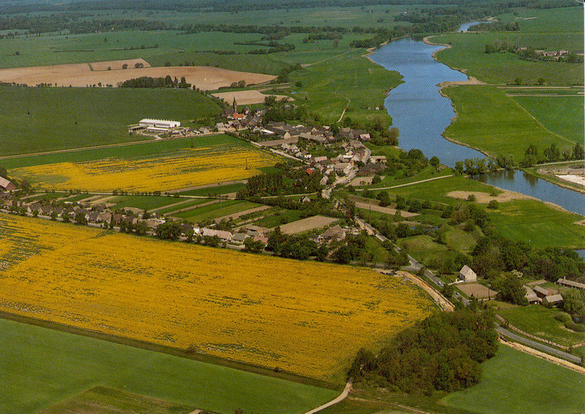
Much of human history has been lived in small, isolated communities

Slide 15
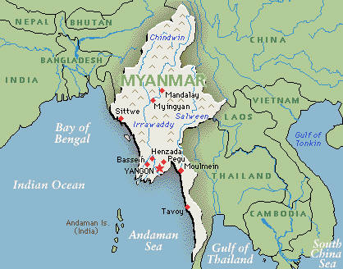
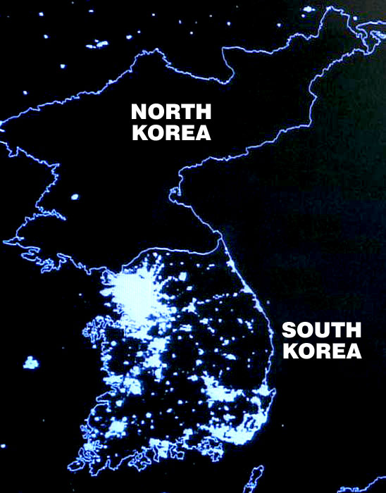
Or, Today’s “Hermit” States
People’s Republic of Korea
Myanmar

Slide 16
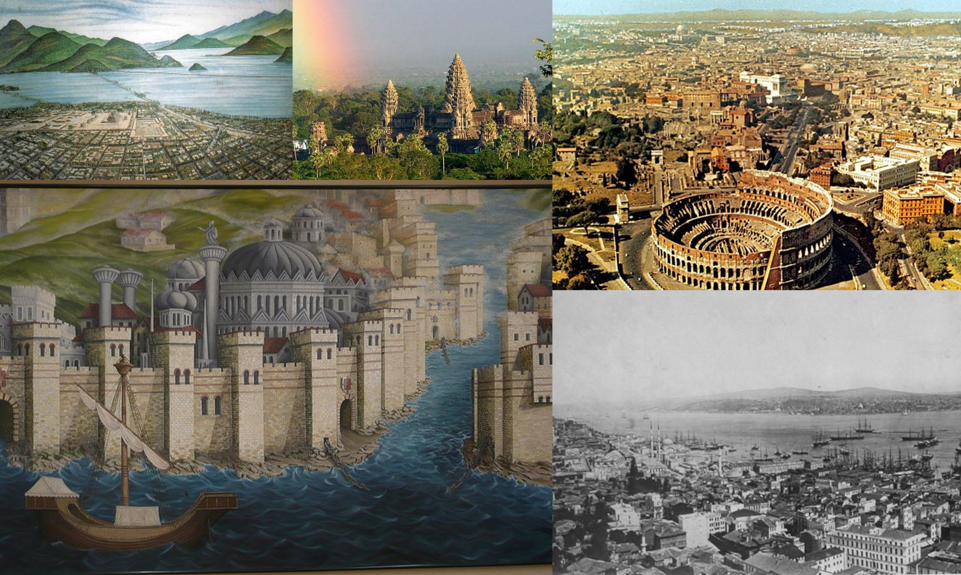
Human history has also been lived in cosmopolitan cities,too.

Slide 17
But, How Did Cities and Villages Get There,
Rather than Elsewhere?
We Were Global
From the Beginning

Slide 18
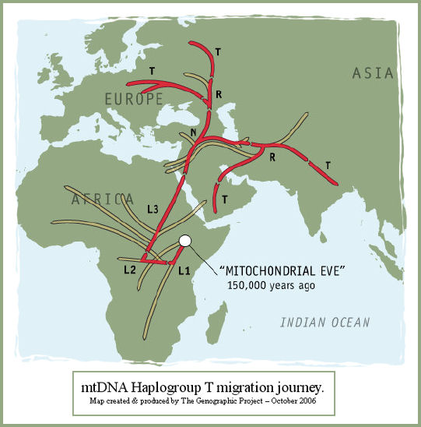
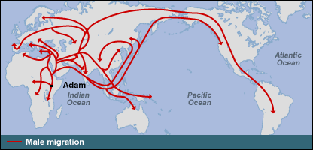
Out of Africa, & Going Global
“Eve” 150,00 years ago
“Adam” 10, 000 years ago

Slide 19
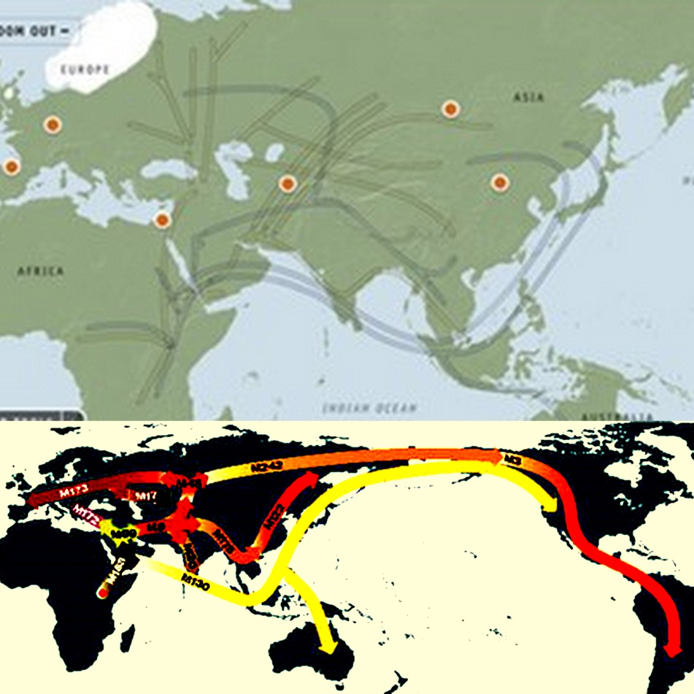
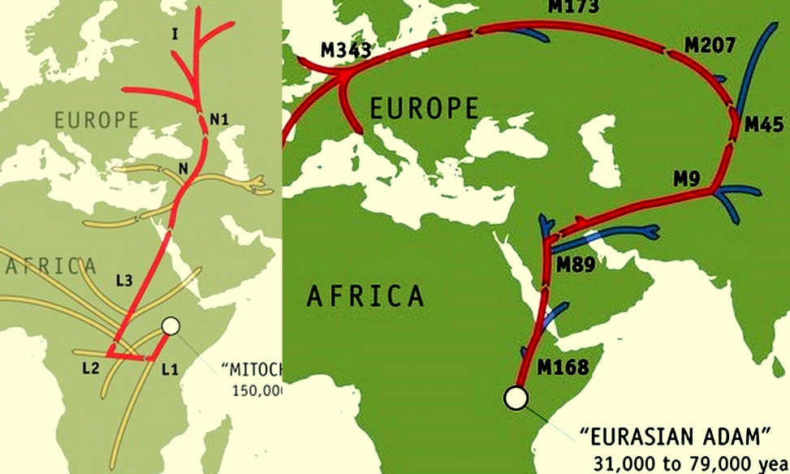
how we got here from there…
all over the map
To Svetlogorsk
150k – 31k years ago

Slide 20
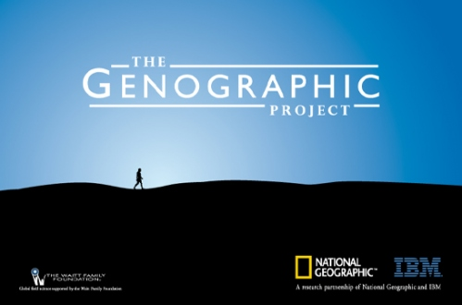
www.nationalgeographic.com/genographic

Slide 21
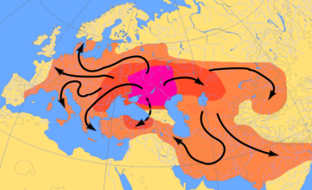
Globalization, Indo-European Style
3,000 BCE
(from Novocherkassk?!)

Slide 22
How Were Such Movements Justified?
(Aren’t They Incursions or Invasions?)
“African Genesis”
Is Really an
African “Incursion”?
No Idea. We Must Guess
????????????
Maybe, we had just “space” but no “places”?
“Novochercasskian Genesis”
Is Really an
Aryan “Invasion”
Hard to Answer, Too.
???????????????
Another Guess?
Maybe, we were not so tribal?

Slide 23
Review #1
There was an ancient globalization, yes
But, there was minimal communication in “actual practice.”
Therefore, no globalization in “actual practice”
Communication is minimal for two reasons:
  Humanity is spread thinly across the globe
  Appropriate communication technology does not exist

Slide 24
Therefore….
Two Theses

Slide 25
Thesis 1:
First, we globalized; then, we territorialized

Slide 26
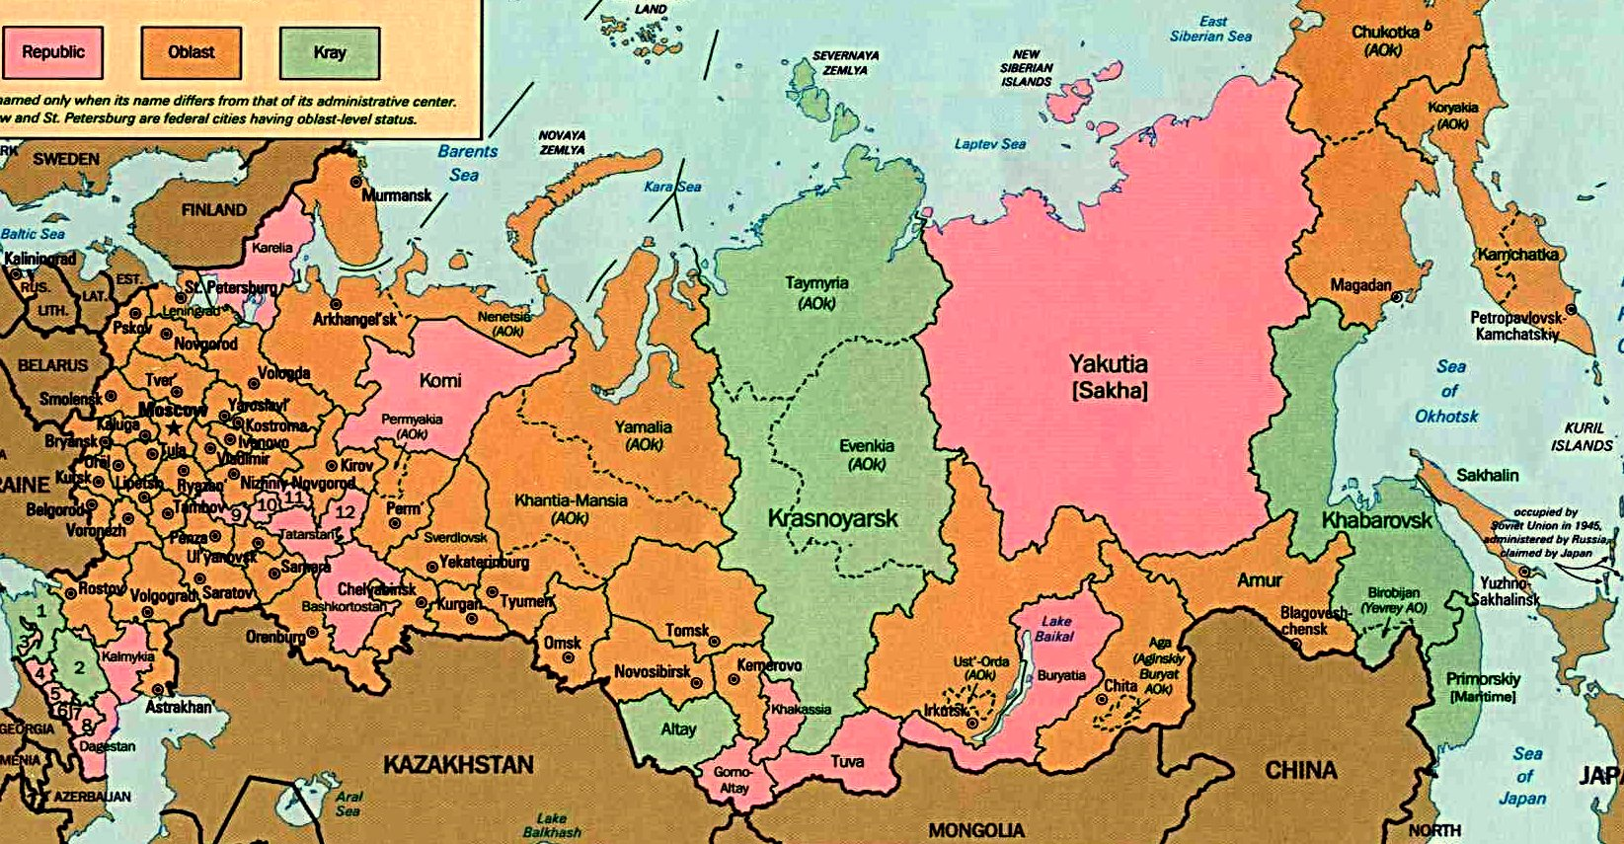
“Space” Became “Place”
Our “Place”: The “Nationalities

Slide 27
Thesis 2:
First, we globalized; then, we tribalized

Slide 28
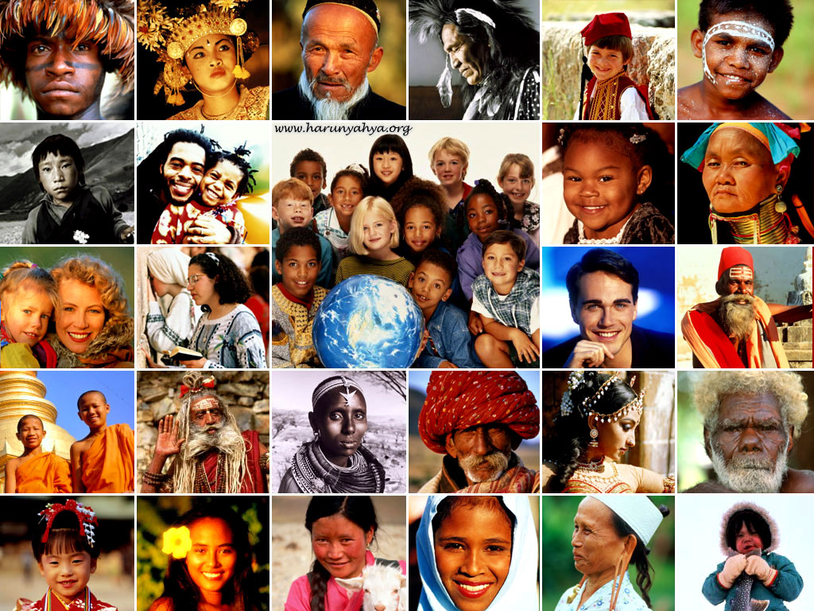
“Ourselves” vs “Others”, “Us” vs “Them”
Our People, Our Tribe, Our Race

Slide 29
Just One little Problem….
Bottom Line:
Minimal communication between “places”
means no (serious) globalization
Humanity precipitated out into
realms of difference

Slide 30
Review #2:
We do know more about recent globalizations

Slide 31
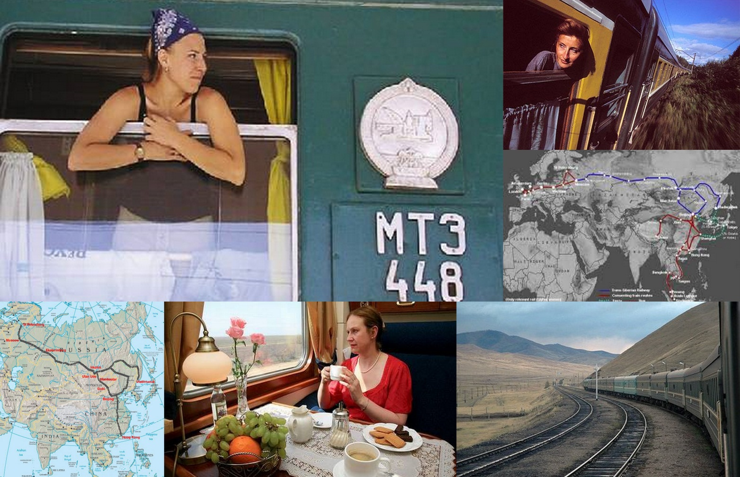
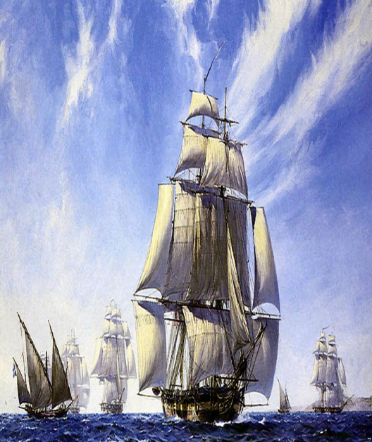
Again, Communication = the key

Slide 32
And…
we know a great deal
about
how these recent globalizations
were justified by
religion.

Slide 33
The Story
We know how globalization
came about
by means of
communicating
political, economic & cultural systems

Slide 34
that is, by colonialism and empire

Slide 35
Second, we know how globalization was seen as legitimate, even obligatory

Slide 36
in large part because of
Religion

Slide 37
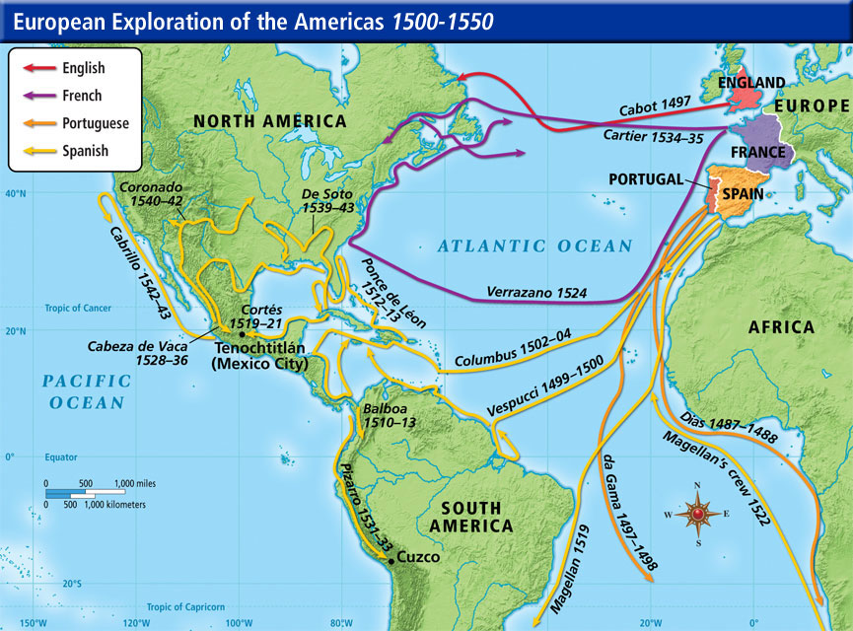
1500’s:
“Actual”Globalization Begins:
The Colonial Age

Slide 38
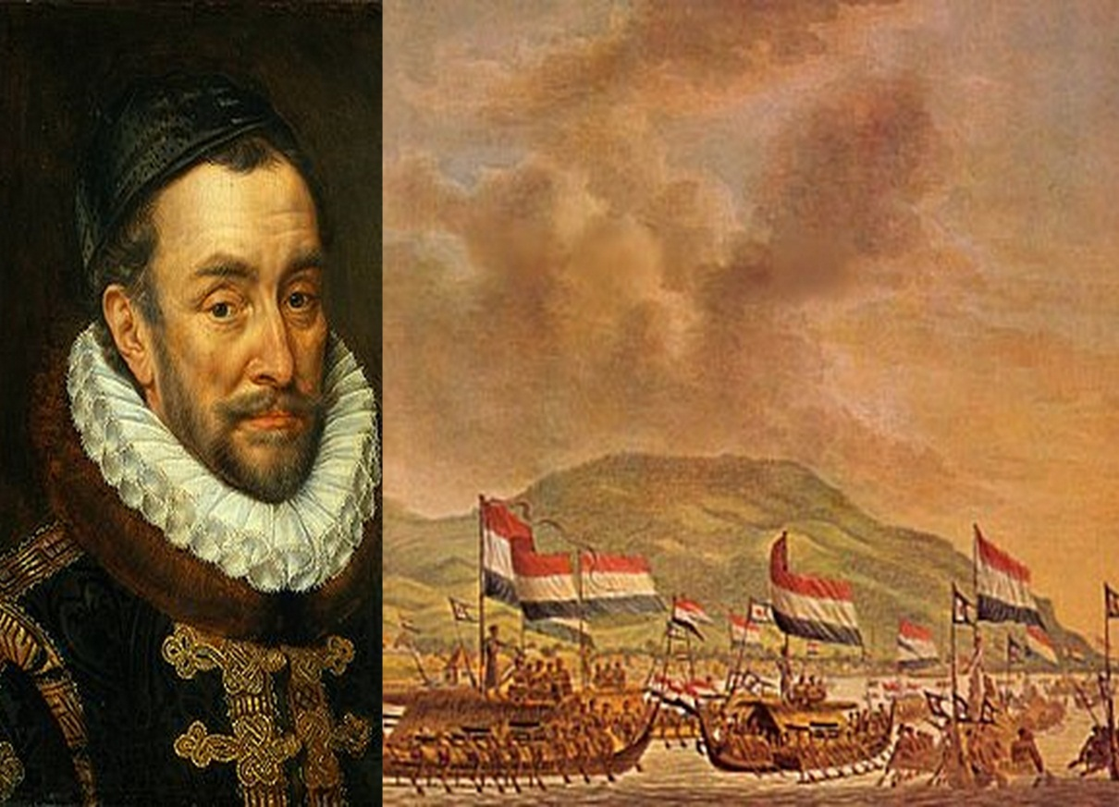
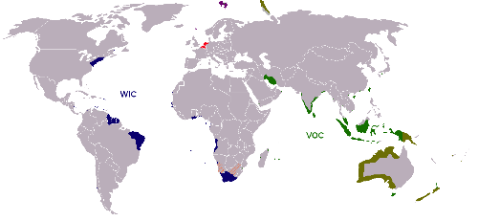
The Netherlands
Willem of Orange
Sea Power
17th C. “Golden Age” of Empire

Slide 39
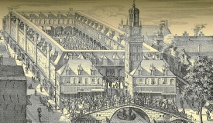
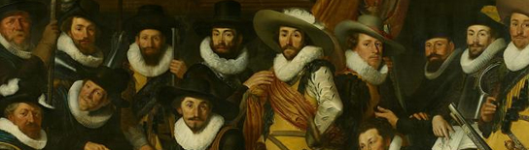
17th C. Amsterdam
1602:
1st Stock Market
Globalized
Citizenry

Slide 40
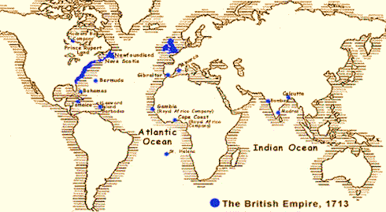
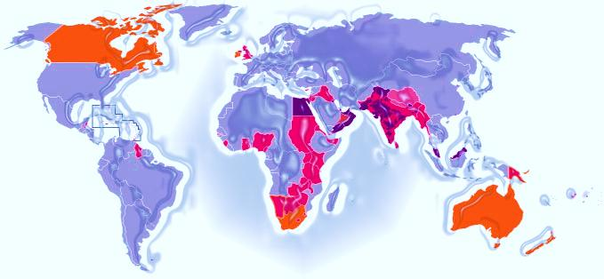
The British Were Different:
Empire, Yes…
First British Empire: 1713
The ‘Last’ British Empire: 1930

Slide 41

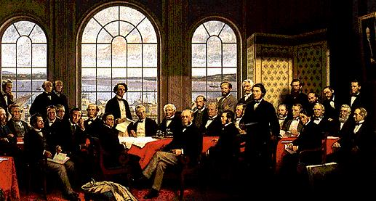
Thus, Commerce Reigns
Canadian
Operations
“Fathers” of “The Bay”

Slide 42
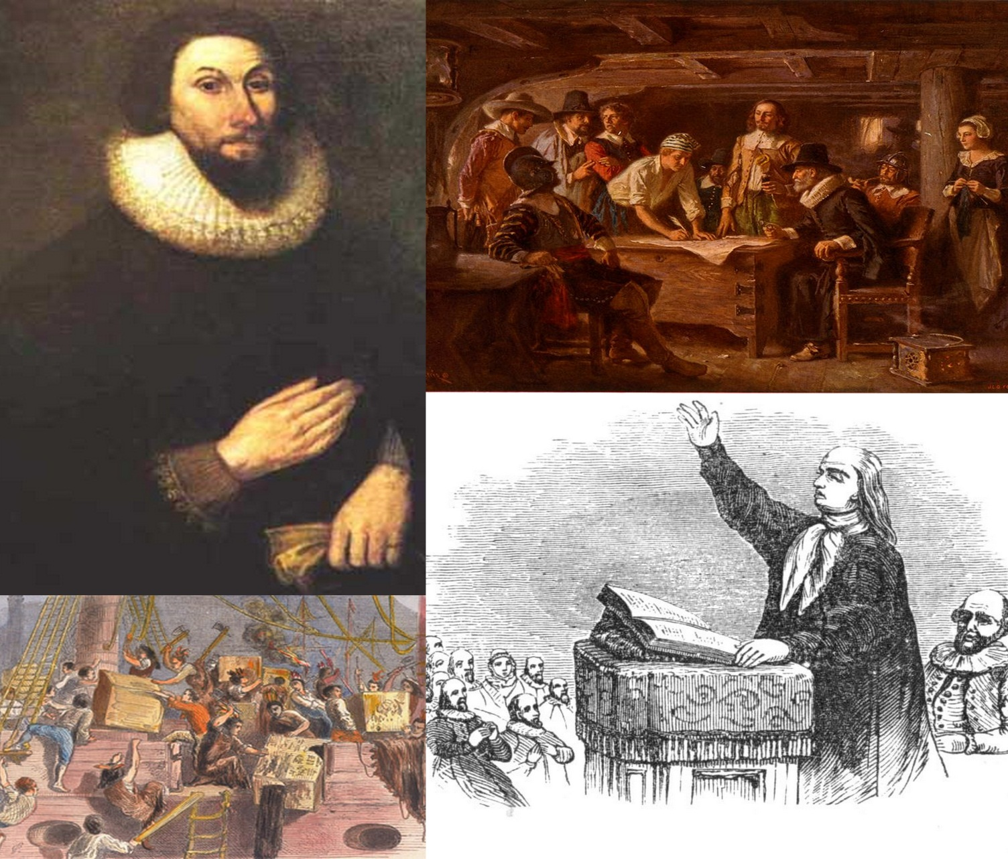
But Also, Religion Rules e.g., in Massachusetts Bay Colony 1624

Slide 43
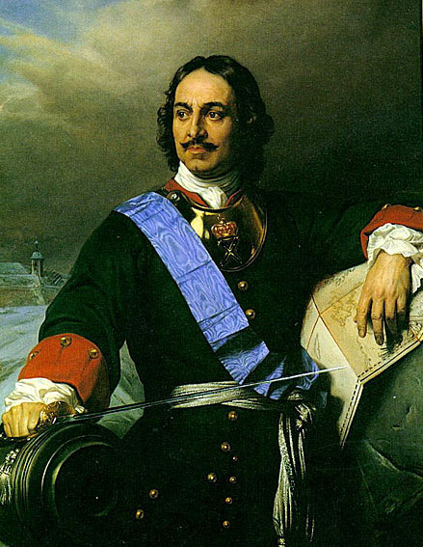
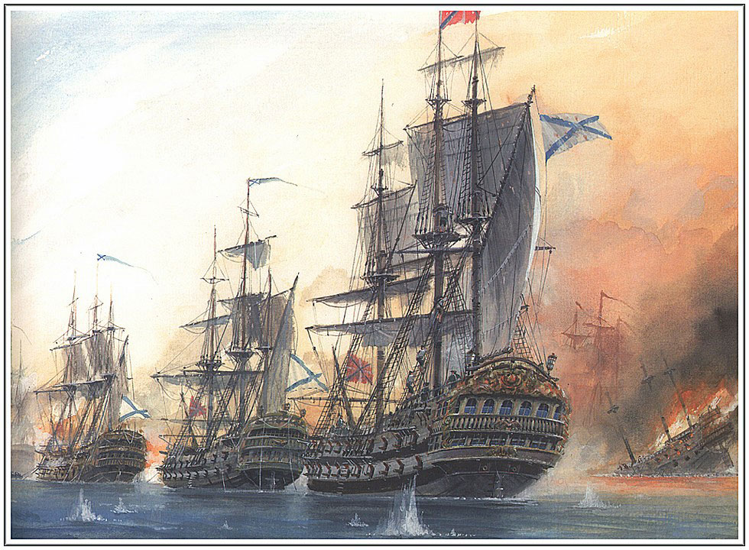
Российская Империя
1721 - 1917
He Learned Dutch
Communication by
Sea Power & Commerce

Slide 44
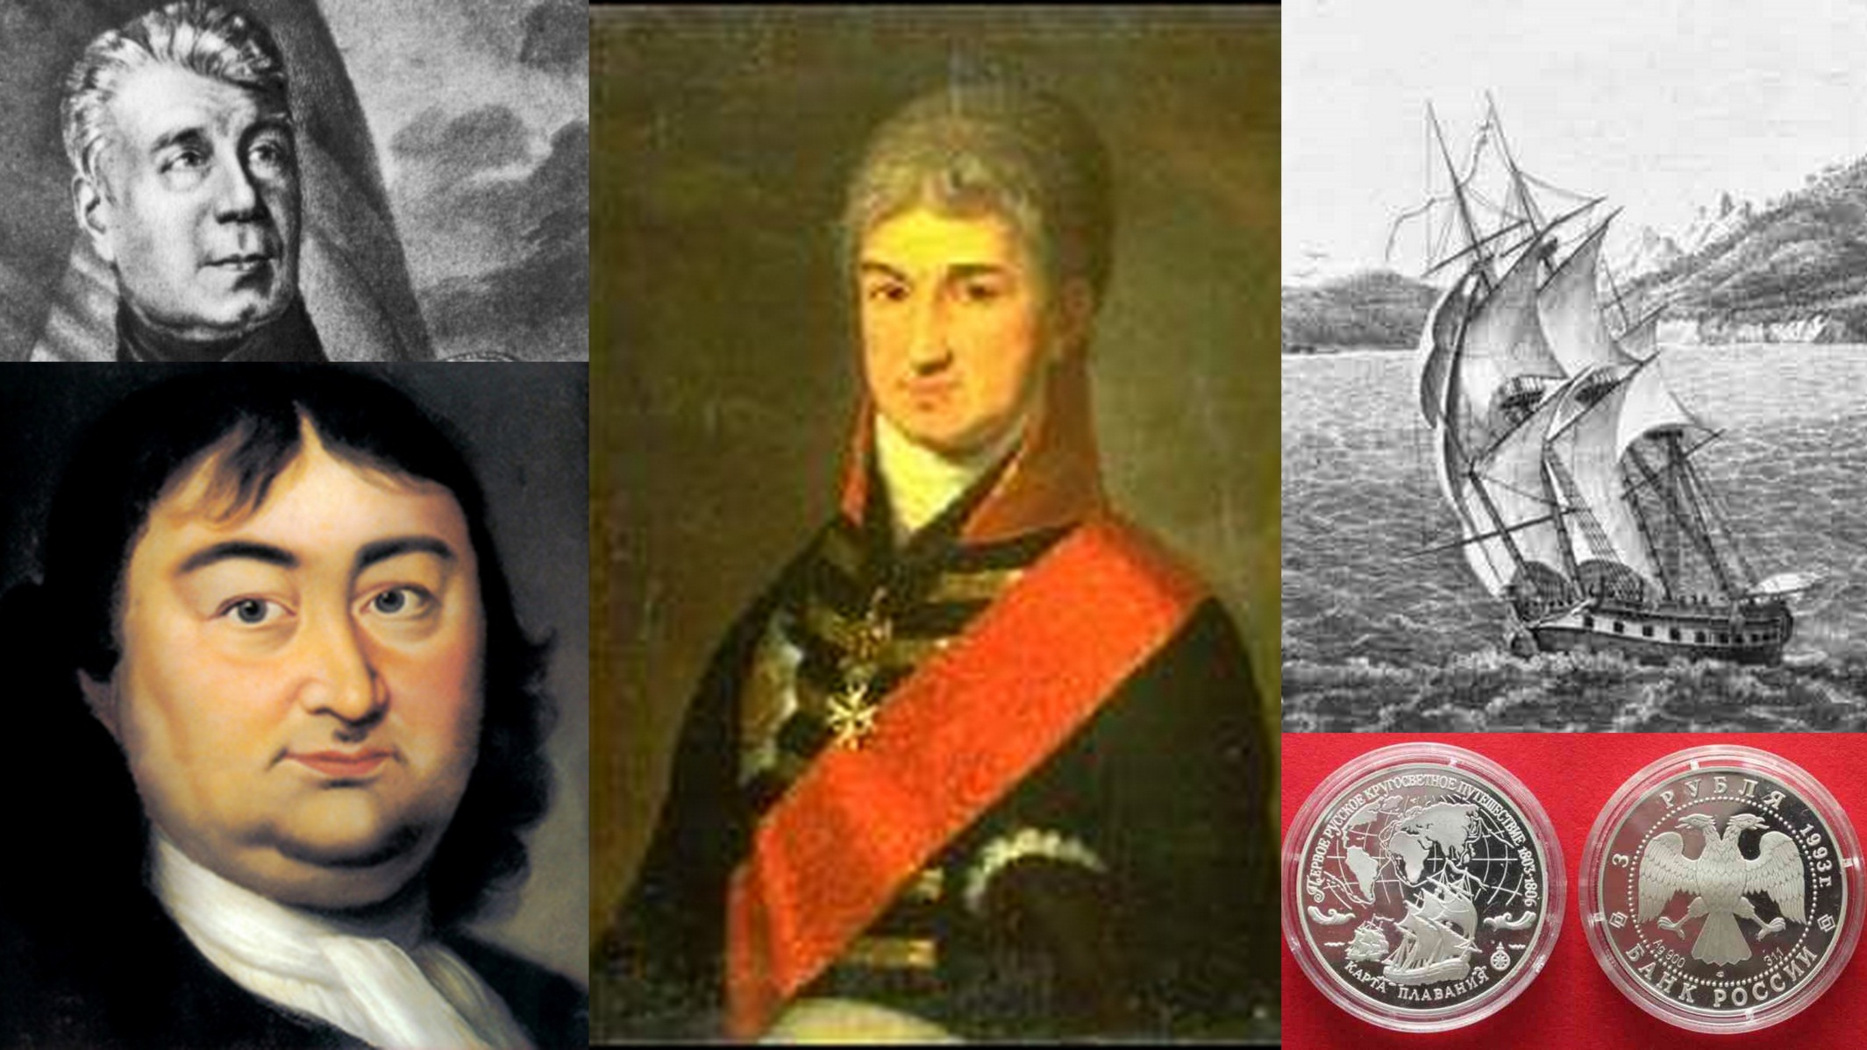
Russia’s Globalizers

Slide 45
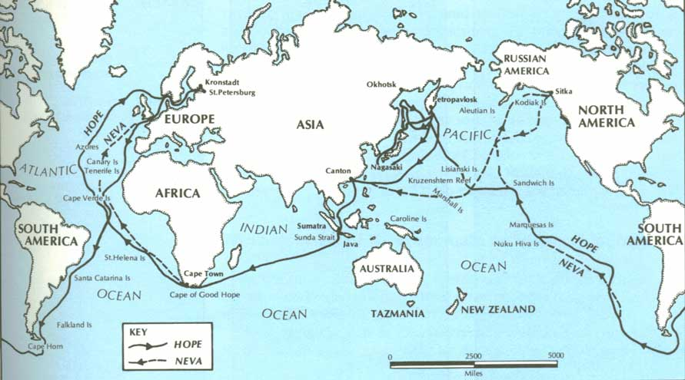
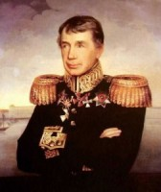
Worldwide Ambitions:
“Nadezhda” & “Neva” Circle the Globe
26 July 1803 -- 7 August 1806
Kruzenshtern
Kronshtadt on the Baltic & Back

Slide 46
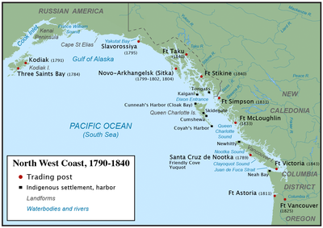
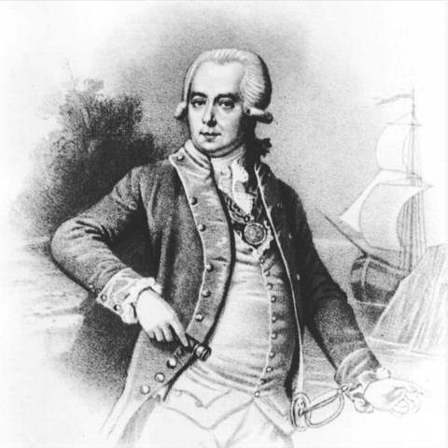
Shelikov & Golikov
The “Russian-American Company”
Russia’s First Joint Stock Company
Russian America: 1832-67
Grigory Golikov

Slide 47
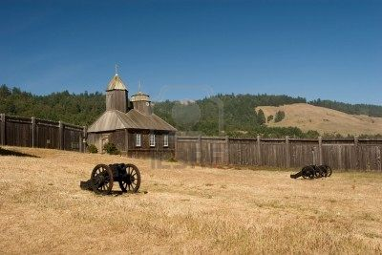
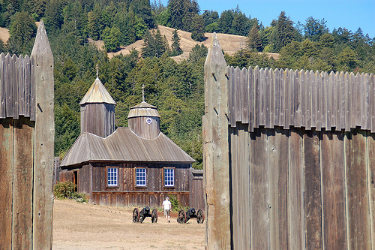
КΑЛЙФОНЙЯ Dreaming: 1841-67
Fort Ross

Slide 48
A role for Orthodoxy?
You tell me

Slide 49
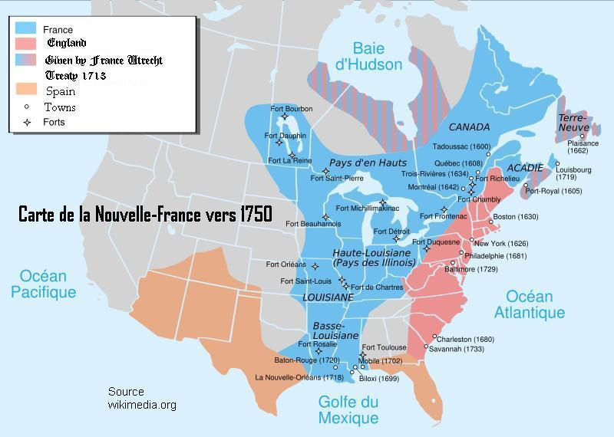
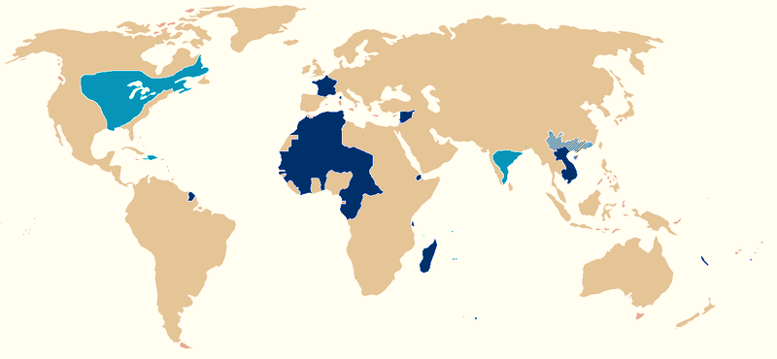
The French
“New France:” 1750
Colonial Domains: 20th C.

Slide 50
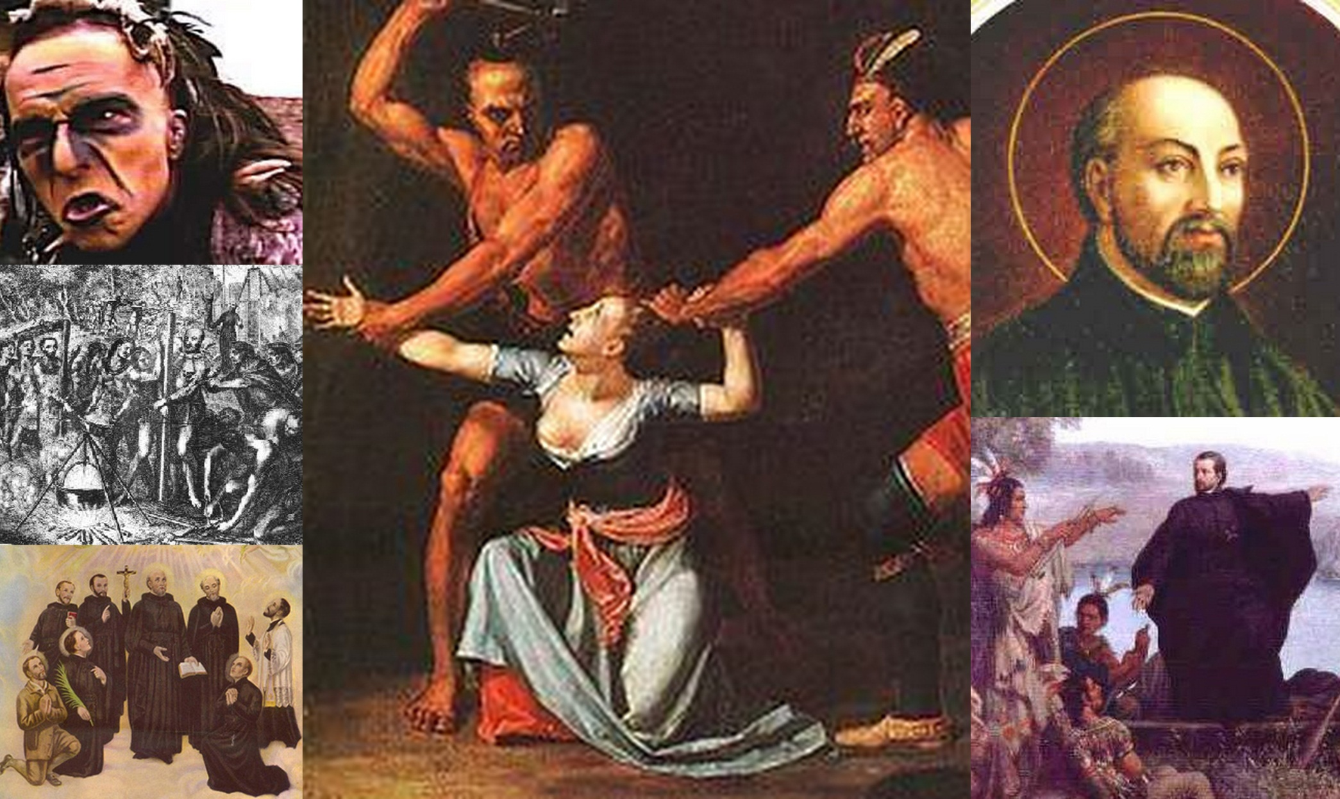
Commerce, But Religion, Too:
The Jesuit Missionizing Enterprise

Slide 51
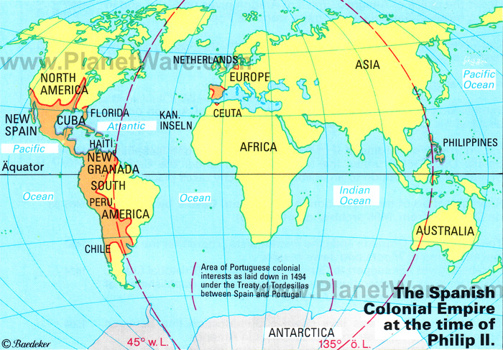
But, really,
It’s All about Spain

Slide 52
Spain
Matters
Most
The Two Meanings of 1492

Slide 53
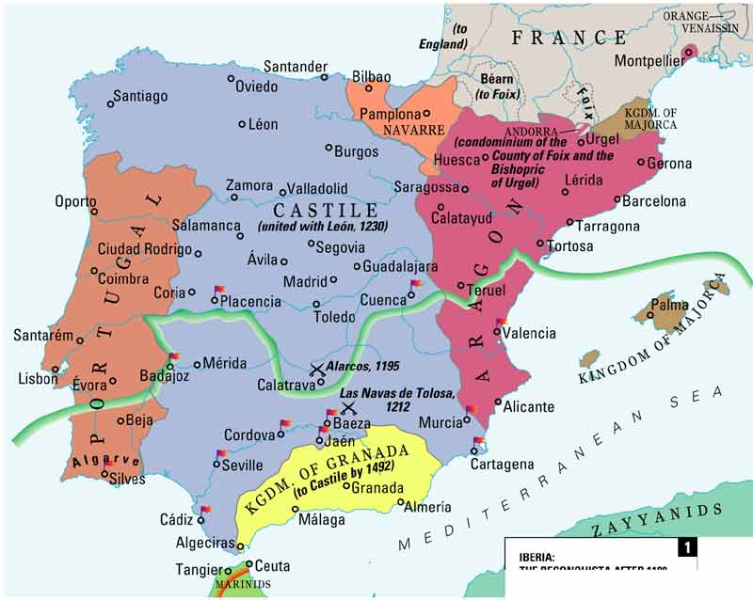
1492: “Reconquista” drives Muslims from Iberia

Slide 54
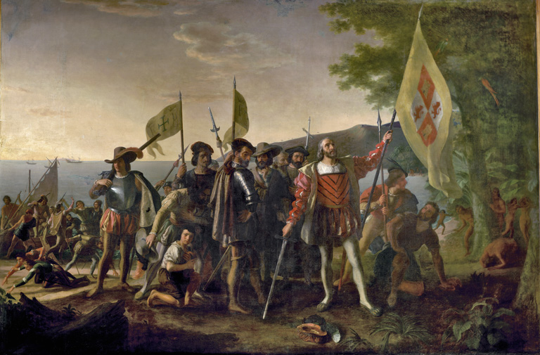
1492: Spain is first into the New World
“La Conquista de America”

Slide 55
The “Reconquista” shaped
The “Conquista de America”

Slide 56
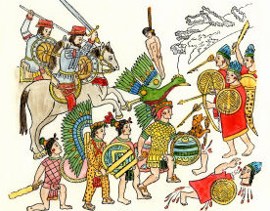
Militarized Elites
e.g., militarized elites, armed mercenaries,

Slide 57
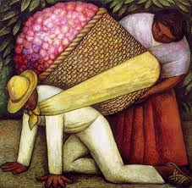
Encomiendias & slave labor

Slide 58
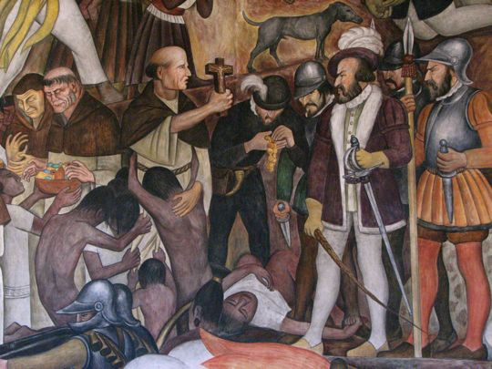
A confident, missionizing Church

Slide 59
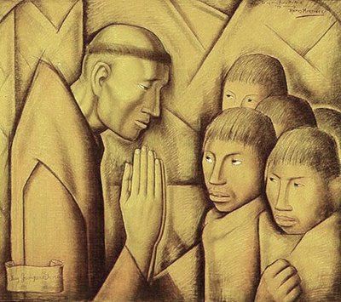
Conversion

Slide 60
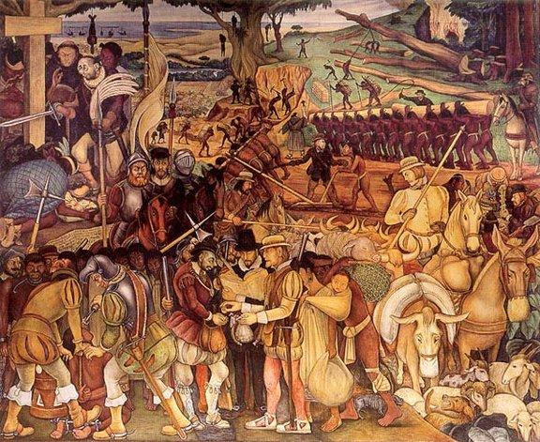
Repopulation

Slide 61
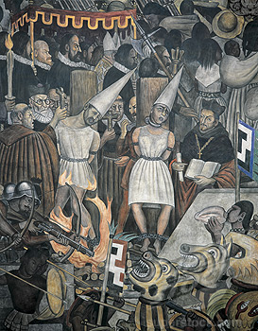
Inquisition

Slide 62
What also matters …
Ideology
Re Ideology: Conquista = Reconquista
Conquista Ideology = religiously based

Slide 63
Why Ideology Matters
It makes it possible for globalization
to be thought ,
or not at all.

Slide 64
Ideology
It justifies or makes legitimate
forms of globalization
or none at all.

Slide 65
Bottom line:
Ideology is one factor making globalization possible in “actual practice.”
Spanish Catholicism provided this ideology

Slide 66
Conquista Ideology
First item

Slide 67
“Tierra de Nadie" (res nullius)
= territory outside law & social reality,
sometimes = indigenous property, in contrast to European territory
similar to Muslim Dar-al-Harb

Slide 68
Conquista Ideology
Second Item

Slide 69
‘Land for Christendom"
principle behind decision to spread Christianity to the people of America,
enabled forced conversion of native peoples if they refuse to accept convesion.
Similar to Dar-al-Islam

Slide 70
Conquista Ideology third item
“Rights of Conquest" of European states and societies over native civilizations as well as their natural resources.
the imposition of the use of native peoples as slaves:
“encomienda” system

Slide 71
A Second Ideological Front:
3 Spanish Humanists vs Conquista Ideology
  Founder, Natural Law theorist of the ‘School of Salamanca,’ Francisco de Vitoria, Dominican.
  Bartolome de las Casas, Dominican, defended the Native Americans against Juan Gines de Sepulveda, Debate at Vallodolid (1550-1)
  Jesuit Francisco Suarez first argued the right of oppressed people to rebel.

Slide 72
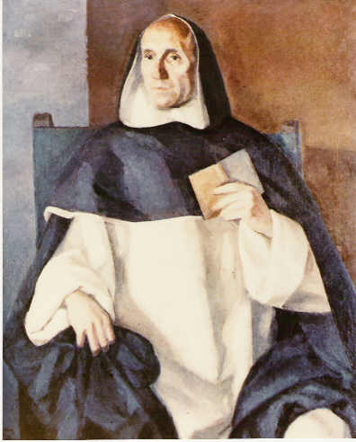
Francisco de Vitoria (ca.1485- 1546)
“Father of International Law"

Slide 73
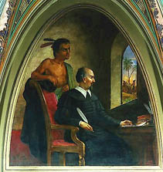
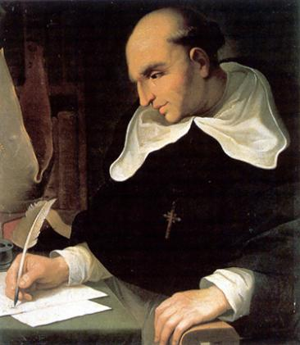
Bartolome de las Casas (1484-1576)
The Destruction of the Indies

Slide 74
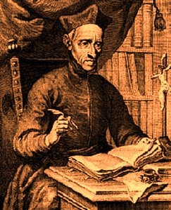
Francisco Suarez (1548-1617)
De Legibus ac Deo Legislatore (1679)

Slide 75
They did much to promote the welfare of the native folk:
“The New Laws”
But, they also gave he Spaniards legal rights in the New World

Slide 76
“Spaniards had (natural) rights…”
to freedom of travel, such as to/from and through Native American lands,

Slide 77
to trade with native folk,

Slide 78
to import and export

Slide 79
to mine
for
precious metals
in native lands

Slide 80
to explore native lands,

Slide 81
to insist upon
native cooperation
in communicating
with them,

Slide 82
to exact sanctions
for resistance
to communication,

Slide 83
such as
waging “just war”
against native folk.

Slide 84
Summary: Spanish Humanists
Modified “Conquista Ideology” by arguing that Native Americans had “natural rights.”
.

Slide 85
Summary: Religion
Arguments rested on “Natural Law” theology of
Thomas Aquinas, 13th C

Slide 86
Summary: Spanish Influence
Spanish humanists
directly influenced Grotius,
and the development of international aw

Slide 87
In this sense,
globalization
rests on
religious justifications

