Slide 1
Understanding Understanding
Not Fetishizing Empathy, But Strategies for “Understanding”

Slide 2
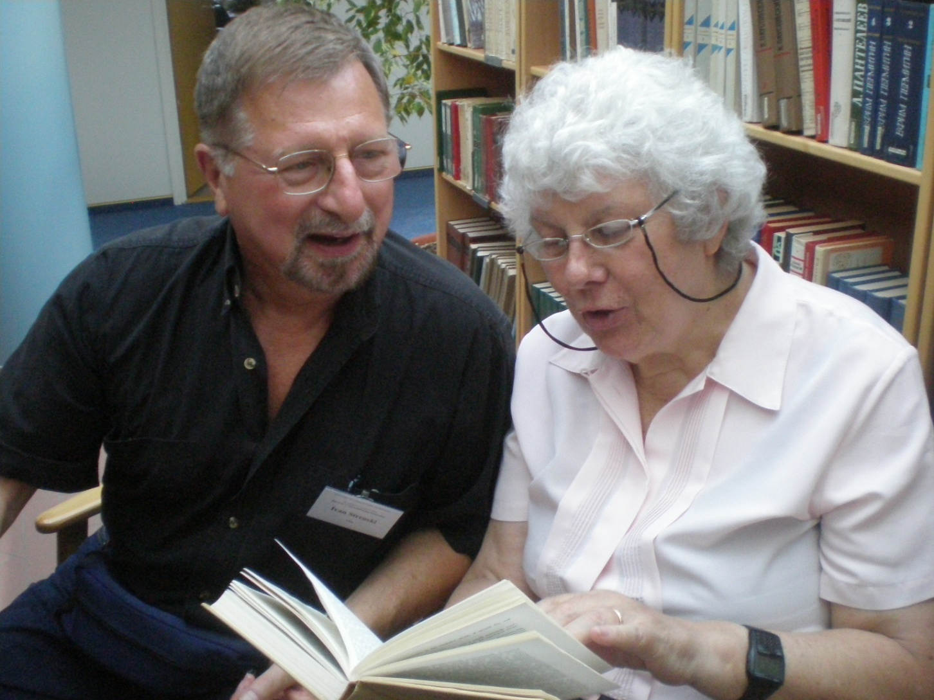
Only When We Check out Empathy
Do We Have Understanding

Slide 3
Check Out Empathy , Gain Understanding
Question your subjects to confirm AND falsify empathetic intuitions into them: “Ask them.”
You may know more than they do! Show it.
Your subjects should at least recognize themselves in what you intuit about them, even if they disagree with your intuitions. Argue!
Discover what gives their acts meaning for them. This is their social reality. This is the ‘game’ – at least one -- they are playing
Does your empathy fit the world of meaning of your subjects?
If so, you “understand” them in their terms.
Remember: you still may propose a ‘game’ that better fits what they are doing. ‘Doctor’ may know best, but both doctor and pattient need to argue the case.

Slide 4

Yes, Now You Understand Them !

Slide 5
Understanding HUMAN BOMBERS
Empathy, intuition are not enough
What are the constitutents of their social worlds? What do ‘they’ say, in what ‘language’? Islam, sacrifice, gift, embodied sacred
Aims: Jihad vs Jews, eliminate Israel, and winning Palestine as nation-state
We understand jihad and the fight vs Israel
But we do not understand how ‘human bombing’ contributes to making Palestine a nation-state – the elimination of Israel ≠ Palestine

Slide 6
ReIigion and Human Bombers
Islam provides sacred canopy of meaning
In particular, religious actions of giving and sacrifice are highly esteemed. Ibrahim
Even though Islam rejects suicide as self-sacrifice, some Muslims accept it as jihad and gift
For them, so-called suicide bombings are really sacrifice bombings designed to keep alive the aim of Palestinian nationhood.
They give their bodies to build the nation

