Slide 1
Understanding Understanding
( & some Buddhism)

Slide 2

Is Empathy Real?
Can Empathy Be Tested?

Slide 3
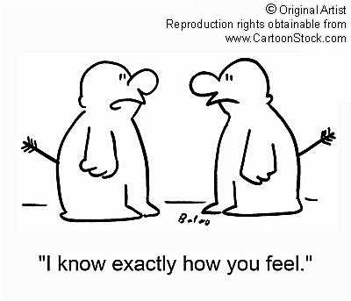
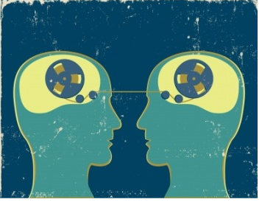
Beware of Fetishizing Empathy,
“Understanding” = What We Want!
Not Mind-reading
Nor Guess Work

Slide 4
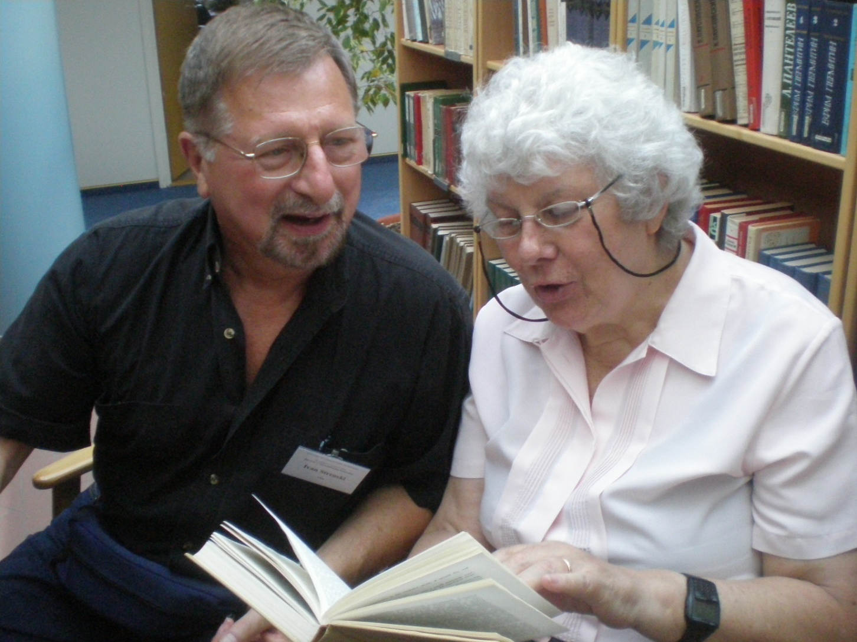
Only When We Check out Empathy
Do We Have Understanding

Slide 5
Check Out Empathy & Gain Understanding
Question your subjects to confirm AND falsify empathetic intuitions into them: “Ask them.”
You may sometimes know more than they do! Show it.
Your subjects should at least recognize themselves in what you say about them, even if they disagree with your intuitions. It is OK to disagree and even to argue (but nicely)!
Discover what gives their acts meaning for them. This is their social reality. This is the ‘game’ – at least one -- they are playing
Does your empathy fit with the world of meaning of your subjects?
If so, you “understand” them in their terms.
Remember: you still may propose a ‘game’ that better fits what they are doing. ‘Doctor’ may know best, but both doctor and patient need to argue the case.

Slide 6

Yes, Now You Understand Them !

Slide 7

But, do you understand their religion, as a whole?
Not That Kind of Whole!

Slide 8

Buddhist Impressions
(but no coherence)

Slide 9
Does Buddhism Fit Together?
(Does It Make Sense as a Whole?)
What are some Buddhist basic elements?
(Smart’s “Dimensions”)
Its myths: Jataka stories
Its “materiality” stupas
Its ethical code: silas, non-injury, e.g.
Its rituals: meditation
Its beliefs: 4 Noble Truths
Its experiences: Nibbana
Its social forms: sangha

Slide 10
How Buddhism Fits Together
“Organically”
(a few examples)
*Jatakas *teach *compassion = myth + belief + morals
*stupas aid *meditation on *emptiness = materiality + ritual + beliefs + experience
*Sangha common life induces *selflessness, & also *Nibbana = social + belief + experience
*Tranquility & *discipline of *Sangha life, together with *meditation induces belief in *Four Noble Truths (dukkha, etc) = experience + morals + social + ritual +beliefs

Slide 11


Understanding Buddhism Is Then….
Not Just Listing
Dis-organ-ized
Dimensions
Fitting Dimensions Together Organically
Into a Whole

Slide 12
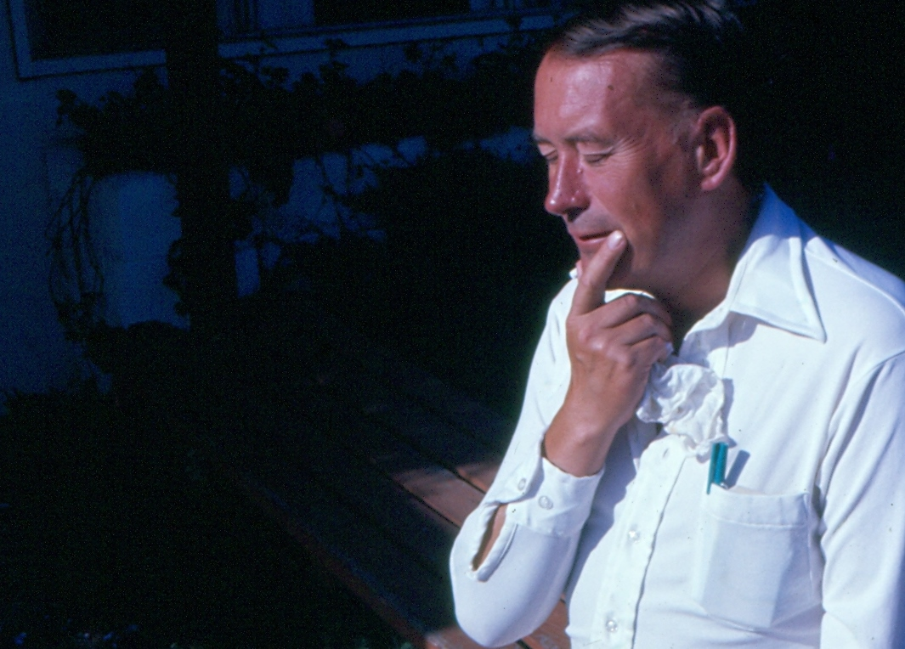
But, People Disagree How Buddhism Fits Together… like Ninian Smart

Slide 13
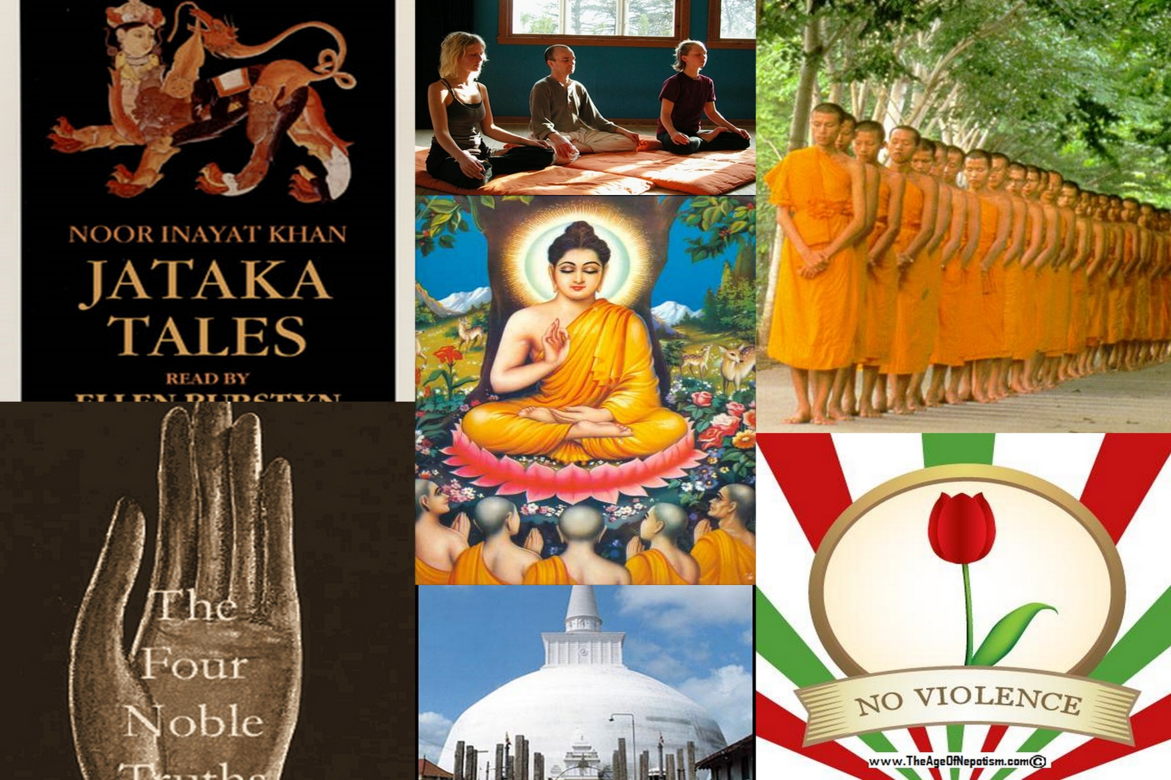
Smart: Buddhism Hangs Together
Because of Religious Experience

Slide 14
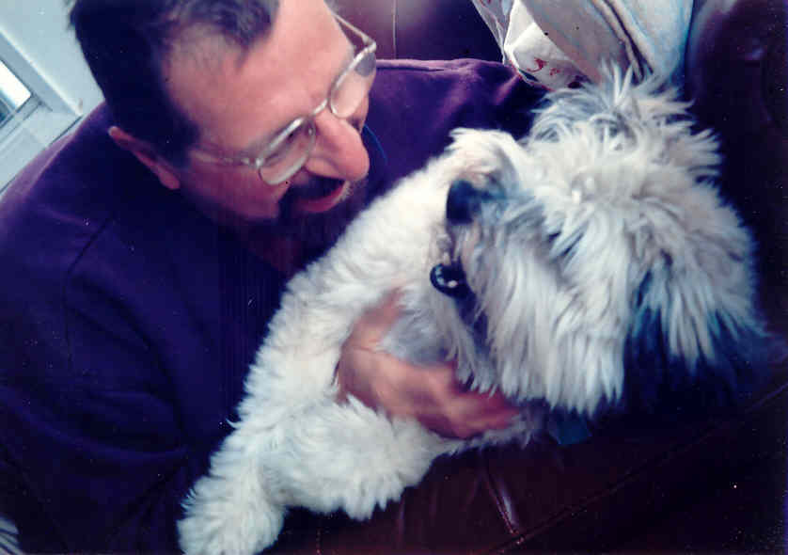
Understanding Takes Effort,
but it’s worth it!

